Slide 1
Online Consortia
Join us in changing the way Colorado goes to college.
Landon K. Pirius, Ph.D.
Vice Chancellor, Academic and Student Affairs
Photo: KOA.com

Slide 2
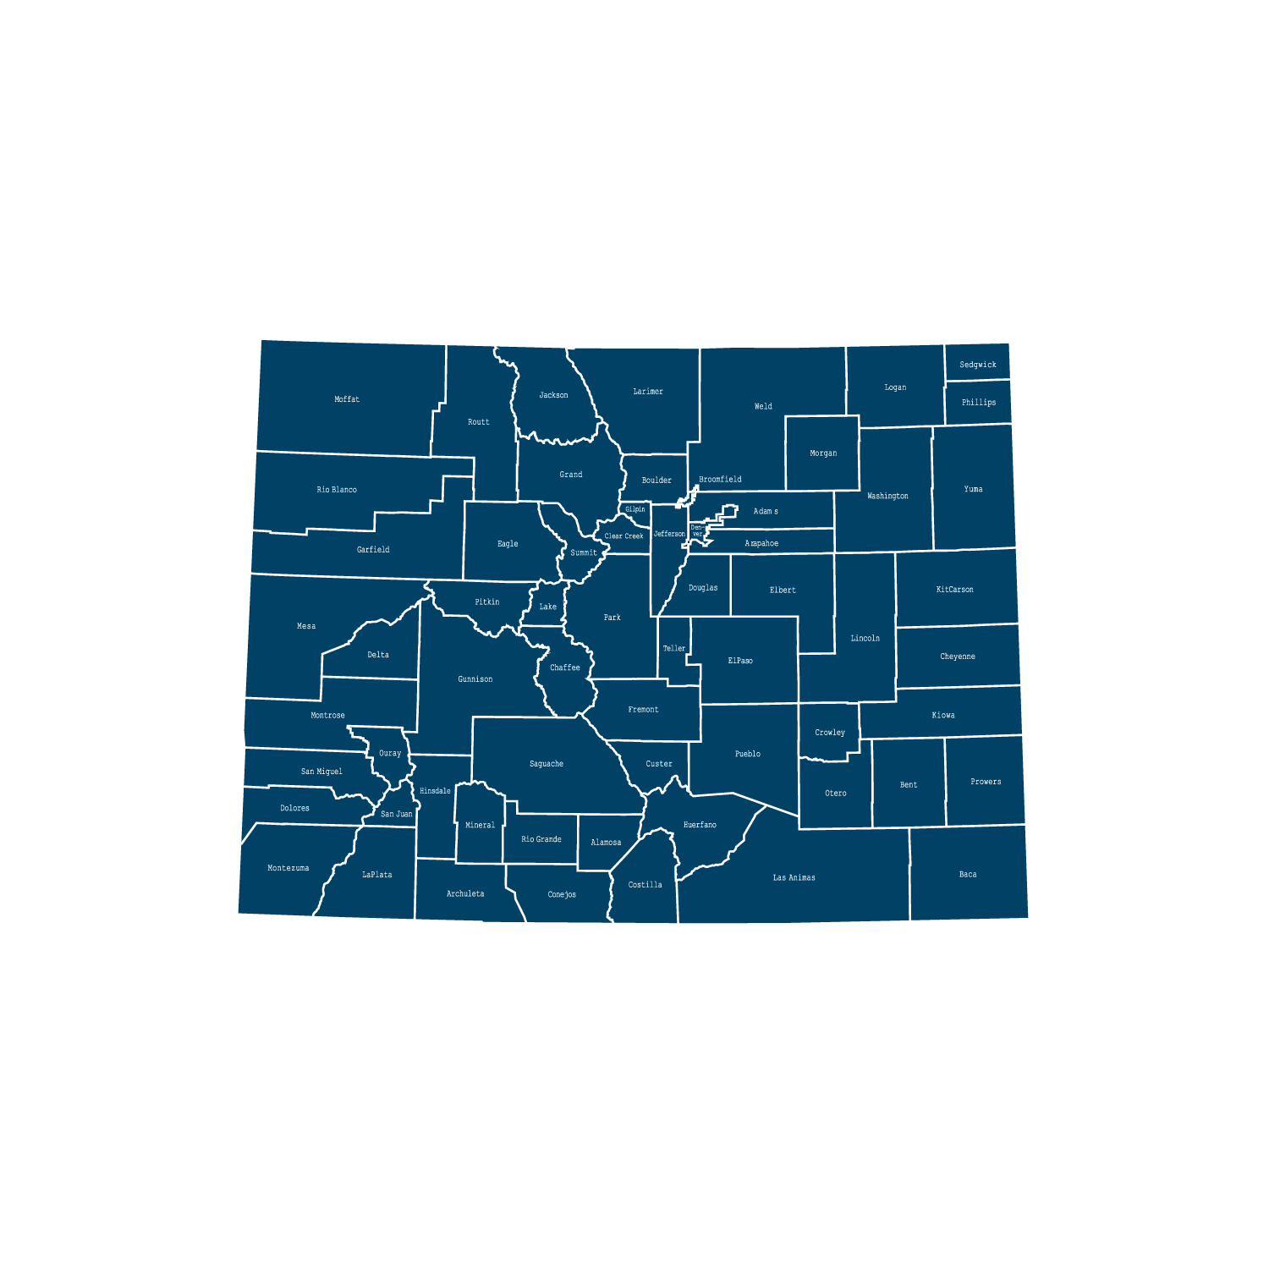
Providing Educational Access Across Colorado
13 colleges
35 locations and online
120,000+
undergraduate students

Slide 3
Why Consortia?
“We can’t be everything to everybody”
Low state funding
Declining enrollments
Small rural and frontier colleges
Some centralization already
Inequitable resource distribution
Growing external pressures and competition

Slide 5
Colorado Online @ Consortium Goals
Rationale | Goals
Meet student needs | Ensure equity of access & success Improve ease of use for students
Compliance with accreditation criteria | College oversight, improve efficiency, leverage existing state online investments
Growing student demand for online learning | Increase capacity, grow enrollment Offer more fully online programs Increase workforce & noncredit options Attract new markets
Economic ability to serve current & future students | Reduce internal competition, become more competitive externally Increase revenue, improve use of resources at a lower cost to students
Support existing CCCS efforts | Expand opportunities via technology

Slide 6
Colorado Online @ Timeline
Pre-Launch Planning
Fall 2020 Consortial Model Report
Spring 2021 Data Collection
Summer 2021 Student experience
Fall 2021 Subcommittee work
Spring 2022 Subcommittee work Design-Build Team
Summer 2022 Design-Build Team
Summer 2019 Steering Committee
Phased Implementation
Fall 2022 Pilot registration
Spring 2023 Pilot
Summer 2023 Mix CCCO/CO@/ Colleges Online
Fall 2023 Mix CCCO/CO@/ Colleges Online
Spring 2024 Mix CCCO/CO@/ Colleges Online
Summer 2024 Mix CO@ / Colleges Online
Fall 2024 100% CO@

Slide 7
Project Structure
Steering Committee
Collaborative and cross-functional
Subcommittees co-chaired by college and system reps
Project Team
Functional Groups & Consultants
Online Faculty & Instructor Advisory Committee
Academic Affairs
Technology
Learning Design
Learning Resources
Student Support Services
Course Scheduling
Curriculum and Instruction
Online Programs
Online Non-Credit Offerings
Faculty and student Support
LMS configuration and integrations
Business processes
Technology build for schedule and registration
Common wireframe (navigation) and course design elements
Collaborative development process and examples of ready-to-teach courses
Recommendations re. training/ support for faculty and students
Library
OER
Course materials: Books, supplies, lab kits, publisher content
Student registration interface and business processes
Transcripting
Advising
Other student support services

Slide 8
Instruction

Slide 9
750 Unique Online Courses (AY22)

Slide 10
Enrollment Distribution (AY22)

Slide 11
Discipline Transition
First Semester Offered through Colorado Online @
 | FA 22 | SP 23 | SU 23 | FA 23 | SP 24 | SU 24 | FA 24
Disciplines with only CCCOnline Courses: ESL, RUS, SCI; Additional disciplines (CCCOnline + College): FRE, GER, GEY, PHI, PHY; High Enrollment Courses: ART1110, BUS1015, CHE1112, COM1150, HIS1310
Additional Disciplines (CCCOnline and Colleges): BUS, COM, ECE, EDU, MAN, MAR, SPA; High Enrollment Courses: One per discipline that will transition in Spring 2024 (excluding MAT)
Remaining disciplines (CCCOnline and Colleges) Arts and Humanities: (ART, HUM, JOU, LIT, MUS, PHI, THE) Accounting and Criminal Justice (ACC, CRJ) Behavioral Sciences: (PSY, SOC) Computer Science and Tech (CIS, CNG, CSC, CWB, CAD, MGD) Math/Dev Ed/ Tech: (MAT / AAA) Health and Life Sciences (BIO, HPR, HWE) History and Political Science (GEO, HIS, POS,WST) Liberal Studies and College Prep: (ENG) Life Sciences, (ENV, SCI) Physical Sciences (AST, CHE, GEY, PHY) Social Sciences (ANT, ECO, SOC)
Disciplines with classes taught by multiple colleges
All remaining courses

Slide 12
Transition: Online Math courses
Spring 2024 | Summer 2024 | Fall 2024
MAT 1420 College Trigonometry MAT 1440 Pre-Calculus | MAT 1400 Survey of Calculus MAT 2410 Calculus I MAT 2420 Calculus II MAT 2430 Calculus III MAT 2431 Calculus III/Engineer App MAT 2540 Linear Algebra MAT 2560 Differential Equations MAT 2561 Diff Eq/Engineer Applicatn | MAT 0250 Quantitative Lit MAT 0300 Algebraic Literacy MAT 1120 Math for Clinical Calculations MAT 1140 Career Math MAT 1150 Technical Math MAT 1160 Financial Math MAT 1220 Integrated Math I MAT 1230 Integrated Math II MAT 1240 Math for Lib. Arts MAT 1260 Intro to Statistics MAT 1320 Finite Mathematics MAT 1340 College Algebra
Courses in bold also include a co-requisite support course

Slide 13
Types of Colorado Online @ course sections
Home College Sections
Pooled Sections
Students and instructor from same college
Individual sections assigned based on historic online enrollment of 25 students from the same college
College selects course materials
Instructor customizes course
Students from multiple colleges
Individual teaching sections assigned based on historic enrollment:
If ≥15 students from same college, then “College-assigned”
If <15 students from any college, then “Wild Card” selection
State discipline faculty select common course materials
Instructor customizes course

Slide 14
What does the student see? (CO Online Home College)

Slide 15
What does the student see? (CO Online Consortium)

Slide 16
Common course materials rationale
For ALL courses, the Higher Education Opportunity Act (2008) requires
disclosing textbook information (ISBN, author, title, publication date, etc.) and cost
in time for pre-registration and registration
in the online course schedule (or linked directly from schedule)
Students who enroll in Colorado Online @ pooled sections
will not know their teacher until they are moved to teaching sections
but must know the cost of their course materials when they register

Slide 17
Common course materials selection process
Discipline faculty nominate materials for CO Online @ pooled sections
Discipline faculty vet & discuss nominated materials
Via synchronous (F2F/virtually) & asynchronous channels
Rubric provided to support discussions
Discipline faculty select common materials from the candidates
Academic Technology team works through any technology integrations

Slide 18
Enrollment Cap
Colleges teach two types of section for Colorado Online @
Home College section: Only students from your college enroll
Teaching section: Students from across CCCS enroll
Placed in a pooled section to manage enrollment
Then placed in a Teaching section before classes begin
Enrollment cap for the pilot = 34
Cap applies to both Home College and Teaching sections
Will adjust the cap based enrollment & attrition data from the pilot

Slide 19
Enrollment Cap – Summer & Fall 2023 testing
Colorado Online will test lower enrollment caps in Sum & Fall 2023
Testing will start with courses that have low drop rates
Summer 2023: Test with 1 course (e.g., CHE1112)
Fall 2023: Test with 3 courses (e.g., ENG1021)

Slide 20
Enrollment Target
Average enrollment at census for the pilot = 25
Home College sections distributed to colleges based on average
Teaching sections managed with CCCS Sectionizer
Target supports financial model

Slide 21
Support Services

Slide 22
Colorado Online @ Support Services
Student advising
Centrally provided
Orientations (onboarding)
Disability services
Instructional design support
Online tutoring
Technology help desk support
Locally provided
Library collections
Software contracts
Locally provided,
Centrally coordinated

Slide 23
Consortial Support Services
Learning design
Accessibility, learner-centered design, Healthy Course Checklist
Ready-to-teach course shells
Professional development
Academic technology
LMS support
24x7 help desk
Tier 2 support – evenings, weekends
System-wide software (ReadSpeaker, Zoom, etc)

Slide 24
Consortial Support Services, cont.
Library support
Creation of a consortial CCCS Online Library and support services
Creation of consortial CCCS OER Services
Negotiated pricing as a system rather than 13 colleges individually
Consortial scheduling & strategic enrollment management / monitoring

Slide 25
Standardization
Common course numbering
Pre-requisites and co-requisites
Contact hours
Start dates, registration dates, census dates, parts of term
Faculty credentials
Business practices

Slide 26
Financial Model

Slide 27
Colorado Online @
The financial model is based on average enrollment of 25 at census
Each college earns tuition revenue based on # of its students enrolled
Type of section | Home College | Pooled
Which students can enroll? | Only students from home college enroll | All students from CCCS can enroll
Estimated # students from teaching college | 25 | ≥ 15 (College Assigned) | < 15 (Wild Card)
Additional considerations |  |  | Additional incentive to offset low teaching college enrollment
Notes:
Home College course sections are created when a college’s enrollment estimate is 25 or more for a specific course.
Only students from that college will be able to enroll.
The Home College will be able to choose and design the curriculum as they see fit, within the learning outcome parameters.
Pooled sections are created when a college’s enrollment estimate is less than 25
Students from across the system will be able to enroll
Colleges that teach Pooled course sections will use common curriculum for that course.
When enrollment estimates are lower than 15, colleges earn an additional incentive.

Slide 28
Colorado Online @ Financial Model – Revenue
Home College classes | Pooled classes
Tuition revenue: 100% goes to home college | Tuition revenue: 41.5% goes to teaching college, 58.5% split by students’ home colleges (see example)
12.0% tuition revenue to support centralized services + Current SO ICR | 12.0% of this adjusted tuition revenue to support centralized services + Current SO ICR
4.2% to new pooled course pick-up incentive pot (divided among colleges that teach Wild Card pooled sections) | 4.2% of this adjusted tuition revenue to new pooled course pick-up incentive pot (divided among colleges that teach Wild Card pooled sections)
 | Wild Card teaching colleges would earn % of pick-up incentive pot; amount varies by number of home college students in a section
Notes:
First tuition revenue is allocated
For home college sections, all students come from the college teaching them, so they get 100% of
Then centralized charges are applied to the tuition revenue for each college
Colleges will be charged 12% for centralized services consisting of five main functional areas: Academic Technology; Learning Design/Professional Development; Library/OER; Student Affairs; and Admin/Business Services.
Colleges will be charged 4.2% to create an incentive pot for teaching pooled sections with low estimated enrollment from the teaching college
Colleges teaching Wild Card sections earn money from the incentive pot. The amount varies based on the number of students enrolled from the teaching college

Slide 29
Colorado Online @ Financial Model – RRCC Example
RRCC assigned a Home College section (only RRCC students register)
 | Students enrolled | Credit hours | Tuition revenue | Central charges | Direct instruct costs | Indirect costs | Pool pick-up | Net revenue
RRCC (Current) | 15 | 3 | $12,254 |  | ($4,276) | ($2,437) |  | $5,541
RRCC (CO Online) | 25 | 3 | $20,423 | ($3,309) | ($4,276) | ($2,437) |  | $10,402

Slide 30
Colorado Online @ Financial Model – RRCC Example
RRCC assigned a Pooled Teaching Section (all CCCS students register, estimated # of RRCC students ≥ 15)
 | Students enrolled | Credit hours | Tuition revenue | Central charges | Direct instruct costs | Indirect costs | Pool pick-up | Net revenue
RRCC | 15 | 3 | $15,644 | ($2,534) | ($4,276) | ($2,437) |  | $6,397
LCC | 5 | 3 | $2,390 | ($387) |  |  |  | $2,002
TSC | 5 | 3 | $2,390 | ($387) |  |  |  | $2,002
Total | 25 | 3 | $20,423 | ($3,309) | ($4,276) | ($2,437) |  | $10,402

Slide 31
Colorado Online @ Financial Model – RRCC Example
RRCC assigned a Pooled Teaching Section (all CCCS students register, estimated # of RRCC students < 15)
 | Students enrolled | Credit hours | Tuition revenue | Central charges | Direct instruct costs | Indirect costs | Pool pick-up | Net revenue
RRCC | 3 | 3 | $9,909 | ($1,605) | ($4,276) | ($2,437) | $3,774 | $5,365
NJC | 5 | 3 | $2,390 | ($387) |  |  |  | $2,002
CCA | 8 | 3 | $3,823 | ($619) |  |  |  | $3,204
CCD | 9 | 3 | $4,301 | ($697) |  |  |  | $3,604
Total | 25 | 3 | $20,423 | ($3,309) |  |  |  | $14,176

Slide 32
Stay Connected
Monthly email updates from Executive Sponsor, Landon Pirius
Colorado Online @ Project Blog (https://coloradoonline.cccs.edu)
Updates, FAQs, virtual suggestion box, recordings from open forums and training sessions
Member lists for Project Teams, Subcommittees, and the Online Faculty and Instructor Advisory Committee
Zoom Info Sessions every other week – Wednesdays @8:00a-8:30am
Updates from college leadership and project / committee reps
Contact us!
Executive Sponsor, Landon Pirius – landon.pirius@cccs.edu
Project Director, Tammy Vercauteren – tammy.vercauteren@cccs.edu
Project Coordinator, Chin Ya Russell – chinya.russell@cccs.edu

Slide 33
Rural College Consortium

Slide 35
Challenges That Exist
Inequitable access to quality academic programs, statewide transfer agreements, and student support services
Serving large geographical areas with small populations
Inability to generate enough funding
Outdated network and server infrastructure
Lack of sufficient classroom technology

Slide 36
Vision
Create a rural network that connects rural colleges and communities with high quality academic programs, workforce development training opportunities, and strong student support services. This network would help ensure long-term sustainability and viability of community colleges and the rural communities they serve.

Slide 37
Governance

Slide 38
Building the Rural Network
Wind Energy
From Sterling to Rangely
Cyber Security
Craig to Burlington
Behavioral Health and Addiction Counseling
From Trinidad to Yuma
Mental Health Counseling
From La Junta to Bayfield
Engineering Science STAA From Lakewood to Lamar
Agricultural Science
From Ft. Morgan to Aurora

Slide 39
Benefits
Expanded access to quality academic programs, workforce development, and student support services
Greater instructional cost efficiencies
Increase credential attainment
Support expansive geographic locations and rural communities

Slide 40
Colorado Skills Institute

Slide 41
Challenges that Exist
Employer demand
Lack of state funding; operating at a loss
A lack of consistent data, processes, and systems for non-credit offerings, enrollment, expenses and revenue.
No system-wide approach to non-credit/workforce development tracking, registration, course offerings, fee collection.

Slide 42
Colorado Skills Institute
Systemwide central marketplace for online non-credit programs
25 programs at launch with industry verification
Content could be college contributed (with revenue share) contracted, or acquired externally
State-wide business corporate portal
Programs will be evaluated by disciplines for PLA

Slide 43
Questions? landon.pirius@cccs.edu

