Slide 1
Colorado Math Pathways
Task Force
Update for CCCS
Dr. Rachel Sefton, CCD
April 2024

Slide 2
Agenda
Why Math Pathways?
Background
Current State of Pathways in Higher Ed & in High Schools
Data from Higher Ed & High Schools
Problems Found
Potential Solutions
Current Draft of Task Force Recommendations
Benefits to CCCS
Questions / Suggestions

Slide 3
Why math pathways?
Math pathways refer to the course or the sequence of courses and opportunities students experience as they prepare for college, career, or other ambitions.
Where we’ve traditionally been:
Placement into tracks has been based by ability
Calculus is prized above all; other options are “lesser”
Math is a gatekeeper to “weed out” weaker students
Access and outcomes are predictable by demographic factors
Where we want to be:
Placement into pathways is based on student interest
Different pathway options have similar relevance, rigor, and honor
The right courses at the right time with the right amount of support allow for more success
Access and outcomes are not predictable by demographic factors

Slide 4
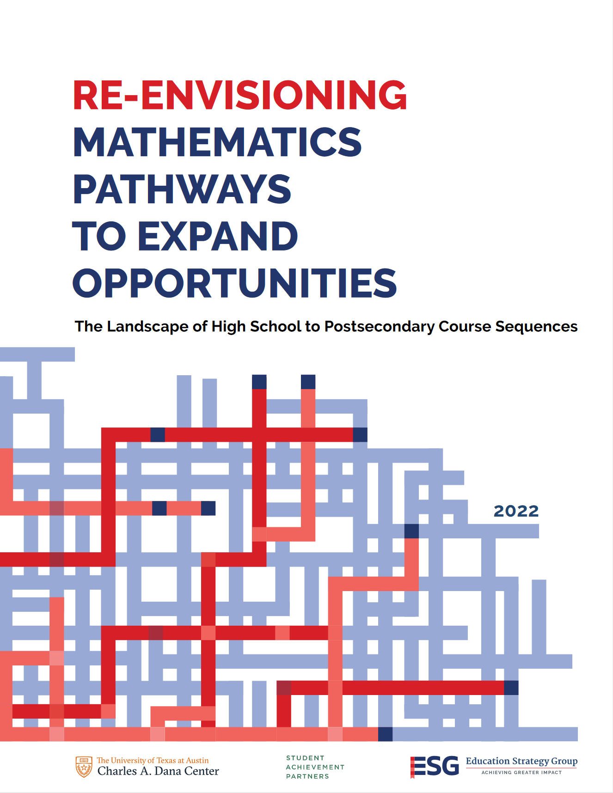
Background
“In fact, at most institutions, fewer than 20 percent of students in College Algebra are in programs that require a yearlong calculus sequence (Herriott & Dunbar, 2009). Each year, only 50 percent of postsecondary students pass College Algebra, and fewer than 10 percent of students who pass this course enroll in Calculus (Gordon, 2008).”

Slide 5
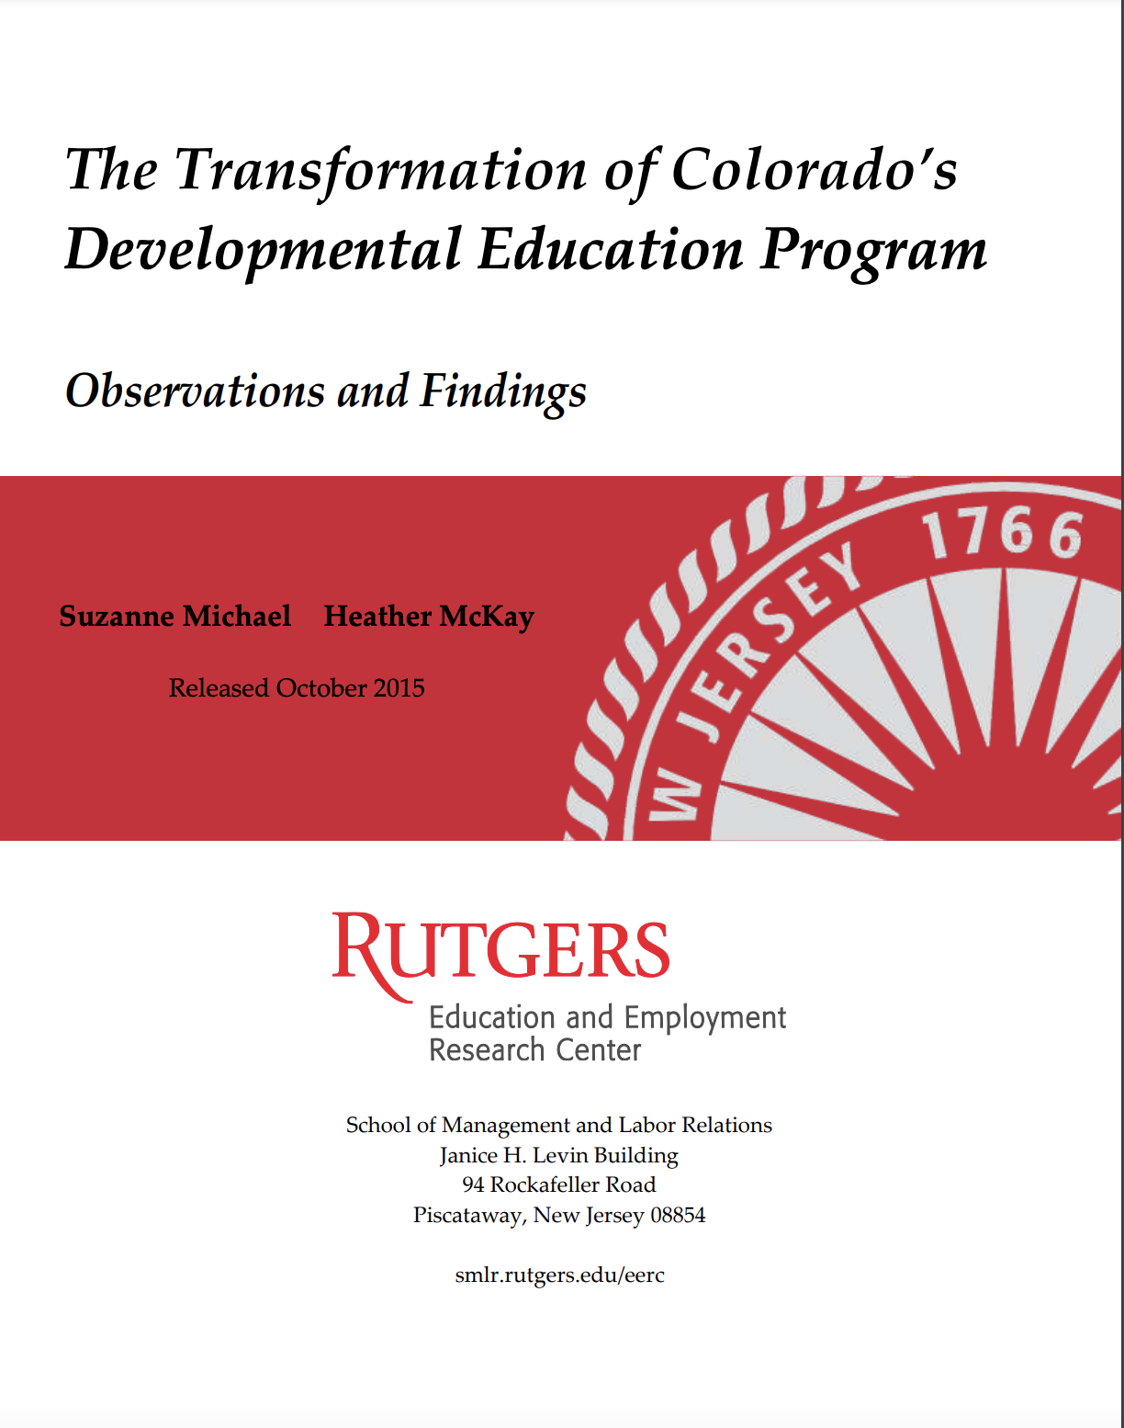
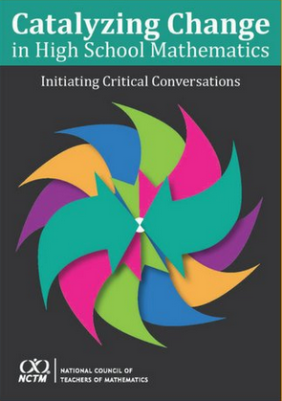
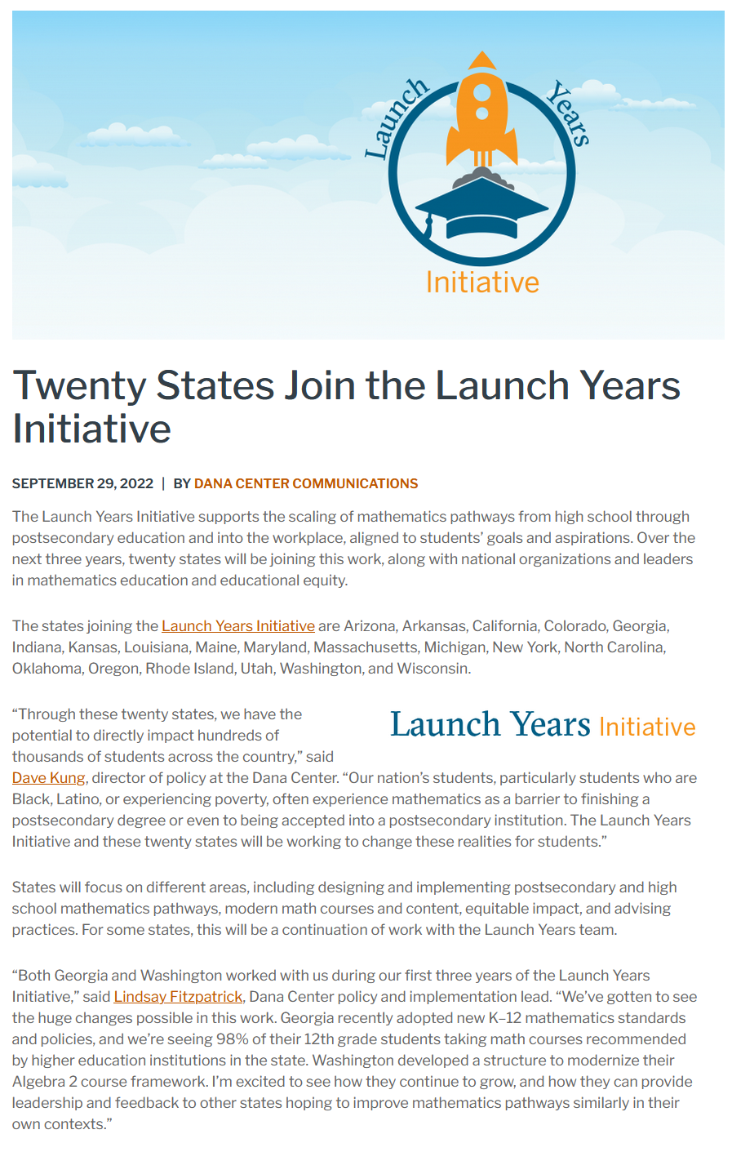
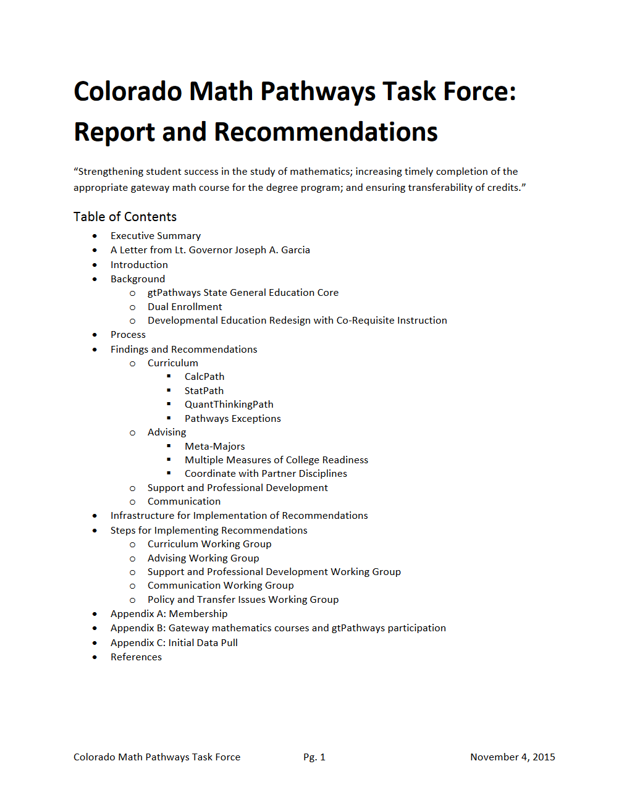
Background cont’d
2022
2015
2012
2018

Slide 8
Timeline
February 2023
Recruit Task Force
Spring/Summer 2023
Define the Problem
Summer/Fall 2023
Define the Challenges
Winter 2024
Brainstorm Solutions
Winter/Spring 2024
Prioritize Solutions and Draft Recommendations
Summer/Fall 2024
Vet Recommendations
September 2024
NCTM Publishes HS Essential Content
Fall 2024
Write and Publish Recommendations
2025
Mathematics Standards Revision Cycle Begins
2025-
Disseminate and Champion Recommendations

Slide 10
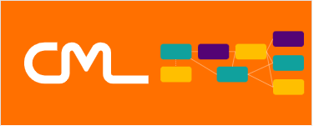
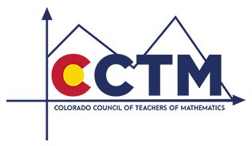

Slide 11
Task force membership
Co-Facilitators
Danen Jobe, Director of Academic Affairs, Colorado Community College System
Raymond Johnson, Mathematics Specialist, Office of Standards and Instructional Support, Colorado Department of Education
Co-Chairs
Lisa Rogers, Past President, Colorado Math Leaders; Board Member, Colorado Council of Teachers of Mathematics; and Student Achievement Coordinator, Fountain-Fort Carson School District 8
Rachel Sefton, Past Co-Chair of the Mathematics Discipline for the Colorado Community College System; Chair of Mathematics & Engineering and Associate Professor of Mathematics, Community College of Denver
Kim Smith, Past President, Colorado Math Leaders; Board Member, Colorado Council of Teachers of Mathematics; and Secondary Math Curriculum & Learning Design Specialist, Mesa County School District 51

Slide 12
Task force membership (continued)
Joseph Bolz, Board Member, Colorado Council of Teachers of Mathematics, and Mathematics Teacher, Denver Public Schools
Lori Cooper, President, Colorado Association of School Executives, and Assistant Superintendent of Student Achievement, Fountain-Fort Carson School District 8
Carl Einhaus, Senior Director of Student Success & P20 Alignment, Colorado Department of Higher Education
Anne Egan, Board Member, Colorado Association of School Boards, and Board Member, Cherry Creek School District
Amanda Foster, Member, Colorado Math Leaders, and Secondary Math Coordinator, Adams 12 Five Star Schools
Amber Gardner, Member, Colorado Math Leaders, Performance Improvement Partner, PK-12 Mathematics, Cherry Creek School District
Monica Gilmore, Member, Colorado Math Leaders, and Teacher on Special Assignment, Secondary Math, Boulder Valley School District
Claudia Glascock, Coordinator, Parent Academy for Student Success, Westminster Public Schools
Gus Greivel, Teaching Professor and Department Head, Department of Applied Mathematics and Statistics, Colorado School of Mines
Lauren Jones Austin, CTE Program Director for Special Populations, Counseling, Equity, and Middle School, Colorado Community College System

Slide 13
Task force membership (continued)
Mark Koester, Professor of Mathematics, Department of Mathematics & Statistics, Metropolitan State University of Denver
Brook Koltun, Director of Advising and Testing, Pikes Peak State College
Megan Korponic, Board Member, Colorado Council of Teachers of Mathematics, and Dean of Students, Greeley-Evans School District 6
Jennifer Lamanski, Instructor of Mathematics, Colorado Northwestern Community College
Janet Oien, Co-Director, Calculus Center, Colorado State University
Chris Rasmussen, Senior Director of Academic Pathways & Innovation, Colorado Department of Higher Education
Cheryl Reeves, Member, Colorado Math Leaders, and Secondary Math Curriculum Specialist, Pueblo School District 60
Michelle Romero, Director, Office of Postsecondary and Workforce Readiness, Colorado Department of Education
Amy Spicer, Vice President of Implementation Design, Colorado Education Initiative

Slide 14
Current state of pathways in higher ed
CCCS Gateway Math Courses
Common Prerequisites for CCCS Math Courses
CCHE Policy on College-Ready Assessments

Slide 15
Current state of pathways in high school
Colorado (CDE) has math standards for 9-12 that are not broken out by grade level or by course. School districts can adopt their own standards that meet or exceed the state standards.
Math courses and the content of those courses are left to the districts and/or the schools to determine. That is, there are no statewide course descriptions or course learning outcomes.
HS graduation requirements:
Some districts require 4 years of math to graduate. Some require only 3. Some require only 2.
Students must pass an assessment from the state’s graduation guidelines menu of options.
Pathways vary from district to district and sometimes even school to school within a district.

Slide 16
Data: What We Have
Higher Ed
“Growing evidence suggests that choosing a specific degree pathway early in students’ academic careers can help ensure they complete their postsecondary education, even if they change their minds and pursue different paths later. Additionally, since outcomes for students who transfer from a two-year institution to a four-year institution are better when they pursue a defined degree pathway, it is important to ensure that more students—and particularly community college students—are identifying and pursuing a specific degree path.” (from Pathways to Prosperity: Postsecondary Access and Success for Colorado’s High School Graduates 2022 Report)

Slide 17
Data: What We Have
High School
Colorado Math Leaders from 8 districts reported:
7 districts require 3 years of math credit, 1 district requires 2 years of math credit
Some explicitly require Algebra 1 & Geometry or Integrated I & II
6 districts follow the AGA sequence, 2 districts follow the Integrated sequence
Current transition course offerings:
AP Statistics, College Algebra, AP Calculus AB, Dual/Concurrent Enrollment, Statistics (7 districts)
Pre-Calculus, AP Calculus BC (6 districts)
Quantitative Reasoning, Business Math, Personal Finance, Math for Liberal Arts (2 districts)
Data Science, Computer Science, Data Analysis and Problem Solving, Consumer Math, Math in the Modern World, Discrete Math, Financial Algebra, Math Topics, Math Analysis (1 district)

Slide 18
Problems Found
Problem 1: Placement of students into math courses is determined more by the perception of student ability rather than students’ interests and postsecondary plans.
Problem 2: Our current math pathways are overly-focused on getting to calculus and do not provide equivalent opportunities to learn other mathematics.

Slide 19
Potential Solutions
Communicate to stakeholders that mathematics is a tool to make sense of the world around us. It is a means of communication, logic, and reasoning. Different pathways are equally important in support students’ interests and career goals.
Acknowledge career readiness pathways alongside college readiness pathways, and build pathways with in mind the jobs from the Talent Pipeline Report.
Clearly define what content is included in the core courses for the earlier years (whether Algebra I, Geometry, & Algebra II or Integrated I, Integrated II, & Integrated III or some new combination). Provide adequate support.
Create a menu of transition courses for the later years (including scope and sequences) for high schools so that schools/districts are not left feeling like the burden is on them to create such courses.
Explore concurrent enrollment options that include quantitative reasoning courses.
Explore virtual/online options for smaller schools whose staff aren’t credentialed to teach concurrent enrollment.
Clearly communicate those courses/options. Train counselors.
Take students’ Individual Career and Academic Plan (ICAP) results into consideration when selecting a pathway of best fit.

Slide 20
Current Draft of Our Recommendations
Create and advocate for equally rigorous mathematics pathways (e.g., calculus, statistics, and quantitative reasoning) from high school through postsecondary education, based on student interest and career goals.
Connect students with career coaches, whether high school counselors or college navigators, to assist students in selecting the pathway best suited for them.
Instead of remedial classes that delay progress, provide extra support classes that increase student success in the core mathematics curriculum.
Strengthen connections between school districts and institutions of higher education (IHEs) through pathways, concurrent enrollment, and refining higher education admissions requirements (HEAR).
Provide time and space for robust professional learning opportunities.

Slide 21
Benefits to CCCS
Strengthening relationships with K-12 partners
Improving advising earlier in the process
De-emphasizing the traditional College Algebra / Pre-Calculus / Calculus pathway
Strengthening incoming students’ math preparation
Increasing concurrent enrollment numbers

Slide 22
Questions? Suggestions?

Slide 23
Thank you!
Rachel.Sefton@ccd.edu

