Slide 1

DAT
Data Science in Colorado
ColoMATYC – April 19, 2024
Matthew Watts – Red Rocks Community College

Slide 2

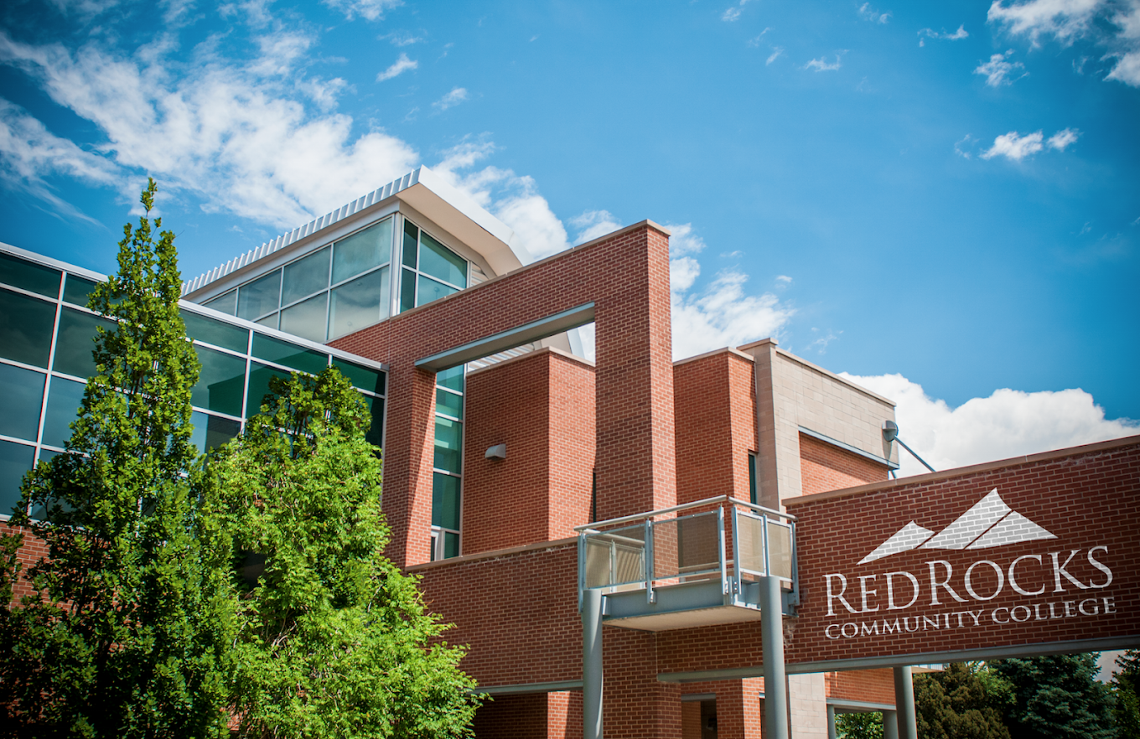
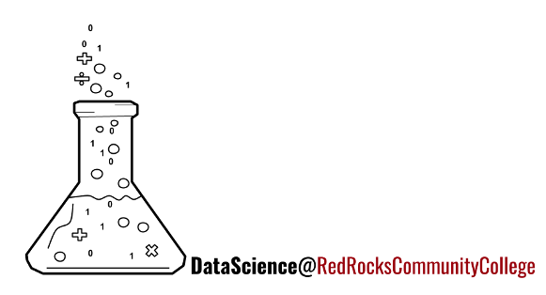
Red Rocks Community College
1969: Community College of Denver - West Campus
Lakewood & Arvada
Both 2 and 4-year & Grad program
Offering Data Science Classes
Notes:
BAS: Secure Software Development, Water Quality Management
MPAS: Masters of Physician Assistant Studies

Slide 3
What is Data Science
Data - information (stored computationally)
Science - the methods of learning how things work
Fields:
  Computer Science
  Business
  Statistics
  Journalism
  Graphic Design

Slide 4
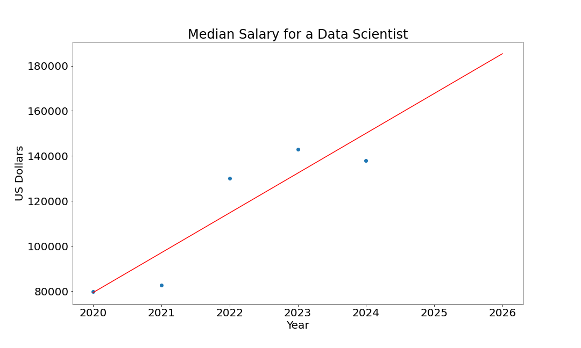
Why Data Science?
Source: Sazidul Islam on Kaggle
Original Source: ai-jobs.net

Slide 5






Data Science Workflow
Collect
Cleaning
Analyze
Visualize
Present
Collecting, storing, and accessing data from databases, webpages, and surveys & experiments.
Preparing raw data to a usable form by formatting data and dealing with missing/incorrect data.
Calculating statistical summaries and inferences for the prepared data.
Creating graphs for the analyzed data.
Publishing findings in various formats: social media posts, formal papers, presentations, and posters

Slide 6

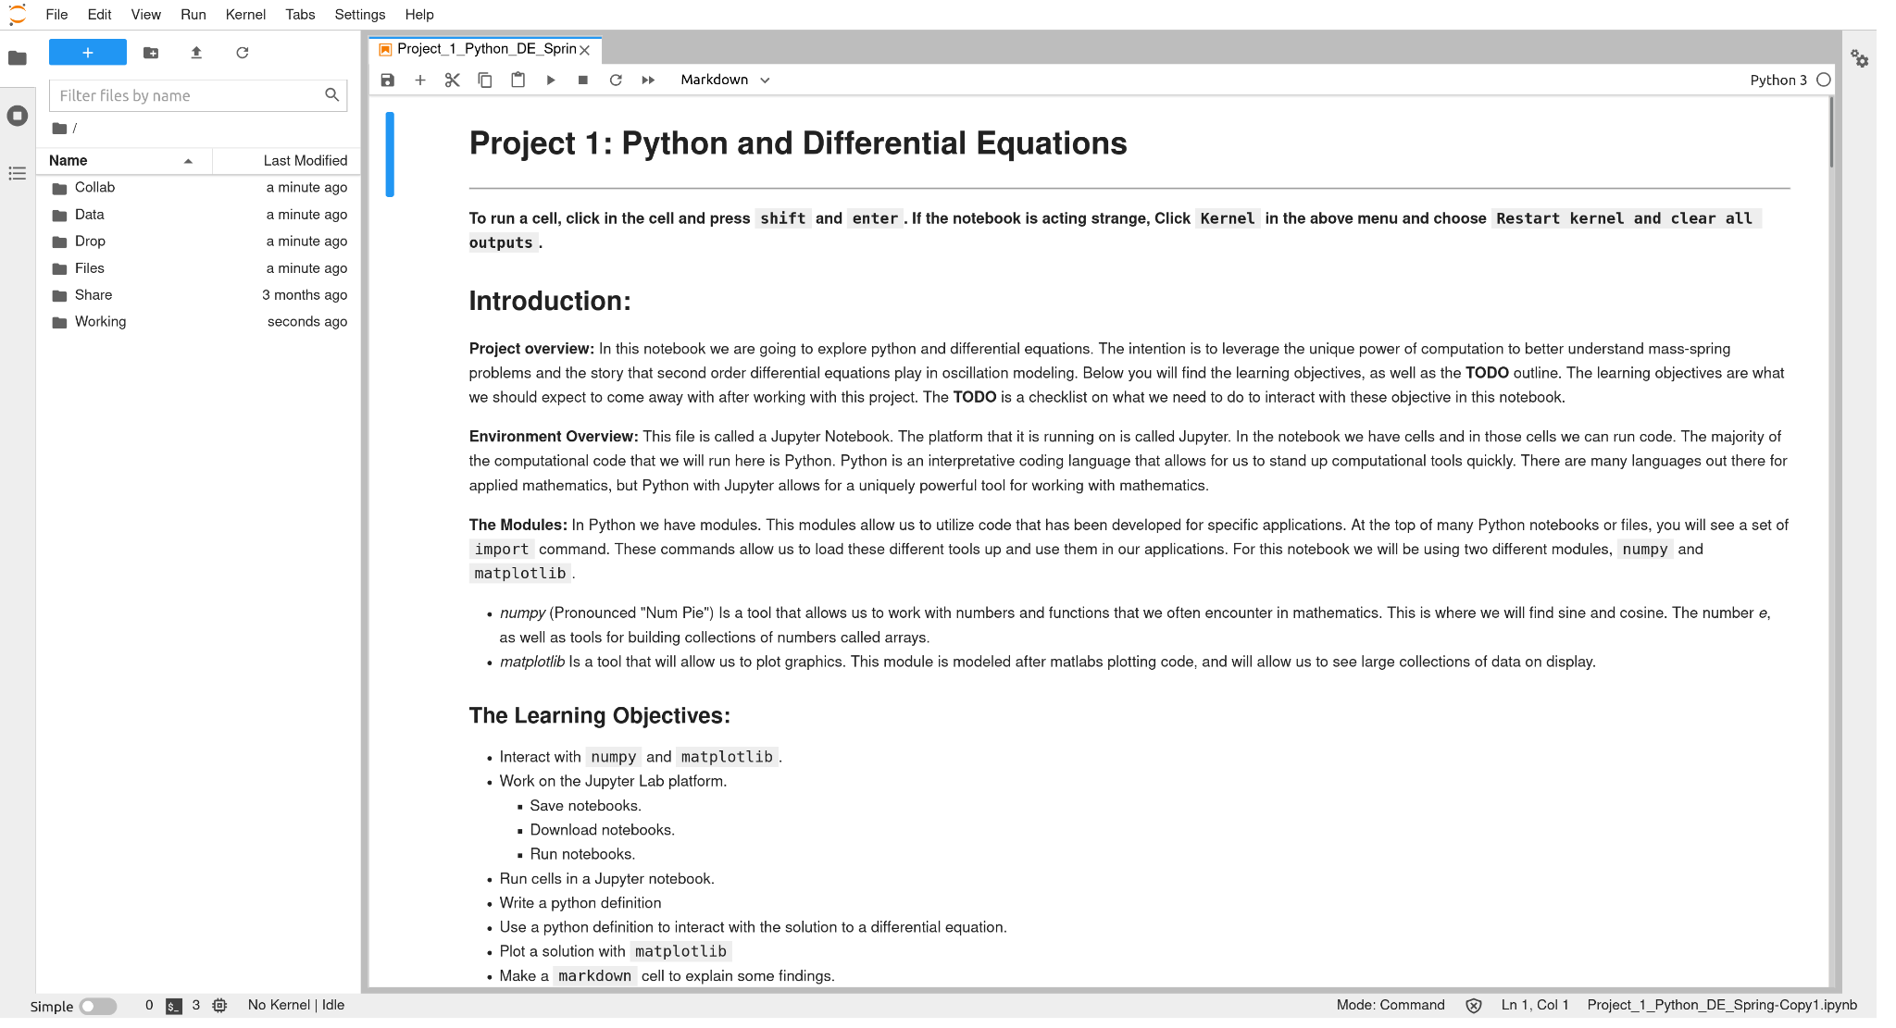




RRCC DataLab
Notes:
The RRCC Data Science program, in collaboration with IT, developed and maintains the compute servers for Math and Data Science (DataLab). These servers allow students to interact with the critical software that is necessary for modern approaches to data analysis. Currently the platform is being utilized in the RRCC calculus sequence, our differential equations and linear algebra classes, as well as all the data science classes. All the software (and the access) is open source and free to students allowing for consistent access to the lab, as well as guidance for local deployment if necessary.
Some of the software that is utilized on our compute lab includes:
Jupyterlab(link is external)
Python(link is external)
Linux(link is external)
Latex(link is external)
R-Studio(link is external)
One major program goal is to dynamically integrate important tools of data analysis into the classes. By maintaining our own platform, we can adapt as standards in the field change.
If you are interested in learning more about the DataLab, or are considering the utilization of a compute platform in your classroom at RRCC, feel free to reach out and we can share the architecture we utilize and some of the methods that have helped us with deployment and maintenance.

Slide 7
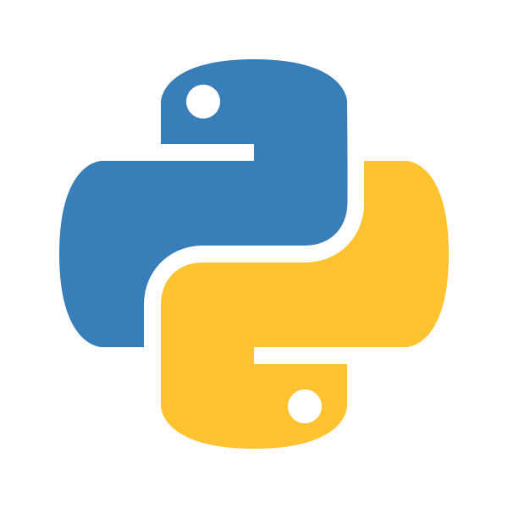

Data Science at RRCC
Intro to Machine Learning (DAT 2025)
Introduction to Data Science (DAT 1001)
Visualizing Data (DAT 2001)
Statistics and Modeling (DAT 2002)
Data Ethics Survey (DAT 1002)
Notes:
2019: ML offered as a topics in MAT course three times (max): pattern recognition, neural networks, algorithmic methods and theoretical relationships. Uses Python
2021: DAT discipline created for CCCS Intro to DS course approved by system. Foundational overview: collecting, storing, manipulating, analyzing, and securing data.
2022: Other three courses approved by CCCS
2023: Visualization offered for the first time: Intro to DAT prerequisite, comprehensive look at variety of visualization types combined with principles and best practices from psychology, graphic design, statistics, and journalism Uses R studio
2024: Statistics offered for the first time. - Calculus based course preferred by some transfer institutions Calc prerequisite
Future: Ethics – ethical thinking in science, history of ethical dilemmas in science, consumer and data science perspectives, privacy, equity and AI.

Slide 8
RRCC Data Science Courses
DAT 1002
Data Ethics
DAT 1001
Intro to Data
MAT 2410
Calculus 1
DAT 2002
Visualizing Data
DAT 2001
Statistics & Modeling
DAT 2025
Machine Learning

Slide 9
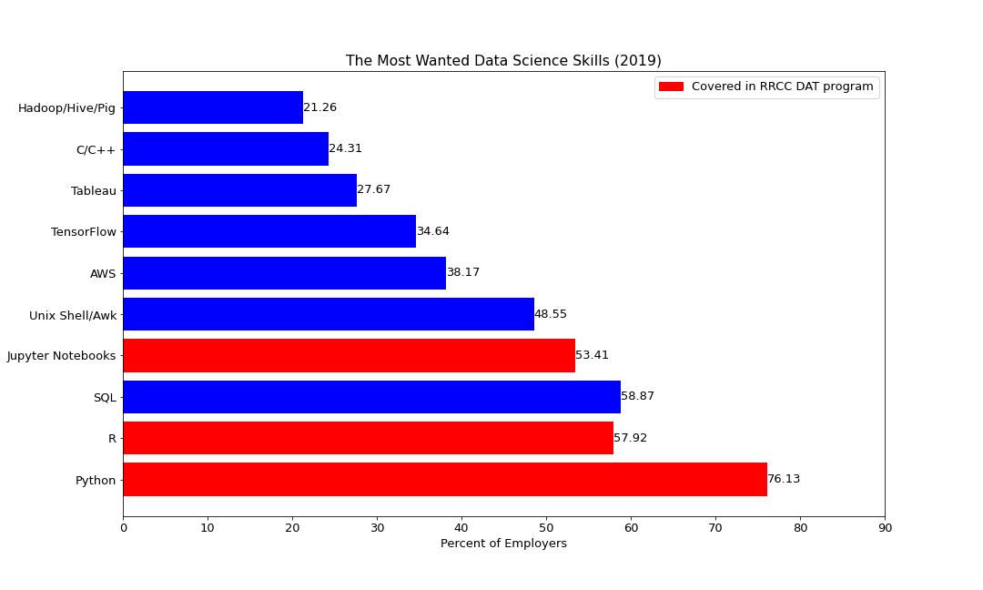
Why Data Science?
Source: Statista
Original Source: Software Strategies Blog/LinkedIn

Slide 10

DAT Success
DAT – Statewide Discipline
Data Fest
Research, Art, Design (RAD) Expo
Library instruction
Transfer Institutions

Slide 11
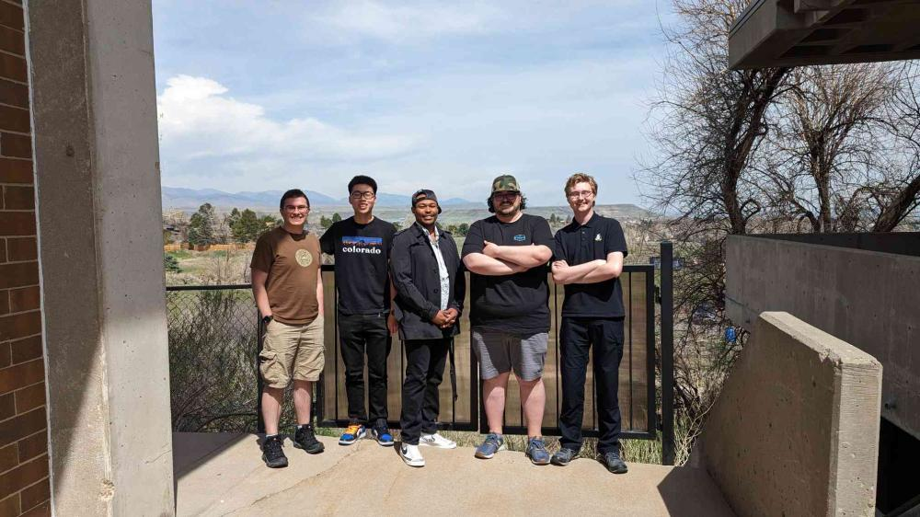

Community College Data Fest

Slide 12
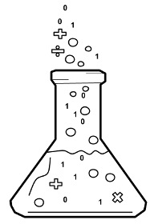
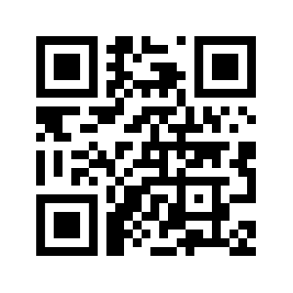

Join the RRCC Data Science Discord!
https://discord.com/channels/1151202085380038666/

Slide 13
DAT Challenges
Enrollment
CTE Certificate

Slide 14
Data Science Certificate
Credits
All Required
Courses
1,2
Computer Science
6
CSC 1019 Intro to Python
CSC 2017 Advanced Python
3
Mathematics
4
MAT 1340 College Algebra
or Higher
4,5
Data Science
6
DAT 1001 Intro to Data
DAT 2002 Visualizing Data
6
Choose One Additional
3
DAT 1002 Data Ethics
DAT 2025 Machine Learning
DAT 2001 Statistics & Modeling
MAT 1260 Intro to Statistics
BUS 2026 Business Statistics

Slide 15
Let's Play!
https://datalab02.rrcc.edu/hub21/
Username: guest_n
Password: colom@tyc

Slide 16
Connect
matthew.watts@rrcc.edu
adam.forland@rrcc.edu
See me after this session

