Slide 1
Create a More Effective D2L Course
Promoting Equity and Inclusion, Increasing Success
Johanna M Debrecht
Johanna.Debrecht@rrcc.edu

Slide 2
ELEMENTS of Effective Design
Relevancy
Rigor
Transparency
Structure
Reflection

Slide 3
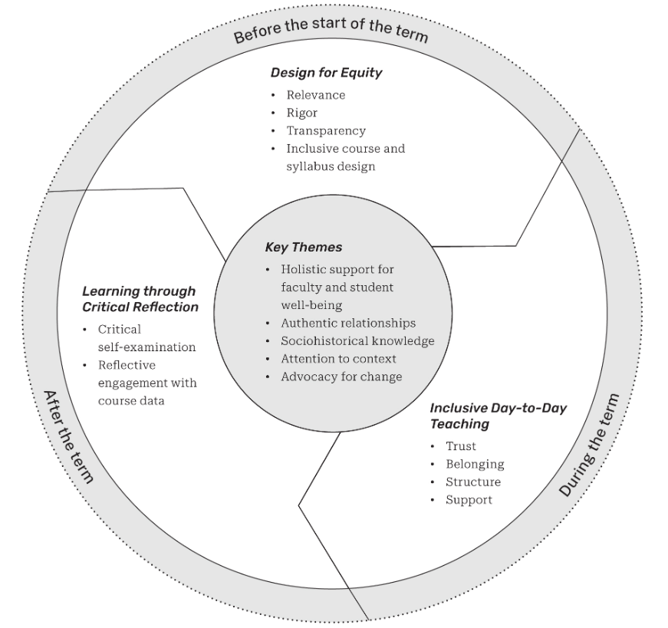
The Norton Guide to Equity-Minded Teaching, (2023), p. xix.
I. Artze-Vega, F. Darby, B. Dewsbury, M. Imad

Slide 4
Why Deliberate Design
When we include options and support that acknowledge learner variability into our course design, we lower the barriers for all.
“Structured courses make it less likely that students disproportionately benefit from or are penalized by their varied levels of ‘college knowledge’” (Artze-Vega et al., 2023, p. 140).

Slide 5
RELEVANCE
How is it relevant to their life, career, goals?
Introduction to Module / Section
Images, names
Student Information Form
Demographics
Dead White Guys Content

Slide 6
RIGOR
Pair rigor with support
Use Learning Objectives as visible course outline
Express confidence in their ability
Goal: transfer of learning to new contexts and problems

Slide 7
TRANSPARENCY
Grades impact students’ lives.

Slide 8
TRANSPARENCY
Explicit guidelines
Choices – Omit 1, Oral or Written, Two Problem Options, Video or Image
Path to recovery
Final replaces lowest exam
Drop lowest exam
Replace Homework average with exam average
Grading for Equity
Accuracy – Reflect students’ learning and performance
Bias-resistance – Minimize subjectivity
Motivation – Growth mindset

Slide 9
STRUCTURE
Make expectations and guidance explicit.
Structure is not just content planning; it is surveying students, having one-on-one conversations, understanding the experiences that impact our students.
Help students engage with material, with us, with each other
Help manage time, learn study skills, manage anxiety

Slide 10
STRUCTURE Elements
Alignment
Learning Objectives
Assignments
Active Learning
GeoGebra, Desmos, CalcPlot3D
Structure & Manage Time
Per week, per module
Time Management Guide
Sequencing & Scaffolding
Prepare
Practice
Engage
Assess (with Feedback)
Reflect
LMS Structure
Top-down, sequential, one-stop
Connective Tissue
Video How to Navigate Course
Descriptive Labels

Slide 11
STRUCTURE Assignments Build Trust
The Why, the How, the What (rubric)
Written explanations / images
Mini-video how to’s
Technology Help
Cellphone photos to pdf files
Zoom
Low- or no-stakes assignment
Professor Check-ins

Slide 12
REFLECTION
Mid-semester & end of semester surveys.
Mid-semester survey
End of semester survey
Student Reflections
~Every 3 weeks
Reflection = Growth
Relationship

Slide 13
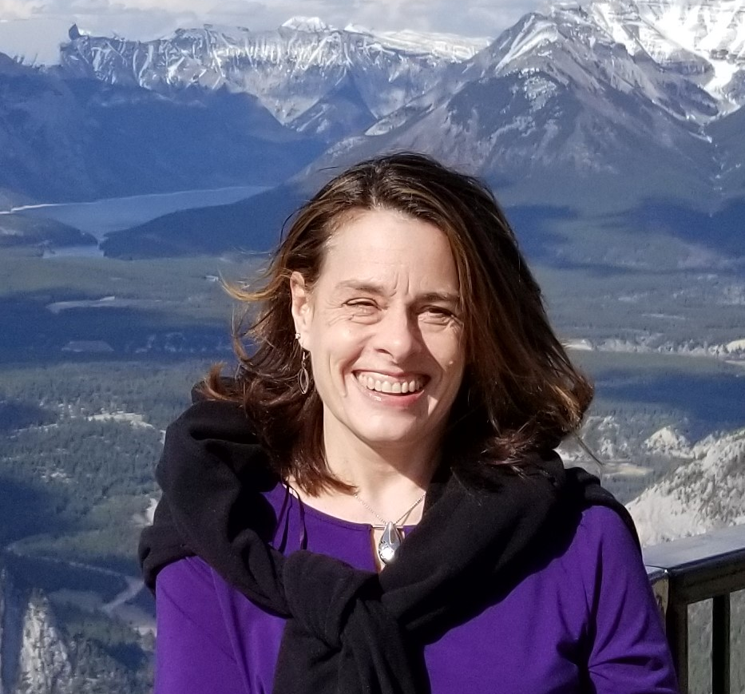
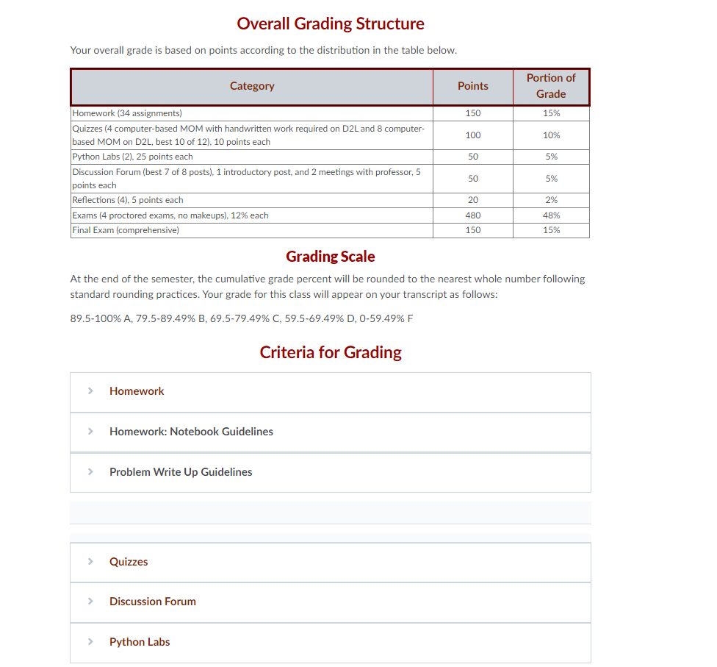
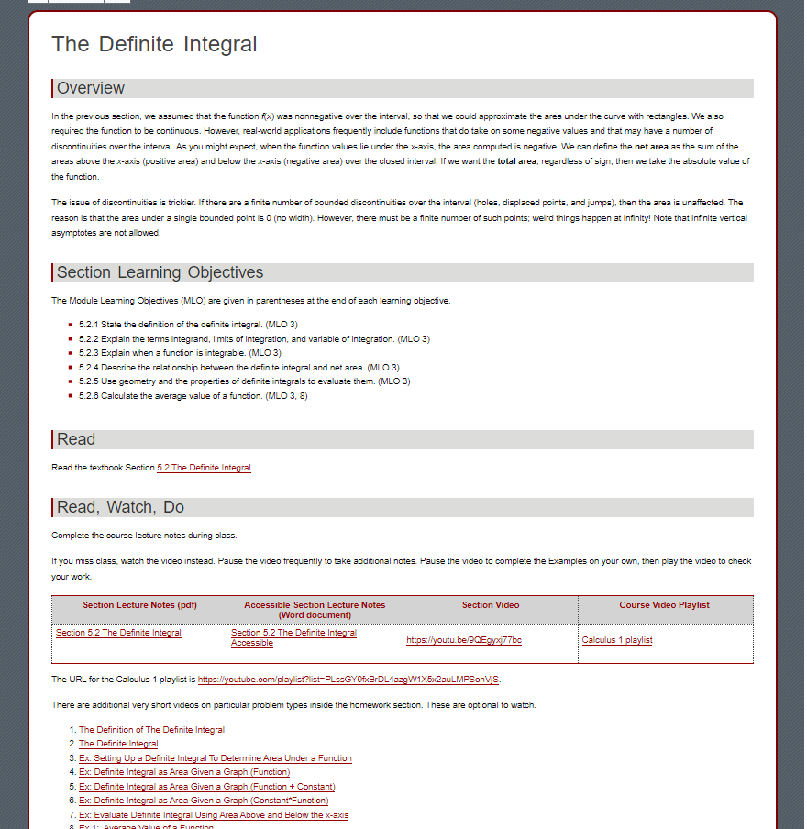
Introductory Welcome Video
EXPLICIT Expectations
Module Template
Imposter Syndrome
Relationship
Detailed guidelines
Examples
Predictable, consistent structure
Engagement with material

Slide 14
EXAMPLE Course Shell
Putting It Together
What does it really look like?

Slide 15
THANK YOU FOR COMING
Johanna.Debrecht@rrcc.edu

