Slide 1
STEM-Ready:
An NSF Grant to
Shift Skills & Mindset of Developmental Math Students
Colin Nicholls & Karon Klipple
University of New Mexico - Taos
Project Funded by NSF D.U.E. Award # 1928720

Slide 2
Presentation Content
Background & Program Overview – CN
  Experience A Stem Ready Module – KK
    (plus comments on Planning, Implementation etc.)
      Status & Next Steps - KK
          Q & A
Notes:
N New Mexico , 60 mi N of Santa Fe

Slide 3
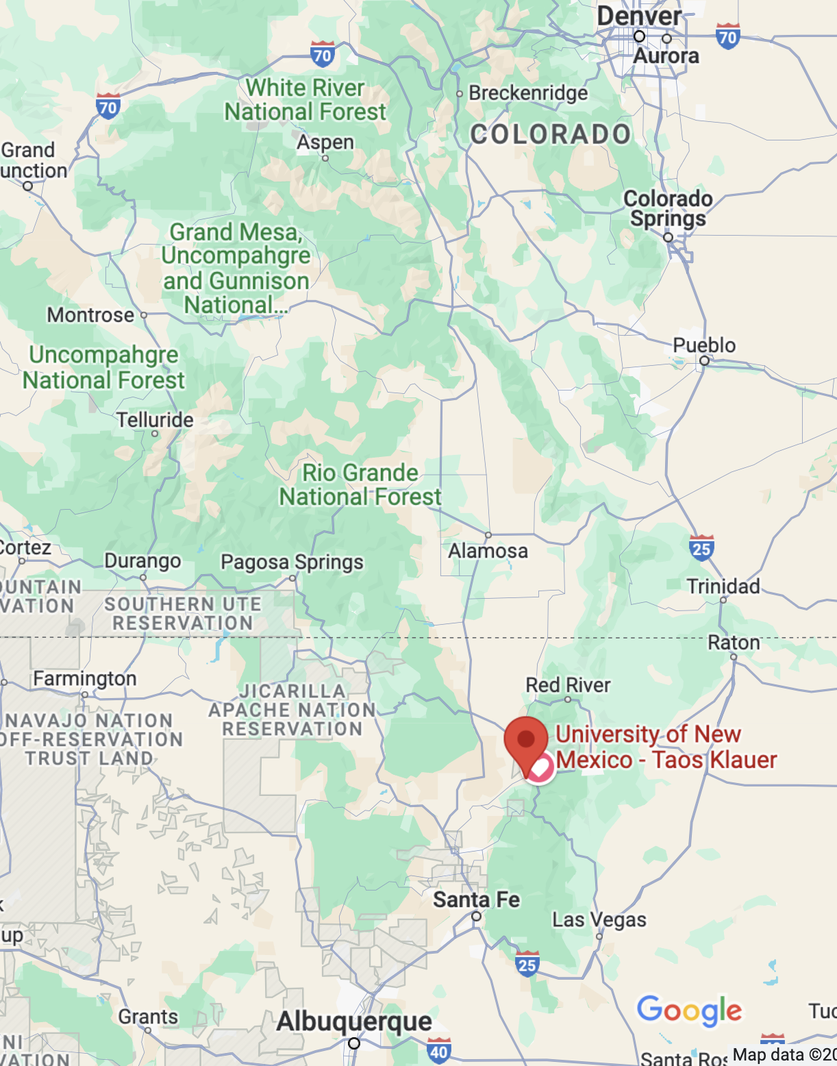
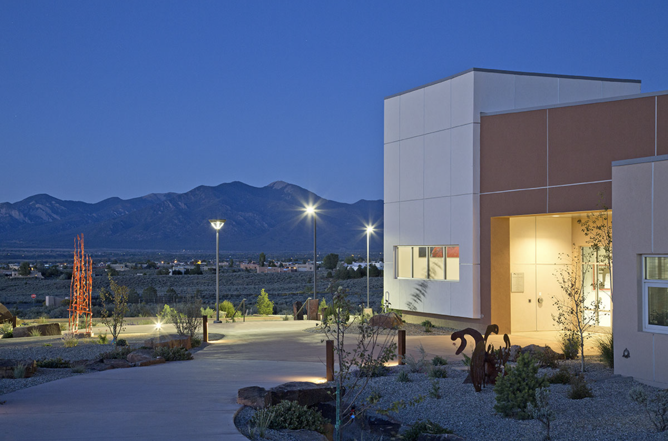
UNM - Taos

Slide 4
Background - I
UNM-Taos
  Open Access branch campus of Univ. New Mexico
  HSI, Serving Rural Communities in Northern NM
  Students Frequently Underprepared for College
Notes:
N New Mexico , 60 mi N of Santa Fe

Slide 5
Background II

Slide 6
Background - III
Students
  Have experienced K-12 math & it didn’t ‘stick’
  Deficiencies typically in Gr 6-10 Content
  Local High School had success with students using Constructivist approaches
      -But materials are K-12 focused
Notes:
N New Mexico , 60 mi N of Santa Fe

Slide 7
Program Overview - Issues
  Instructors experience many students struggling with common topics (fractions, signed integer arithmetic, proportions..)
    Foundational for later advanced content
  Constructivist approaches have benefit
    Build conceptual understanding & Habits of Mind
    Constructivist Approaches are student paced & tend to be slow
  Students think they are ‘Bad at Math’
    We lose Potential STEM students before they reach STEM courses
Notes:
N New Mexico , 60 mi N of Santa Fe

Slide 8
Program Overview - Approach
  Use constructivist approach (experiential, contextual, groupwork, reflection…) with ‘Age Appropriate‘ context
    Only on Key Topics – ‘Keystones’
        Selected based on student needs and relevance to content of Later STEM courses
          e.g. Fractions → rational numbers → Rational Functions
          Signed integers → chemical processes (Gibbs free energy, endo/exothermic reactions etc)
        7 different Keystones have been developed.
        Keystone Modules include activities which enhance Employability skills & Mathematical Habits of Mind
Notes:
N New Mexico , 60 mi N of Santa Fe

Slide 9
Program Overview - Realizations
  Can’t stick to rigid calendar progress
    Student Paced Pedagogy - analysis & intervention essential
  The ‘COVID monkey wrench in the works’
    How do you achieve interaction online?
  Addition of ‘Implementation/Learning Environment’ . Keystones
    Icebreakers
    Personal Progress Portfolio
Notes:
N New Mexico , 60 mi N of Santa Fe

Slide 10
Personal Progress Portfolio – Implementation Keystone
Concept.
Meta Cognition -
A High Yield Strategy
(Preparation not process)
Students are required to reflect on learning 2 or 3 times per semester plus in Final.
This is carried forward and continued in all Math classes up to and including first level Gen. Ed. courses
Math
Content
Math
Habits of
Mind
Employability
Skills

Slide 11
Current Status - I
7 Keystones Identified:
  - Proportions - Linearity
  Fractions - Percentages
  Signed Integers - Learning Environment
  Metacognitive reflection
Tested initially in Classrooms and well received except
in Pre-Algebra level classes (Cognitive demand too high)
‘Chunked’ pre-Alg. Level courses to be more palatable for Introductory classes

Slide 12
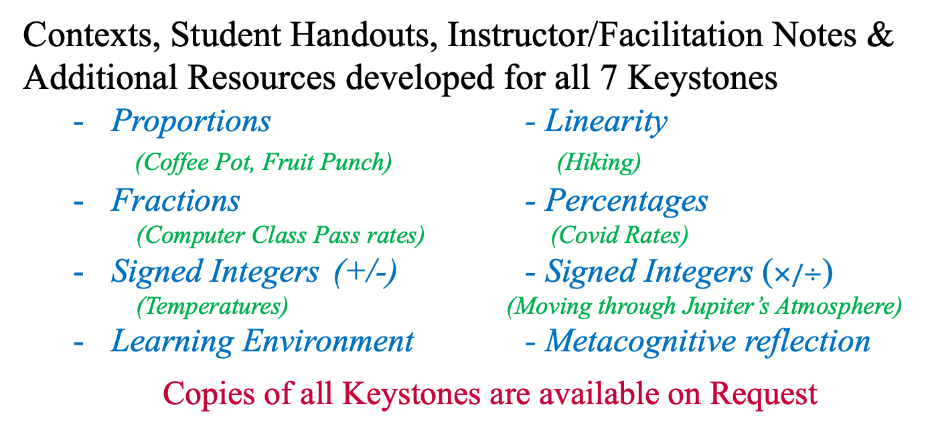
Current Status - II
Contexts, Student Handouts, Instructor/Facilitation Notes & Additional Resources developed for all 7 Keystones
  Proportions - Linearity
  (Coffee Pot, Fruit Punch) (Hiking)
  Fractions - Percentages
  (Computer Class Pass rates) (Covid Rates)
  Signed Integers (+/-) - Signed Integers ($×/÷$)
  (Temperatures) (Moving through Jupiter’s Atmosphere)
  Learning Environment - Metacognitive reflection
  Copies of all Keystones are available on Request

Slide 13
Karon’s Stuff

Slide 14
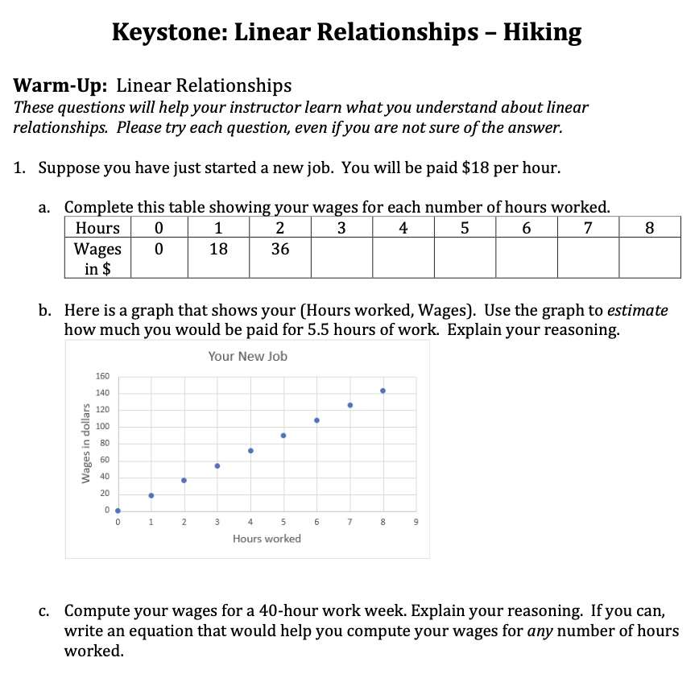
Linear Models Keystone
When: this is students' first introduction to linear models
Learning Outcomes:
Students recognize that linear relationships can be described by words, tables, graphs, and equations.
Students recognize that the steepness of a line is related to rate.

Slide 15
Let's Explore
What do you notice?
What do you wonder?
Where do you anticipate students might struggle?
Have you used an end of lesson reflection? How did it work? What advice do you have about it?
Notes:
Take a few minutes to read this individually.
Then ponder these questions – private write.
Talk with the person next to you.
It provided a helpful context – anchor – that we could come back to as we continued to work with lines.
it was challenging. Students struggled to make connections across contexts (hourly pay rate and hiking rate) and students continued to struggle with interpreting slope.
One of the challenges we encountered was that students weren’t necessarily prepared to engage in this WAY – particularly if they were used a class that was primarily lecture based and focused on learning procedures.
Hard to drop this in to a class with a different philosophy

Slide 16
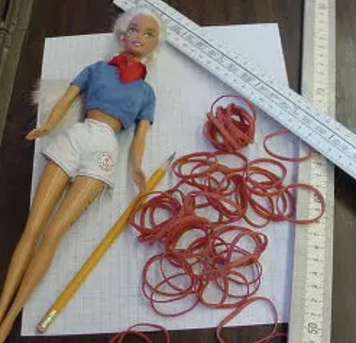
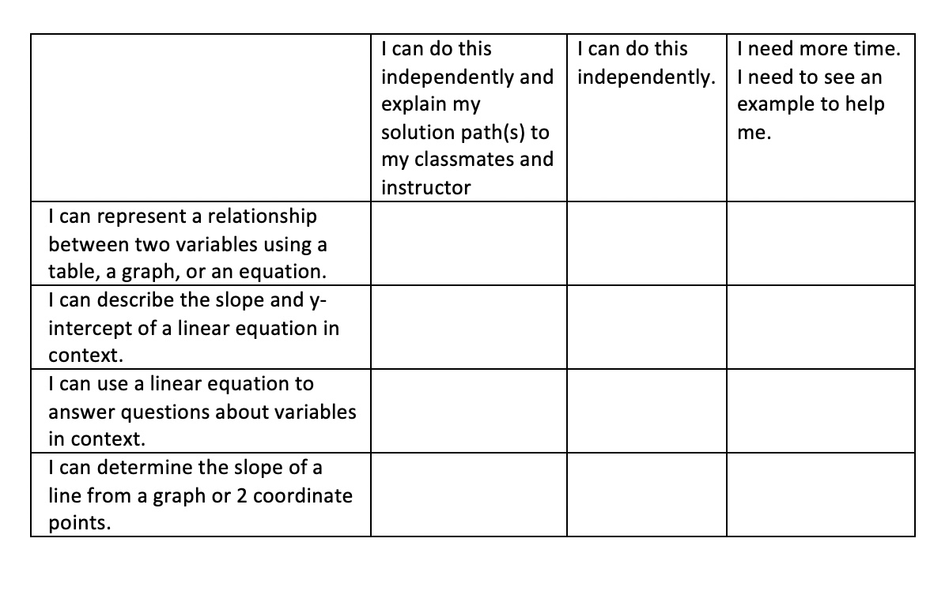
Redesigning Elementary Algebra
Instructional Approach:
All math content is contextualized to real-world scenarios
Students discover / explore concepts & construct their own knowledge
Students work in groups to promote mathematical discourse
Students reflect on their own learning, guided by the learning outcomes
Notes:
Little if any naked math, all math has an inherent purpose
Students are not told the concepts, rather they discover them.
Students do their work in group together with their peers. I did invest time (not enough) in building connections among class members / within teams.
That speaking about math – and hearing and interpreting others’ – helps deepen their understanding
opportunities to reflect at the end of lessons…’what did I learn about the relationships between lines and graphs today?’
And at the end of the module, where students assess themselves on each learning outcome as part of studying for the exam.

Slide 17

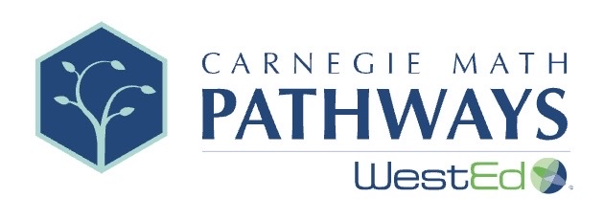
Redesigning Elementary Algebra
Development Process:
Refined the learning outcomes
Identified OER resources
  Open Up Resources (grades 6-10)
  Carnegie Math Pathways (quantitative reasoning for college students)
Learn by doing!
Notes:
Previously these were vague. Wanted clear, actionable objectives so that students could asses whether they’ve done them. (And this was a good time to make sure they aligned with the expectations for the subsequent course.)
Moved (moving) to standards based grading
There are some excellent resources available. Exploratory. Well scaffolded. For the most part they were age appropriate. Not always. But in those cases we were able to make minor changes.

Slide 18
Lessons Learned and Next Steps
Teaching and Learning is cultural
Just as we focus on shifting students’ mindsets about their ability to learn, we must also shift their expectation of what’s expected of them in a mathematics learning environment
Notes:
It’s clear that the traditional model of instruction isn’t working. If it were, we wouldn’t have students in our developmental classes!
Research showed that active, collaborative, discovery based learning was much more effective.
I was ready to try it!
But that doesn’t mean my students were ready.
Next steps:
Continue to refine keystones and Math 100 curriculum
Focus on establishing classroom norms and student expectations at the beginning of class
Bringing data science to two-year-colleges

Slide 19
Questions ??

Slide 20
Contacts
Colin Nicholls – UNM Taos
colnic@unm.edu
Karon Klipple – UNM Taos
Kklipple@unm.edu

