Slide 1
Moving, Doing, and
Learning Math
Hortensia Soto (hortensia.soto@colostate.edu)
ColoMATYC
Colorado Mountain College
April 11, 2025

Slide 2
Please do …
Thank you, Google for all the fun images!

Slide 3
Goals
Introduce you to embodied cognition
Show case how to leverage it with salient concepts
Have fun!
PS … symbolism and formalism of math is important to me!

Slide 4
Let’s Play: What is a Circle?

Slide 5
Game: How to Play!
Participants
What do you feel?
What is your experience?
Have Fun!
Observers
What do you see, hear, feel?
Have Fun!

Slide 6
What did you learn? What else might you learn?

Slide 7
Embodied Cognition
Philosophy that describes reasoning as body-based stemming from experiences with the physical environment

Slide 8
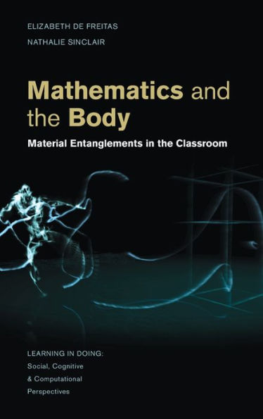
Utterances
Sound Production
Body Motion
Facial Expression
Gaze
Body Poise
Hand Gesture
(Nemirovsky & Ferrara, 2009)

Slide 9
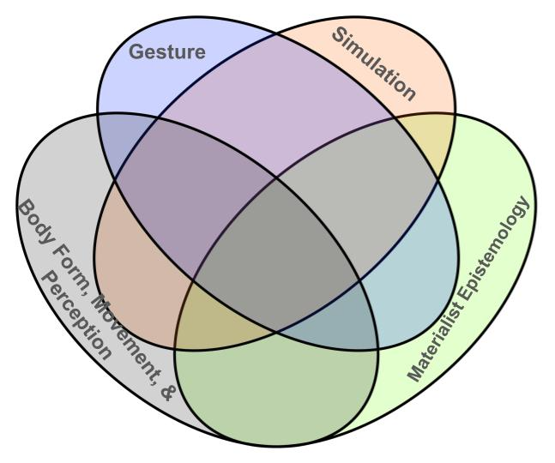
Forms of Embodiment and Student Learning (Nathan, 2021)
 | Grounding | Offloading | Cognitive-Sensorimotor Transduction | Participation
Body form, movement & perception | Pragmatic actions; Metaphors | Finger counting | Directed actions ←→Reasoning | Communities of practice
Gesture | Pointing; Iconic; Metaphoric | Pointing to imagined or real | Metaphors & Gesture | Turn taking; Collaborative
Simulation | Instantiations | Enact movement on objects/diagrams | Cut, multiply, add for integration | Participatory simulation
Materialist Epistomology | Reification; Direct representations | Manipulatives; Models | Thought experiments; Functional actions | Groups/Teams

Slide 10
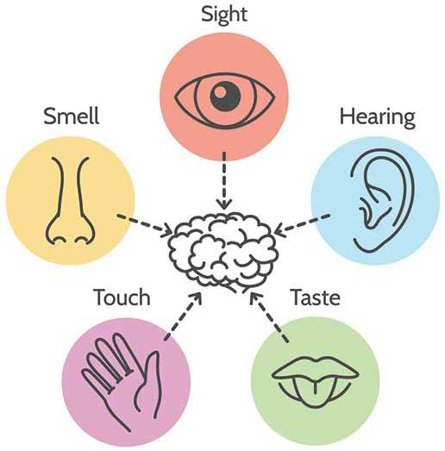
“Usen sus cinco sentidos!” - My mom
Sensation
Action
Perception

Slide 11
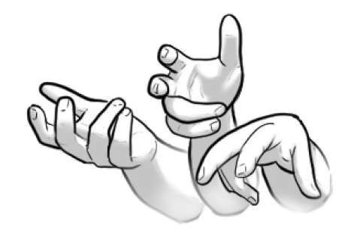
Spontaneous Embodiment

Slide 12
Intentional Embodiment: “Befriend the concept” (van Dormolen & Arcavi, 2000, p. 15)
Formalism
Symbolic
Embodiment

Slide 13
Let’s Play: What is the sum of the interior angles of a Euclidean triangle?

Slide 14
Game: How to Play!
Participants
What do you feel?
What is your experience?
Have Fun!
Observers
What do you see, hear, feel?
Have Fun!

Slide 15
What did you learn? What else might you learn?

Slide 16
LET’S PLAY!
Notes:
Materials 1. Rope 2. Different Colored Painters Tape 3. Axis with degrees vs -1,1

Slide 17
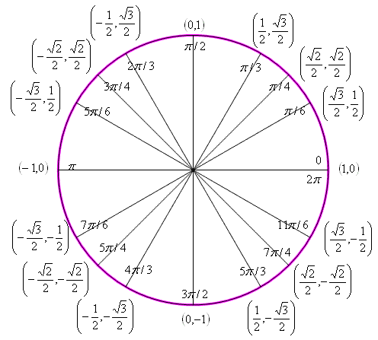
Unit Circle
Need
Someone to act as center/origin
16 people to act as the 16 points on the circle holding the rope
Form a circle with radius of 1.

Slide 18
Making Right Triangles
Learning to Cooperate
Let’s go around the circle with center holding rope and extending to points on circle
Make a full turn.

Slide 19
Making Right Triangles
Let’s go around the circle with center holding rope and extending to points on circle but bring rope down to x-axis to create right triangles.
Start at 0 degrees and make a full turn.
Let’s keep track of base and height of triangle

Slide 20
Wonderings!
When we were not able to make a right triangle? Why did that happen?
If we are keeping track of base and height of a triangle, why do we have negative values for these “physical objects?”
What else did you notice?

Slide 21
Defining Trigonometric Functions in Terms of Right Triangles

Slide 22
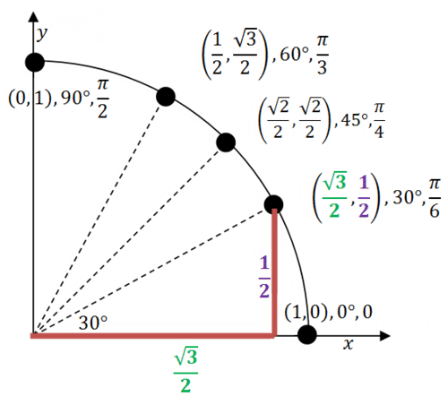
Trigonometric Functions in Terms of Unit Circle
$$Sine α=\frac{y}{r} Cosecant α= \frac{r}{y}$$
$$Cosine α=\frac{x}{r} Secant α= \frac{r}{x}$$
$$Tangent α=\frac{y}{x} Cotangent α= \frac{x}{y}$$

Slide 23
Unraveling the Unit Circle→ Sine Function $$Sine α=\frac{y}{r}$$
Unit Circle → Graph (angle vs ratio)
What is the value of r?
Where should the ratio of $\frac{y}{r}=\frac{y}{1}=y$ be 0? Support reasoning!
Where should the ratio of $\frac{y}{r}=\frac{y}{1}=y$ be greater than 0? Support reasoning!
Where should the ratio of $\frac{y}{r}=\frac{y}{1}=y$ be less than 0? Support reasoning!
Let’s Unravel!

Slide 24
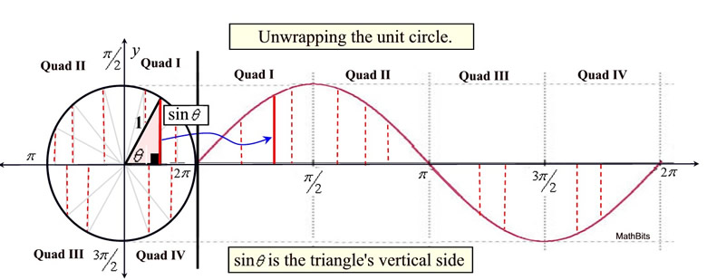
Unraveling the Unit Circle: What do you notice?

Slide 25
What did you learn? What else might you learn?

Slide 26
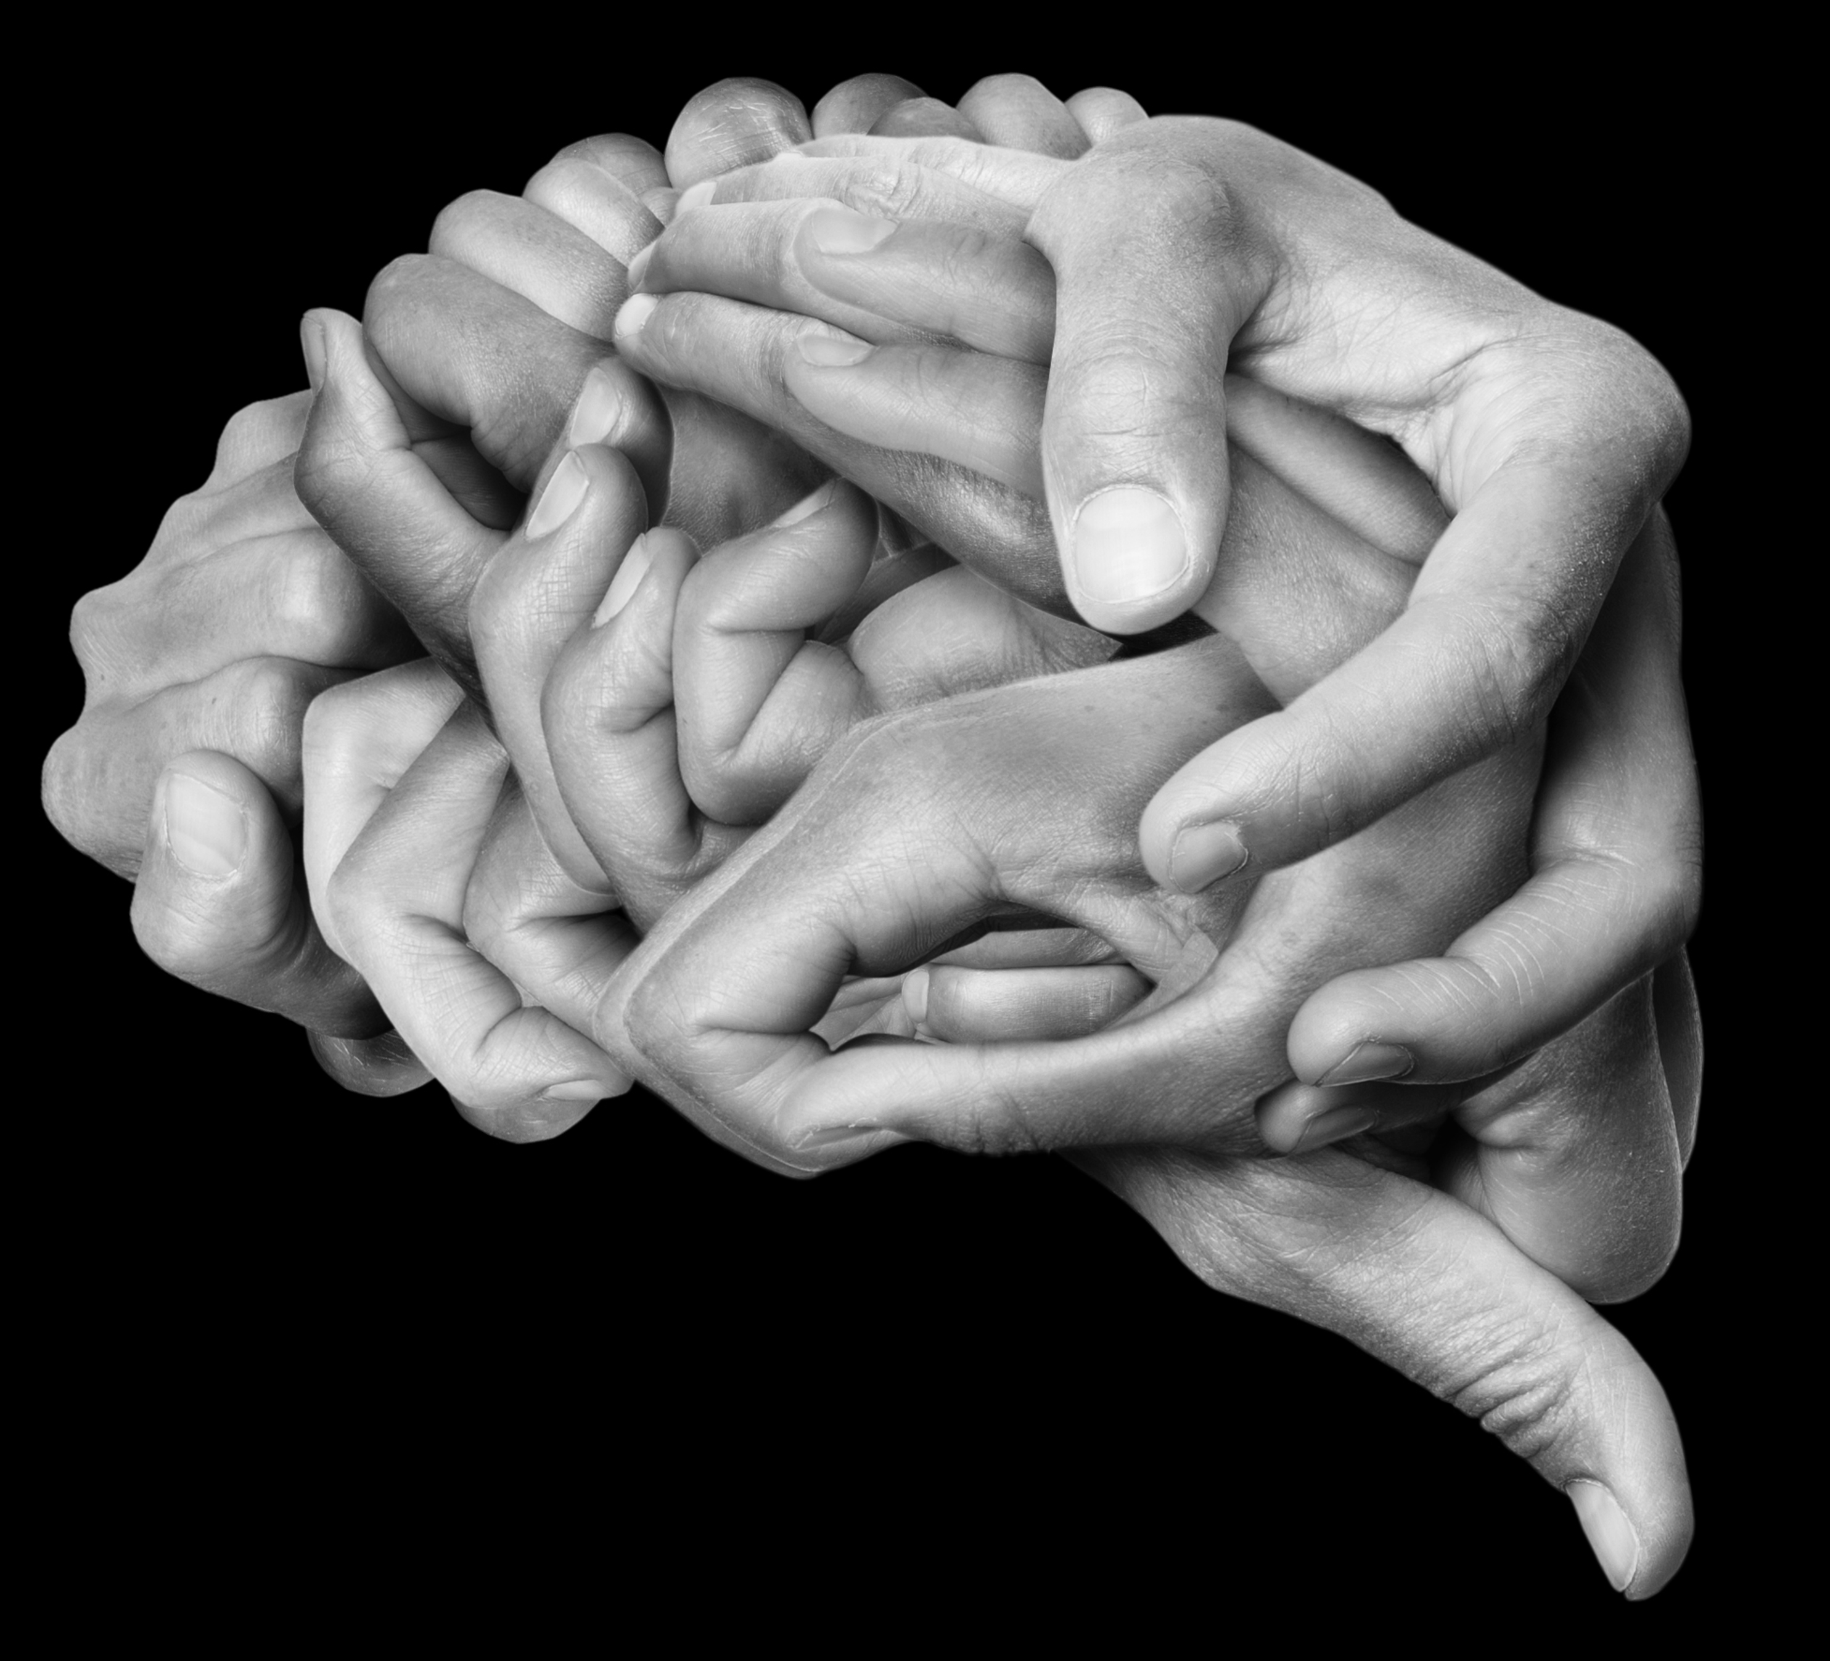
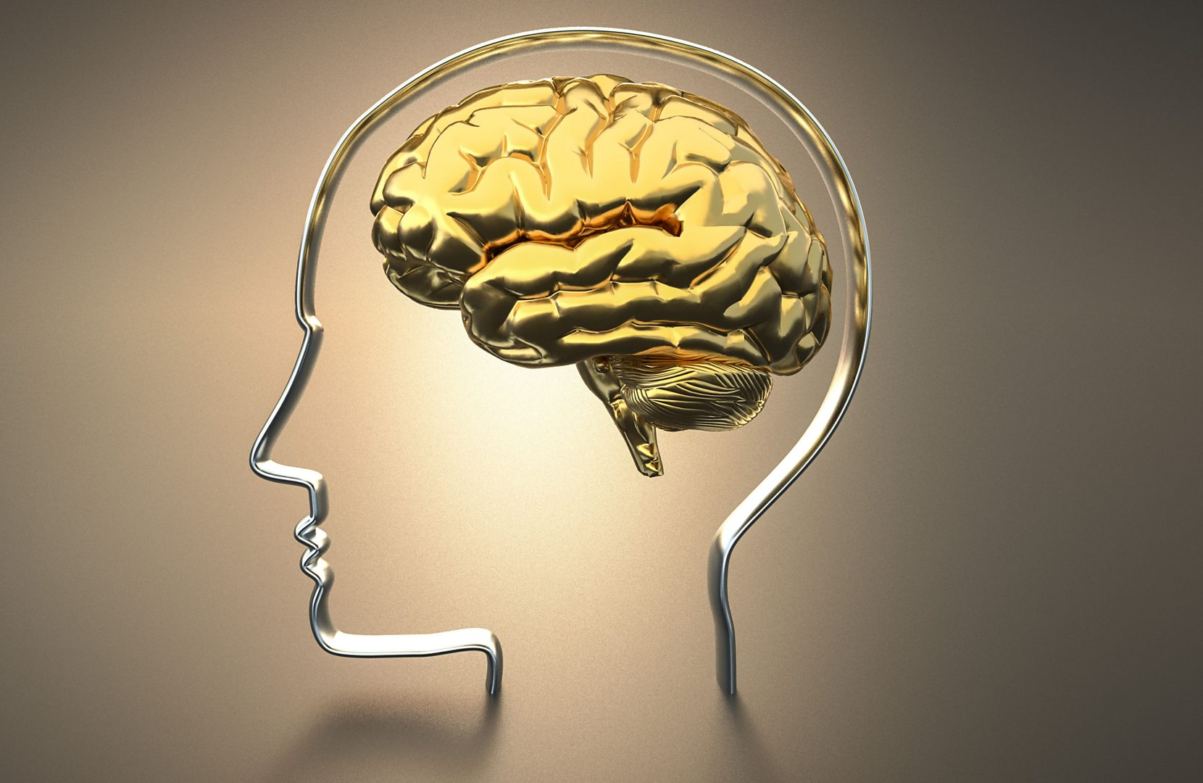
How does math move for you?

Slide 27
Thank You! Thoughts? Questions? Wonderments? Hortensia.soto@colostate.edu

