Slide 1
Creating a Multipart Student-Centered Data Analysis Project

Slide 2
The Classic Semester Long Statistics Project
Students design a research question
They collect data through a survey, attempting to minimize bias
They use this data to create charts and informative graphics
They perform various statistical tasks
Derive summary data
Conduct hypothesis tests
Find confidence intervals
Perform a simple regression analysis
Write a report or create a Powerpoint

Slide 3
Weaknesses of this Model: Question Design
Students must design a question before they grasp the scope of the project
Students often report feeling constrained by socio-political pressure, causing them to avoid meaningful topics in favor of less sensitive ones

Slide 4
Weaknesses of this Model: In Person Data Collection
While in-person data collection is believed to be the most reliable it has many weaknesses.
Many students do not feel comfortable interacting face to face with strangers
Choice of data collection times and locations can be difficult to randomize
Potential interviewees may feel little incentive to respond
Answers may be misleading or possibly false

Slide 5
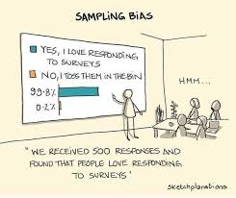
Weaknesses of this Model: Phone and Online Data Collection
The prevalence of Caller ID results in few people answering phone calls from unknown numbers
Emailed surveys are easy to ignore/ forget about
Online surveys over social media, while popular with students, have high levels of response bias

Slide 6
Weaknesses of this Model: Social Distancing
Random data collection became even more difficult during the COVID-19 Global Pandemic when campuses closed campuses and social distancing was highly encouraged.
Image: World Health Organization

Slide 7
But When Life Gives You Lemons…
There is an increased incentive to explore new avenues and ideas
(Image Source:
https://www.walmart.com/grocery/ip/Simply-Lemonade-All-Natural-Non-GMO-52-fl-oz/757977763)

Slide 8
Data Collection Across Classrooms
An alternative model is for the instructor to create a database from a list of general questions answered by students in multiple sections of an Introduction to Statistics class.

Slide 9
Advantages of the Multiclass Model
Students feel incentive to answer because more responses will lead to better projects
Due to the large sample size, students feel safer answering truthfully as all class responses are mixed together … individual students cannot be identified.
The variety of collected data stimulates student creativity, leading to a wide variety of available questions

Slide 10
Spring 2025
Project Given to Five Sections of MAT 1260:
Two Sections FRCC Boulder County Campus
Two Sections FRCC Westminster Campus
One regular start
One Late start
One Section Online Pooled

Slide 11
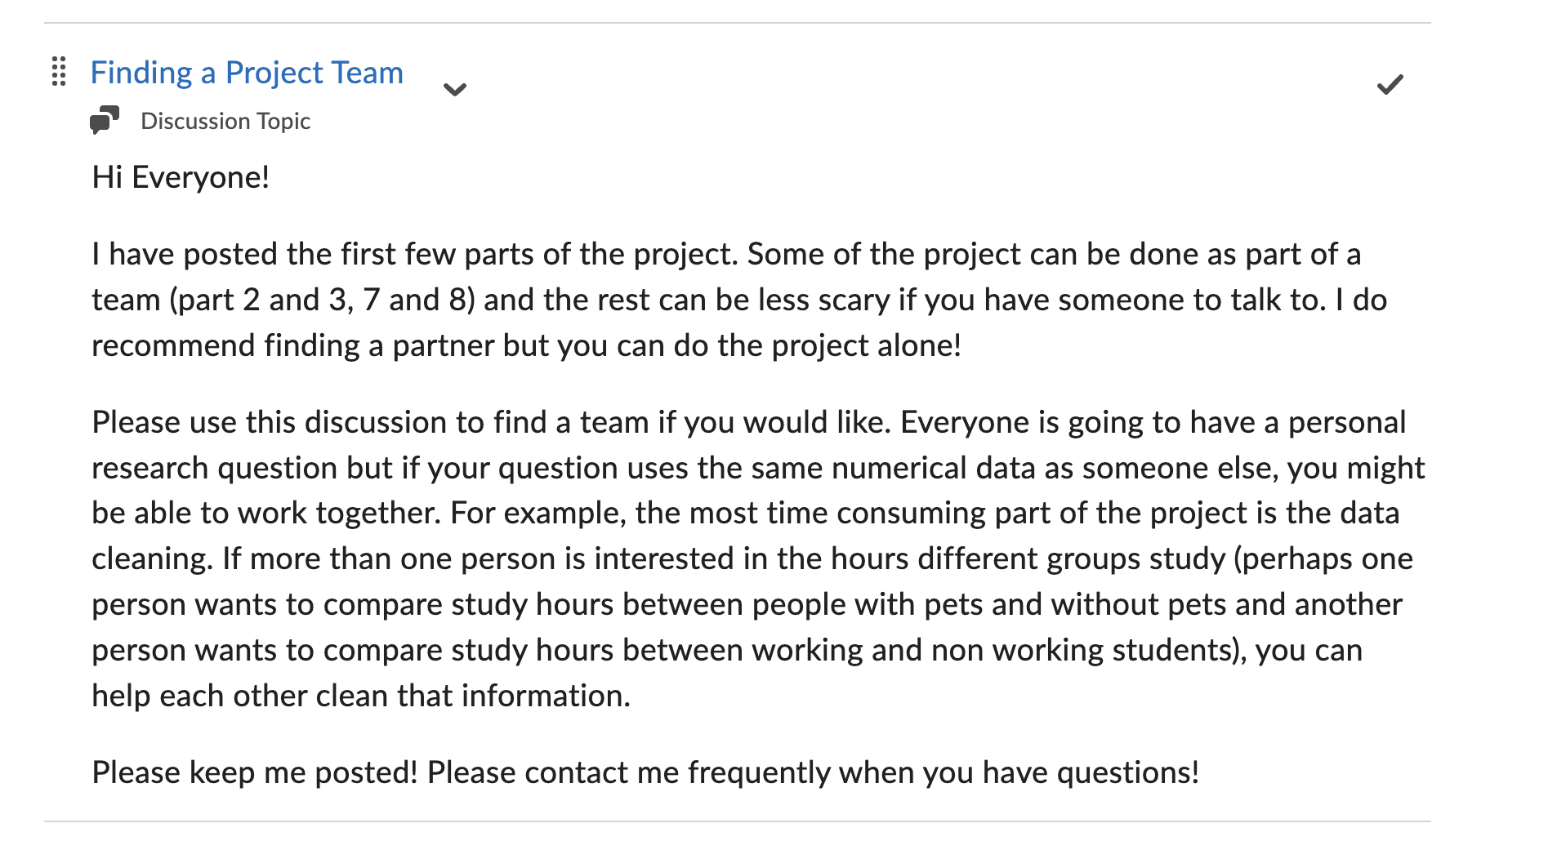
Group Versus Individual? Why Not Both?

Slide 12
Final presentations can be done in teams, but each student formulates their own question, while students are encouraged to assist each other.

Slide 13
Example Survey Questions From Spring 2025
How Would You Describe Your Gender?
How Would You Describe Your Ethnicity?
How Would You Describe Your Race?
How Many Days a Week Do You Exercise, On Average?
How Many Hours Do You Work Each Week, On Average?
How Stressed Do You Feel About Your Schoolwork?
How Do You Feel About the Future?

Slide 14
Sample Responses

Slide 15
An Example Question
Do community college students who already plan to attend graduate school study more than students who intend to stop at an Associates or Bachelor’s degree?
Using the Data From:
How Far Would You Like to Take Your Education?
How Many Hours A Week Do You Study, On Average?

Slide 16
A Prediction
Community college students who already plan to attend graduate school study more than students who intend to stop at an Associates or Bachelor’s degree.

Slide 17
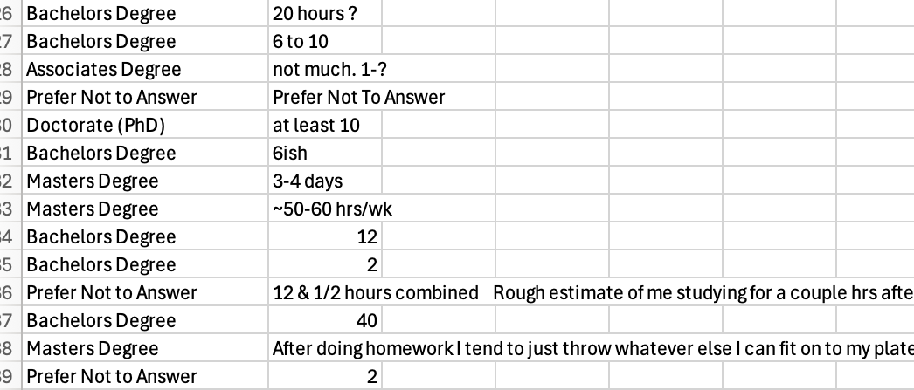
Sample Data Before Cleaning

Slide 18
Students Make and Document Their Own Data Cleaning Rules
If given a range, take the average
If student gives a number but expresses a wish to change it, use that number
If student gives a number for normal weeks use that number
If student gives a time for this class and for others take mean of both and add together
Remove if no clue as to an estimate
If given an open ended range, use the end point

Slide 19
Cleaned Data

Slide 20
Combined Histogram

Slide 21
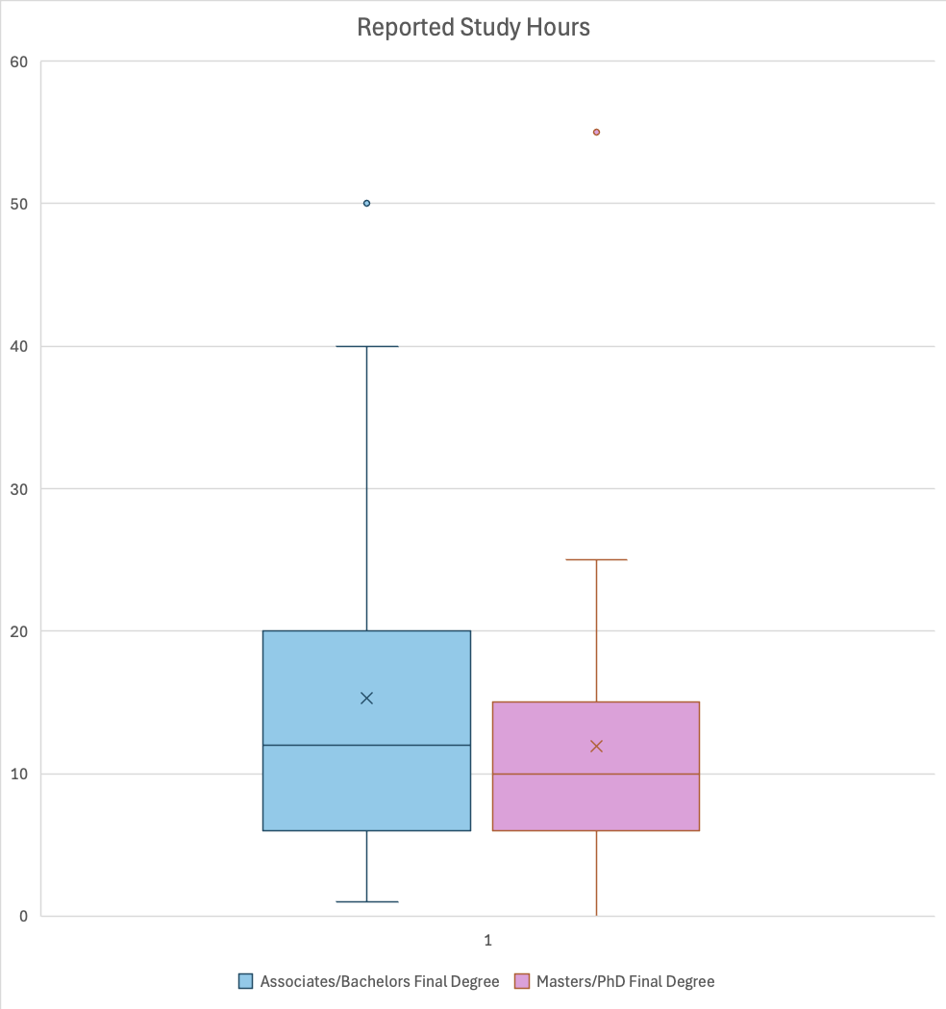
Box Plot Comparison
Which appears to have the higher median? Which appears to show more variance?
Do your plots support your prediction? Why or why not?

Slide 22
And Now For Something Completely Different
The good news about anxiety
In the right amount, anxiety can heighten focus and detail orientation. It also spurs creativity and motivates us to problem-solve.
Washington Post: March 16, 2025

Slide 23
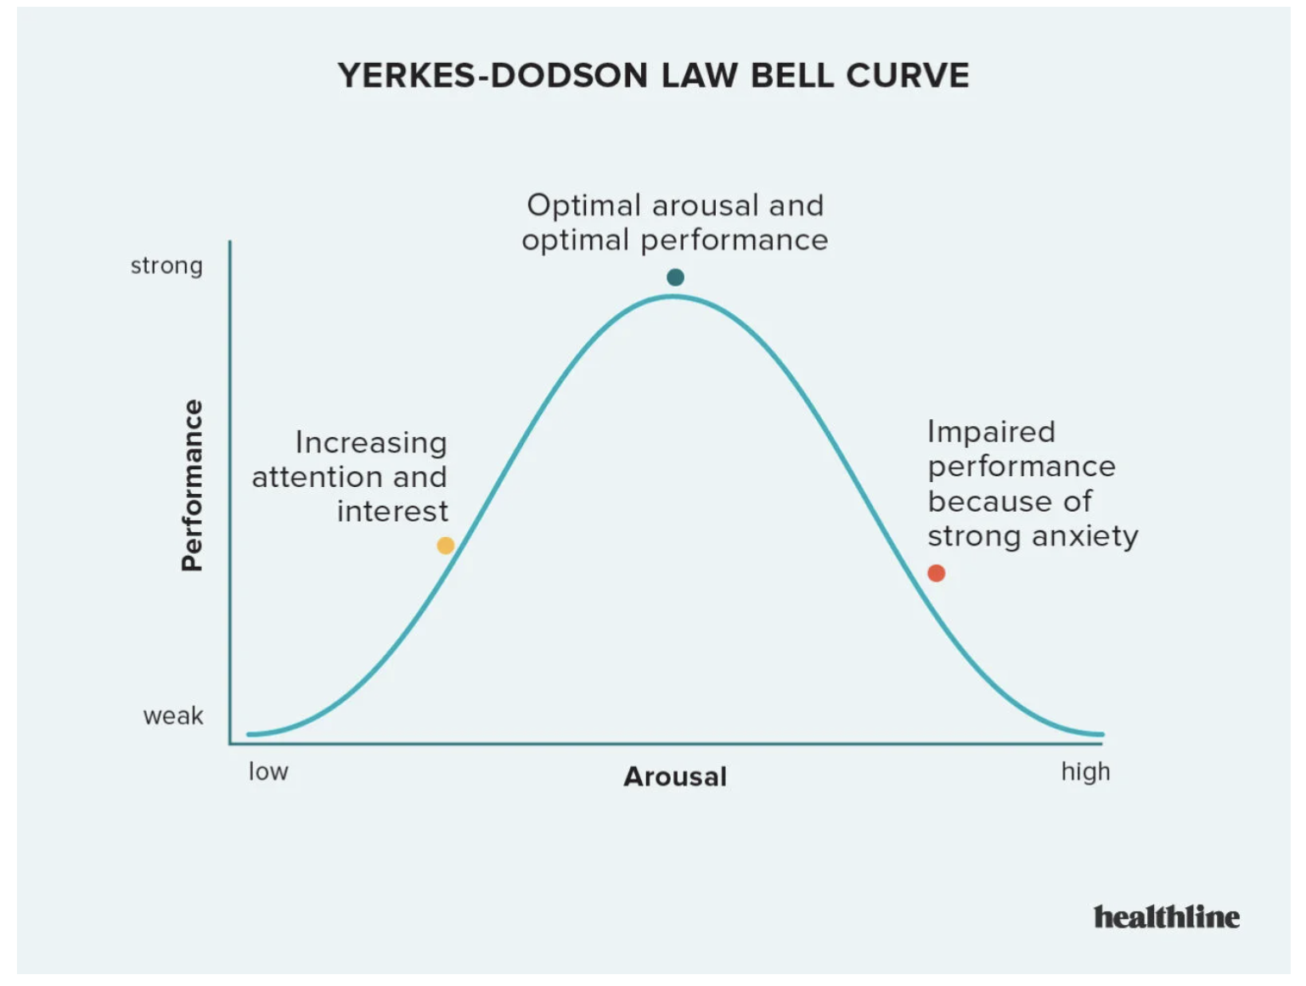

Slide 24
I want you to think about a kind of stress in your life that has an underperformance, peak performance, and an overwhelm stage: think the kind of stress you feel while trying to accomplish something challenging, like training for a race, improving physical fitness or studying for an exam, for example.
This can be physical, emotional, mental, or combination stress.

Slide 25
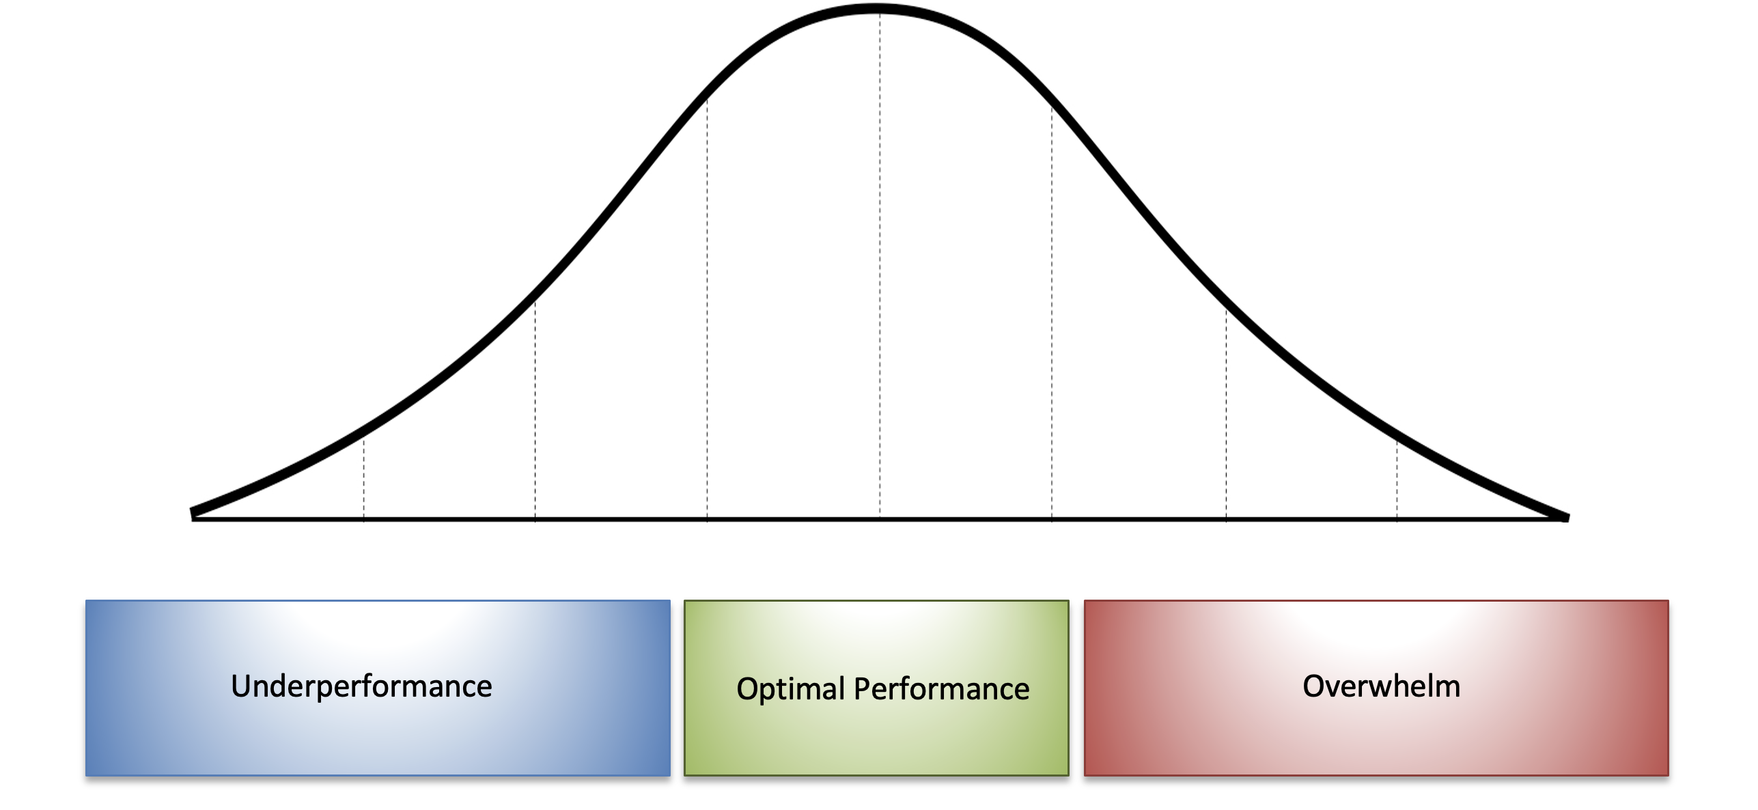

Slide 26
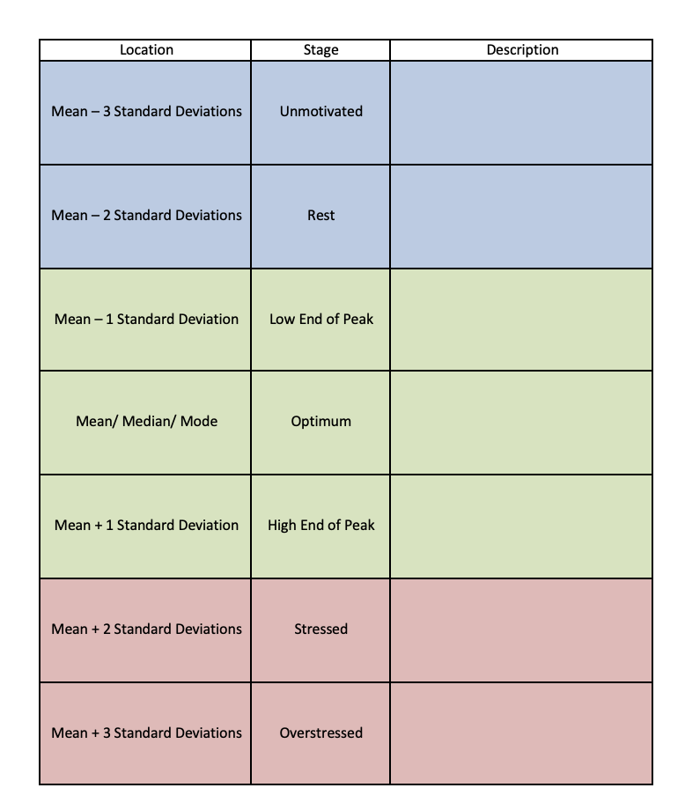
Given the experience you chose, describe how you feel at every whole value standard deviation.
68% of the time you want to be in the green area … what does it feel like?

Slide 27
What does it feel like to be in the blue region? What can you do to move from blue to green?
What does it feel like to be in the red region? What can you do to move from red to green?

Slide 28
Hypothesis Testing
Return to your question:
Is the difference you observed in your initial question significant?

Slide 29
Regression
Compare two quantitative variables from the data set that you think may be related!

Slide 30
Final Project
Each person should:
• Explain why you thought your question is interesting. • Identify at least one confounding variable and briefly describe why it might affect your findings. • Make a prediction and explain why you are making that prediction (it is ok if your prediction turn out to be wrong! Being wrong is an important part of doing science!).

Slide 31
Conclusion
Describe any further research you would like to do on your topic:
• What lingering questions do you still have? • Are there any new questions you wonder about? • Are there any other variables you would have liked to see in the survey?

