Slide 1
Best Practices for Creating an Active and Engaging Online Learning Environment
RaKissa Manzanares
University of Colorado Denver
Mathematical & Statistical Sciences
rakissa.manzanares@ucdenver.edu

Slide 2
Our Challenge
To have an adequate number of people for STEM jobs, we (universities and colleges) need to produce 1 million ADDITIONAL graduates with STEM degrees over the next decade.
“The first two years of college are the most critical to the retention and recruitment of STEM majors” (Holdren & Lander, 2012, p. ii)
Notes:
PCAST Report by Holdren & Lander
Presidents Council of Advisors on Science and Technology

Slide 3
Question?
What percent of freshmen who intend to major in STEM (science, technology, engineering, mathematics) actually finish a STEM major?
A) > 80% B) 60 – 80%
C) 40 – 60 % D) < 40 %

Slide 4
Question?
What percent of freshmen who intend to major in STEM (science, technology, engineering, mathematics) actually finish that major?
A) > 80% B) 60 – 80%
C) 40 – 60 % D) < 40 %

Slide 5
What are some common reasons students give for leaving STEM majors?
Discuss…

Slide 6
What are some common reasons students give for leaving STEM majors?
Guess the percentages:
??%: “Turned off of” science
??%: Non-STEM major seems more interesting
??%: Lifestyle of STEM career unappealing
??%: Inadequate advising or help with academic problems
??%: Poor teaching by STEM faculty
??%: Conceptual difficulties with STEM subjects
(Seymour & Hewitt, 1997)

Slide 7
What are some common reasons students give for leaving STEM majors?
Guess the percentages:
60% “Turned off of” science
57% Non-STEM major seems more interesting
43% Lifestyle of STEM career unappealing
75% Inadequate advising or help with academic problems
90% Poor teaching by STEM faculty
27% Conceptual difficulties with STEM subjects
(Seymour & Hewitt, 1997)
Notes:
73% of Non-switchers cited poor teaching as an issue within their majors.

Slide 8
Why do we focus on the first 2 years?
“The first two years of college are the most critical to retention and recruitment of STEM majors.”
Holdren & Lander, 2012, p. 6

Slide 9
About that Teaching…
“The lecture has been a mainstay of higher education since the word ‘lecture’ was created in the 14th century, and today most introductory STEM courses are taught largely through lectures.”
“Extensive research on how the human brain learns indicates that diversifying teaching methods enhances critical thinking skills, long-term retention of information, and student retention in STEM majors.”
Holdren & Lander, 2012, p. 8

Slide 10
About that Teaching…
“A significant barrier to broad implementation of evidence-based teaching approaches is that most faculty lack experience using these methods and are unfamiliar with the vast body of research indicating their impact on learning.” (Holdren & Lander, 2012, p. iii)
“Moreover, these active learning techniques benefit all students and can close the achievement gap between ethnic groups and men and women”
(Holdren & Lander, 2012, p. 9)

Slide 11
Pedagogy Can Help!
Nat. Acad. of Sciences (Freeman report):
Meta-analysis of 200 studies (higher ed. STEM)
passive lectures vs. anything else
Passive lectures: 55% higher DFW
Conclusion?
Medical metaphor:
Passive Lectures = Professional Malpractice

Slide 12
What is Active Learning?
Active learning is "anything that involves students in doing things and thinking about the things they are doing" (Bonwell & Eison, 1991, p. 2).
An approach to instruction in which students engage with the material they study through reading, writing, talking, listening, and reflecting. Active learning strategies can be as short as a few minutes long.

Slide 13
Why Incorporate Active Learning?
Reinforces important material, concepts, and skills.
Provides more frequent and immediate feedback to students.
Addresses different student learning styles.
Provides students with an opportunity to think about, talk about, and process course material.
Creates personal connections to the material for students, which increases their motivation to learn.

Slide 14
Why Incorporate Active Learning?
Allows students to practice important skills, such as collaboration, through pair and group work.
Builds self-esteem through conversations with other students.
Creates a sense of community in the classroom through increased student-student and instructor-student interaction.

Slide 15
Three Sided Approach
Technologies Designed to Promote Active Learning
Activities Known to Promote Active Learning
Pedagogical Strategies Useful in Implementing Active Learning.
Notes:
Everything I’m going to share with you I do both in my on campus classes as well as my online classes in varying degrees.

Slide 16
Let’s Start from the Beginning
Before Day 1…
  Develop Your Classroom Culture
    What do you want your learning environment to sound like, feel like, look like, be like?
    What are the roles and responsibilities of the teacher? Of the students?
    Translate all of this into your syllabus and course overview/welcome materials.

Slide 17
How Do We Get Students To Engage With This Material?
Scavenger Hunt
Course Overview Quiz
Pecha Kucha
Notes:
Quiz: Proctoring requirement, where to take exams, how to be successful in the class, where to find course materials and due dates

Slide 18
Build A Community
First 2-3 weeks of class are critical to fostering the classroom culture you desire and building an inclusive community of learners.
An active and engaged classroom begins with students getting to know you and their classmates.

Slide 19
Ice Breakers & Personal Introductions…That Don’t Suck!
Story of Your Name
Two Truths and One Lie
Word Clouds
Championing Statements

Slide 20
Story of Your Name
Share with the class the story of how you got your name.
Get into groups of 3-4 and share your story.
Can do this online in a threaded discussion or voice thread.
Notes:
I like to have my students make videos so that we can get to know each other’s personalities.

Slide 21
Two Truths and One Lie
As a personal introduction activity:
https://ucdenver.instructure.com/courses/348532/discussion_topics/481677
Can also be used as an activity to engage students with the mathematics content.
Notes:
Make Video, post in Threaded Discussion, comment on what you think the lie is on at least 10 student videos.
Multiple due dates (Thursday video post, Saturday comment on other’s videos, Sunday state your lie)

Slide 22
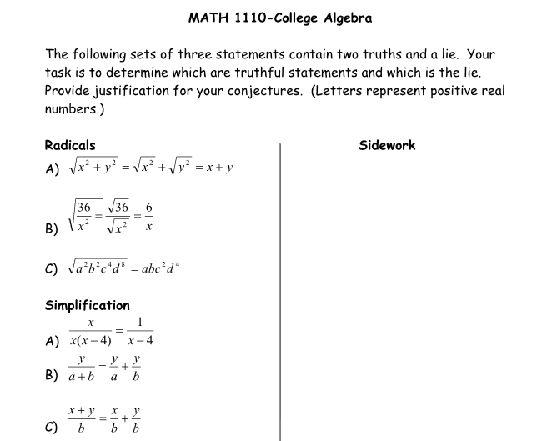
Two Truths and One Lie

Slide 23
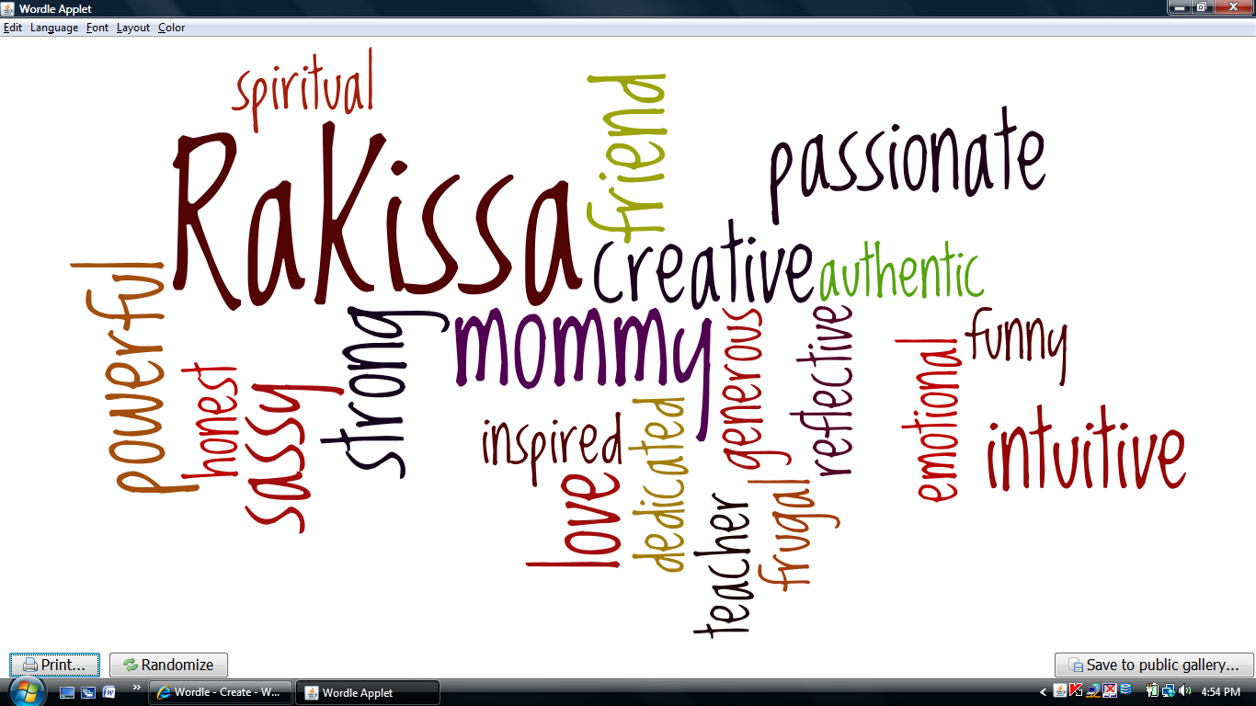
Word Clouds
Notes:
Post in Threaded Discussion
Comment on things that you have in common with your classmates, or things that you found interesting.
Wordle, Tagul…lots of free ones online.
Can also use word clouds to help students organize their thinking about the material. Big ideas are in bigger fonts, and sub topics with lesser influence get smaller in font size.

Slide 24
Championing Statements
What are you a champion of?
  In this course?
  In your life?
  I am a healer and teacher of personal empowerment and self-expression. I am an artist who creates aha moments and dances with the inspired actions of my students. I am a champion of people becoming the artist of their own lives creating their truth and power with brushstrokes of unconditional love.
Notes:
Voice Thread-can create discussions with video, audio, or text.

Slide 25
Modules
Organize by Week
Create a Home Page – Weekly Overview
Imbed Links
Give Students Something to Engage With.
  ThingLink
  Video
  Images
  Fun Math Facts
Notes:
If you aren’t using modules you need to! Helps organize the material for students.

Slide 26
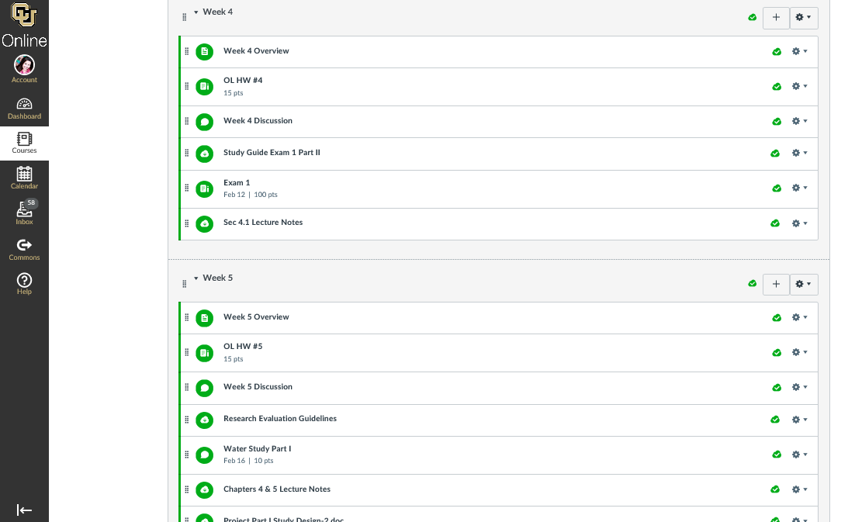
Notes:
I open my modules week by week so that keep up with the material and are engaged in discussions together.

Slide 27
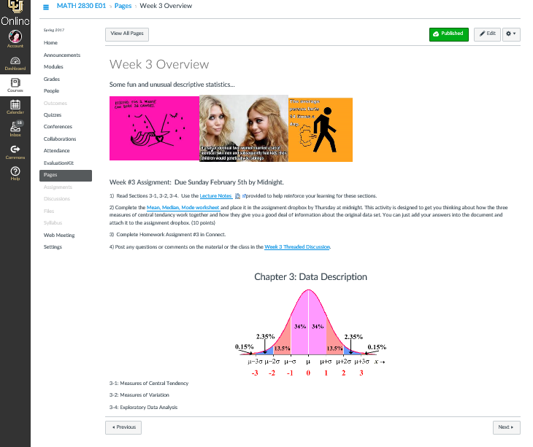
Notes:
Notice my images with fun math facts. And an image that will give students an idea of what the material will be over.
Also I have a list of every assignment and the corresponding due dates on this page.
I’ve embedded links to make it easy for students to jump straight to files or assignments.

Slide 28
ThingLink
https://www.thinglink.com/scene/891741072688939009
Notes:
ThingLink is an app that allows to take an image or video and put tags on it.
You can share these on social media or embed a link into your course LMS.
Great for intro to material and review of material.
Very Basic use is free but the Pro Teacher cost is $35/year.

Slide 29
Improve Discussions
Get at each student’s perspective.
Include videos and graphics to engage students with the content.
Use games, polls, simulations, and mind maps to foster a discussion.
  Kahoot
  Popplet
  UMU
Notes:
In Threaded Discussions – set it so students can’t see classmates replies until they’ve replied first.
Kahoot – game/quiz app
Popplet – mind map app
U-MU (polling and quizzing)
Can use VoiceThread to facilitate discussions.

Slide 30
Video Analysis & Discussion
https://ucdenver.instructure.com/courses/348532/discussion_topics/481675?module_item_id=1031395
Notes:
Add math related videos on a concept and start a discussion with the class.
This could include making a video of typical mistakes/misconceptions students make/have around a concept and creating a discussion around those issues.

Slide 31
Games & Polls
UMU – Polling and Quizzing
  https://www.umu.com/model/screen?session_id=67387#/
Kahoot – Quizzes and Games
  https://play.kahoot.it/#/k/dd4f80f4-20fe-4d79-8d57-7939b093ba74
Notes:
UMU – free version only allows you to track the first 30 participants data for reports.
Run Kahoot quiz on my computer (must be up for others to play)

Slide 32
Simulations
Central Limit Theorem
  http://faculty.carrollu.edu/ckuster/CT/Central%20Limit%20Theorem%20Simulation.html
Gizmos
  https://www.explorelearning.com/
PhET Simulations
  https://phet.colorado.edu/en/simulations/category/math/mathconcepts

Slide 33
Implement Videos
Instructional Videos
Office Hours
  Record virtual office hours and share with the class after session is complete.
Review Sessions
  Record review sessions and post in the LMS.
Notes:
Zoom is a great resource for this.

Slide 34
Instructional Videos
Ideally you should be the STAR of these videos!
  Students give more credibility to videos with their instructors in them.
  Students are more likely to watch them if you’re in the video.

Slide 35

Instructional Videos
Keep it Simple!
  Webcam
  Cell Phone
  Document camera like Ziggi HD coupled with Screencast-O-Matic or Camtasia
Notes:
Screencast-O-Matic and Camtasia free screen recording software. You can make up to 15 minute videos with webcam or document camera and host them on YouTube

Slide 36
Sample Videos
https://www.youtube.com/watch?v=r_FMKTVnDk0
https://www.youtube.com/watch?v=ccQAc11whFU
Notes:
1st video is showing me working on board
2nd video is using the document camera illustrating how to use the calculator.

Slide 37
Video Resources
Khan Academy
PatrickJMT
InstaGrok
  https://www.instagrok.com/
Online Homework System
Notes:
-The idea with these videos is for you to select the videos that will be most helpful to students for specific content.
-Khan Academy and PatrickJMT are great places to find videos about math concepts and how to solve typical problems.
-InstaGrok is a search engine for interactive Concept Maps. You can customize and share them with students.

Slide 38
References
Holdren, J. P., & Lander, E. (2012). Engage to excel: Producing one million additional college graduates with degrees in science, technology, engineering, and Mmathematics. President’s Council of Advisors On Science and Technology. Retrieved from http://www.whitehouse.gov/sites/default/files/microsites/ostp/pcast-engage-to-excel-v11.pdf
Freeman S, Eddy SL, McDonough M, Smith MK, Okoroafor N, Jordt H, Wenderoth MP (2014). Active learning increases student performance in science, engineering, and mathematics. Proc Natl Acad Sci USA 111, 8410–8415.

Slide 39
Shameless Plug…
Rocky Mountain Regional MAA Meeting
  April 21st
  Pre-Session: Active Learning Bootcamp
  Facilitators: RaKissa Manzanares
  & Gary Olson
CU Online Symposium
  May 18th

Slide 40
Questions?
  rakissa.manzanares@ucdenver.edu
  Thank You…
  Gary Olson-University of Colorado Denver
  Natasha Speer-University of Maine
  Dave Kung-St. Mary’s College of Maryland

