Slide 1
Back to the Future:
How the Math of the Past Looked Better Than Today
Luke Walsh - Catawba Valley CC - North Carolina
lwalsh@cvcc.edu | @lukeselfwalker
http://shethinksifactorsexy.wordpress.com

Slide 4
How often, from your lessons, do your students see mathematical art?
How often, from your lessons, do your students see the art of mathematics?

Slide 5
Mathematical Art

Slide 6
http://www.weareteachers.com/blogs/post/2014/10/14/9-creative-art-projects-that-will-make-your-students-love-math

Slide 7
http://www.weareteachers.com/images/default-source/blog-images/octopus-math.jpg?sfvrsn=0

Slide 8
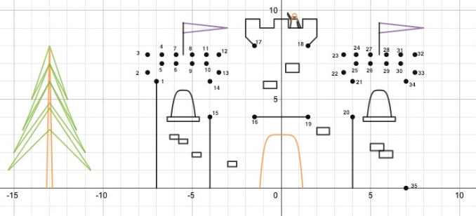
http://padlet.com/lwalsh/connectdot

Slide 9
http://www.weareteachers.com/images/default-source/default-album/m-m-arrays.jpg?sfvrsn=0

Slide 10
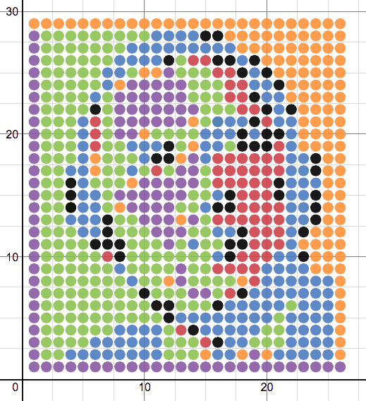
https://www.desmos.com/calculator/g1ty27ovzk

Slide 11
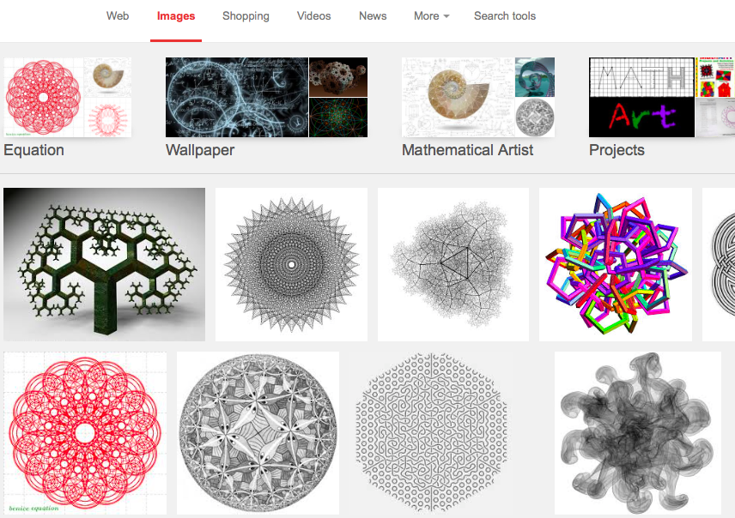

Slide 12
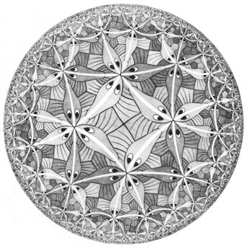

Slide 13
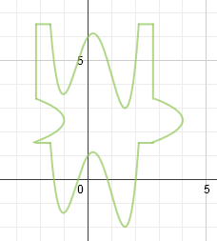
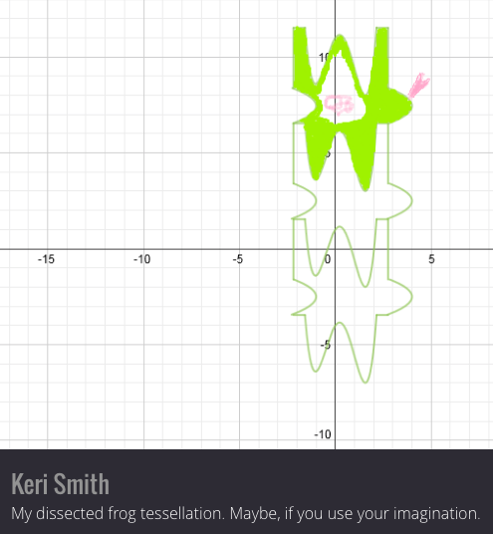
“My dissected frog tessellation. Maybe, if use your imagination.”
http://padlet.com/lwalsh/vzlplg5w4o/wish/7237516

Slide 14
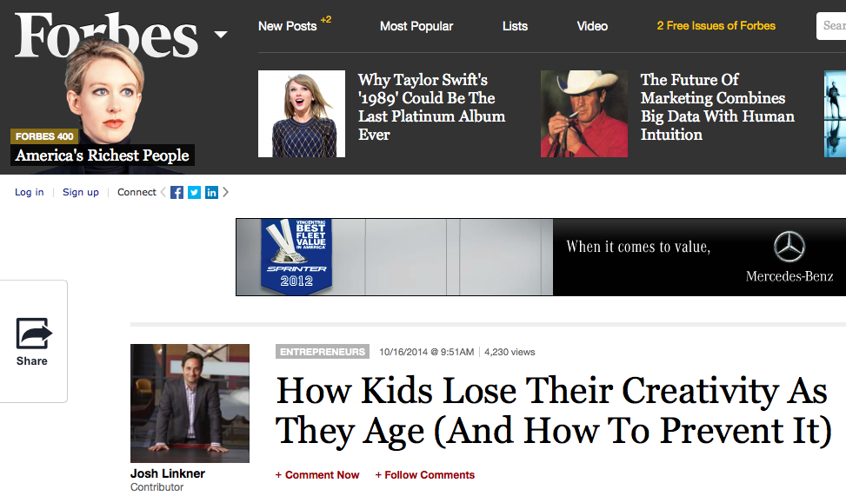
http://www.forbes.com/sites/joshlinkner/2014/10/16/how-kids-lose-their-creativity-as-they-age-and-how-to-prevent-it/

Slide 15
http://www.forbes.com/sites/joshlinkner/2014/10/16/how-kids-lose-their-creativity-as-they-age-and-how-to-prevent-it/

Slide 16
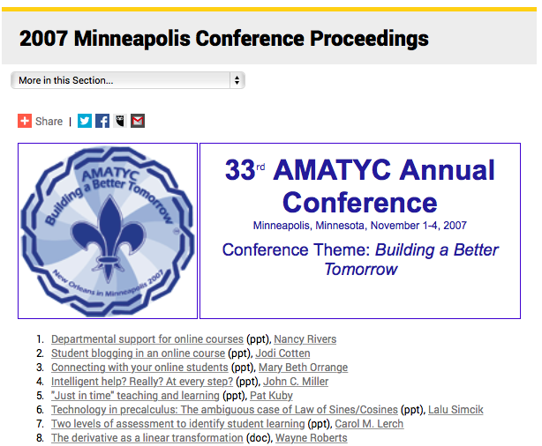
https://amatyc.site-ym.com/?page=2007ConfProceedings

Slide 17
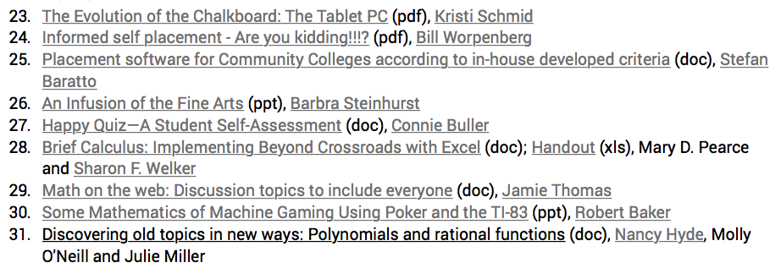

Slide 20
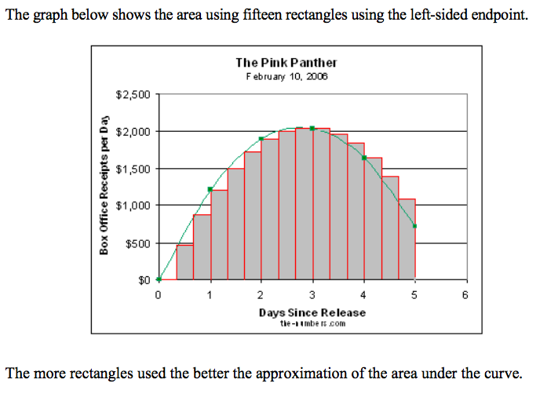
Riemann Sums in Excel - 2007
Mary Pearce and Sharon Welker - Wake Tech Community College

Slide 21
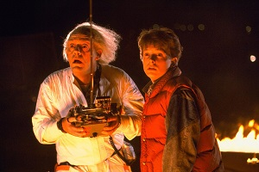
Where do you want to go ColoMATYC Marty?
Long Beach, CA...1996!

Slide 22
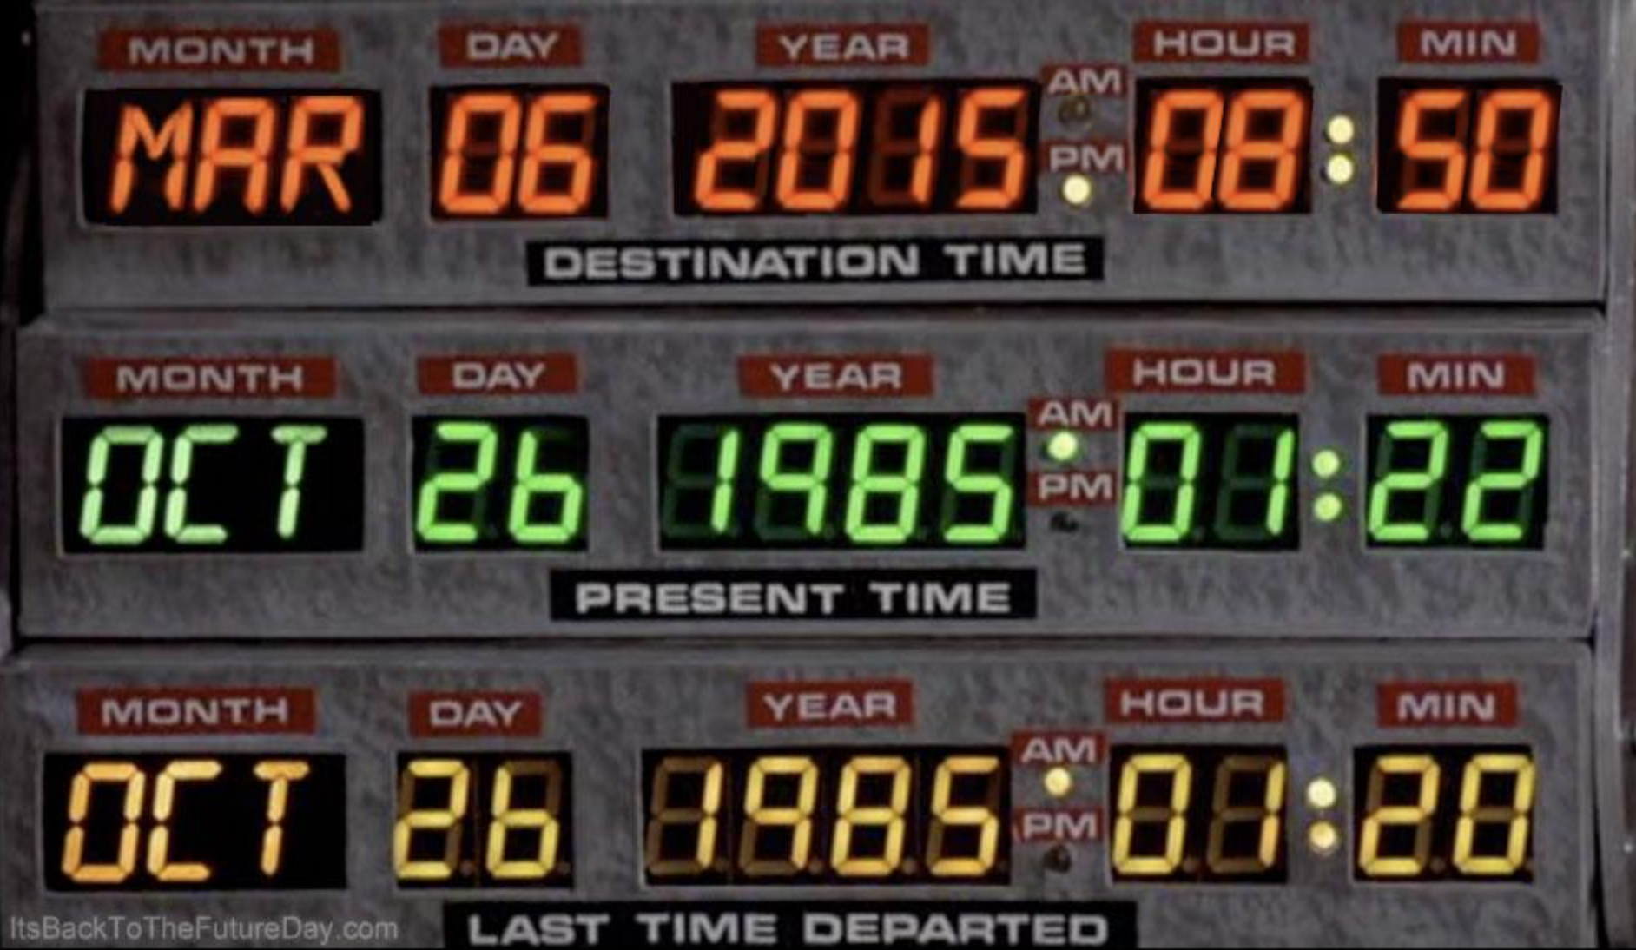

Slide 23
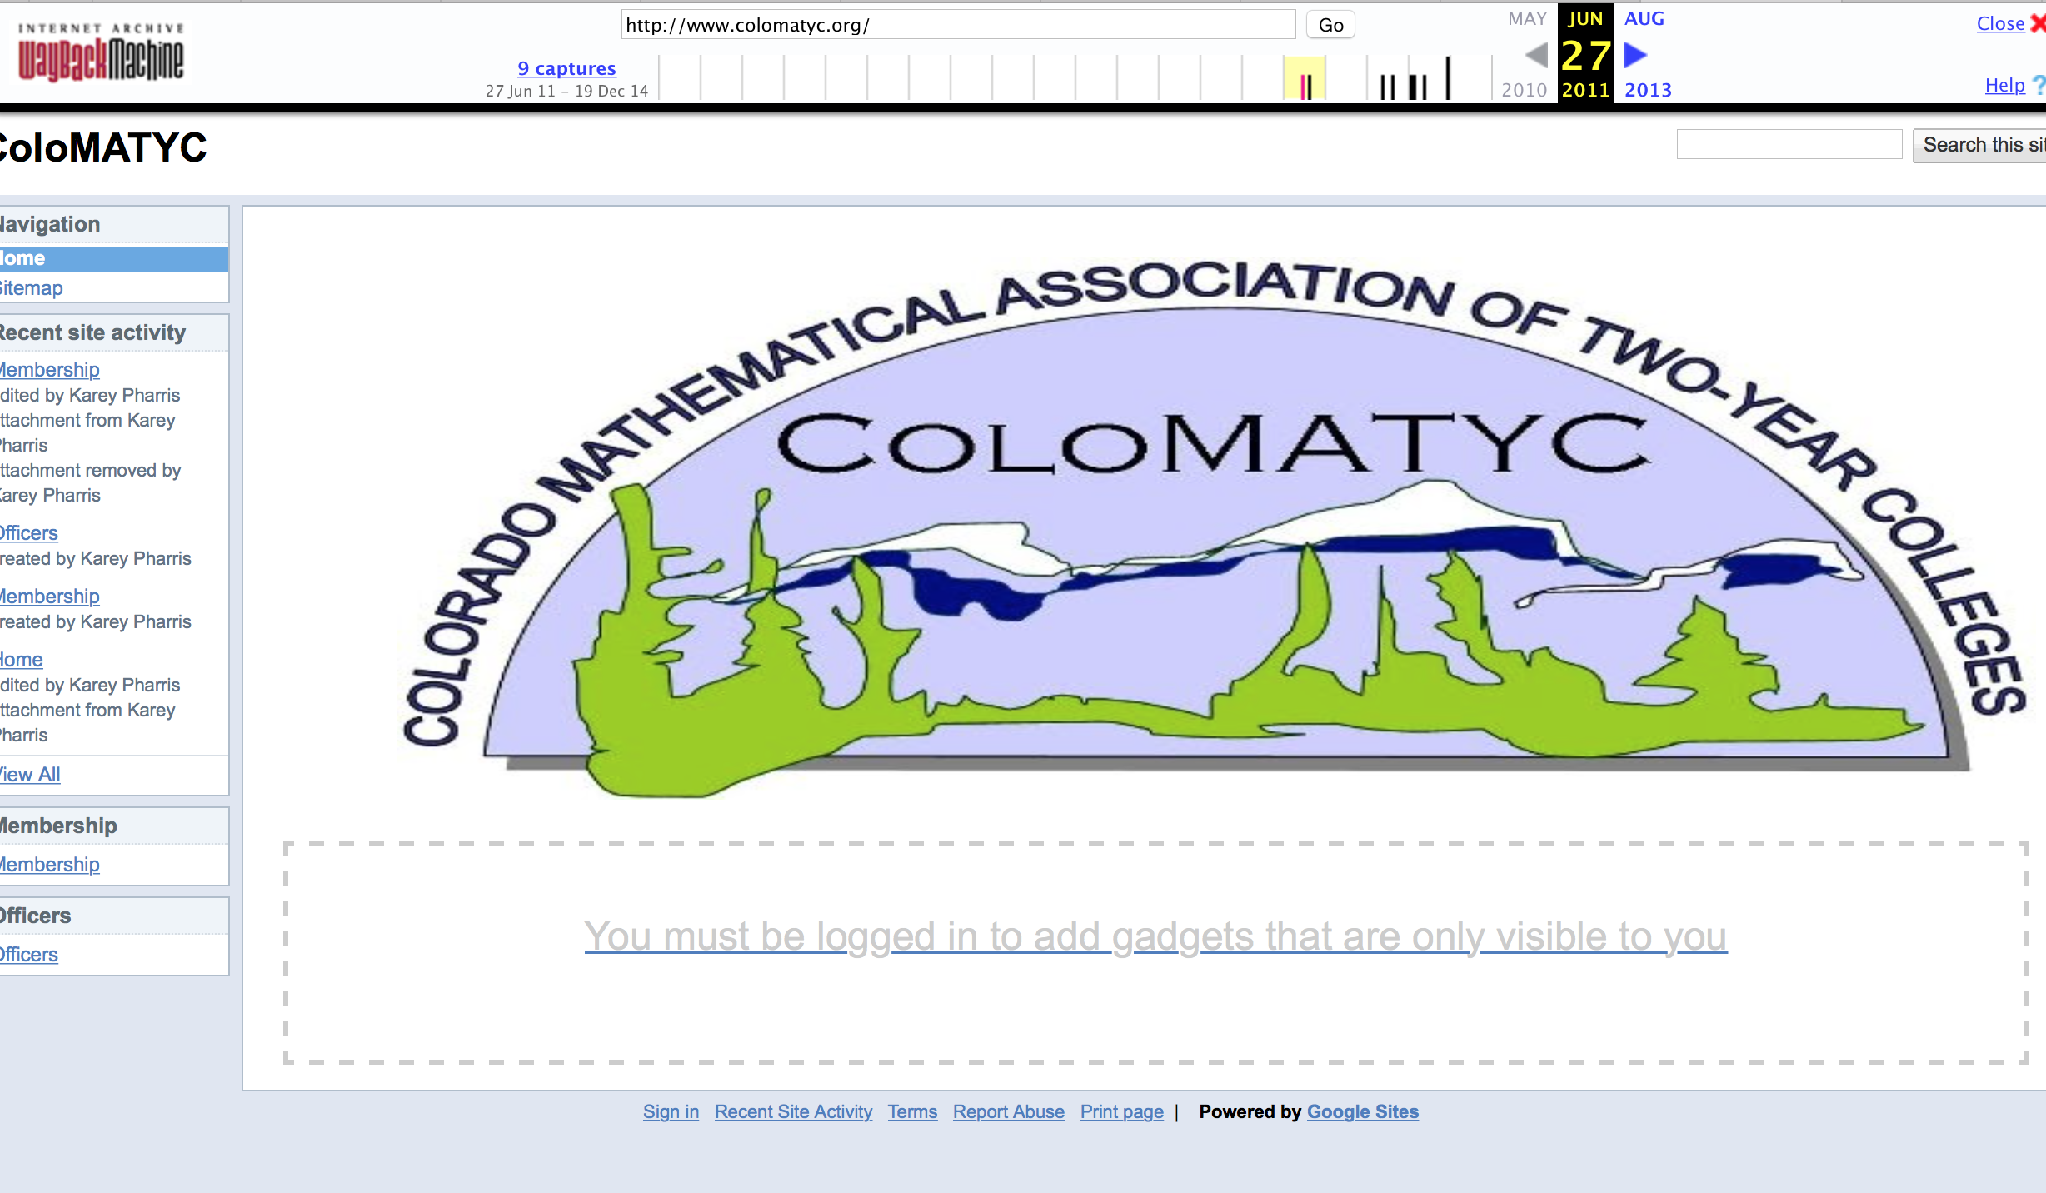
August 2011

Slide 24
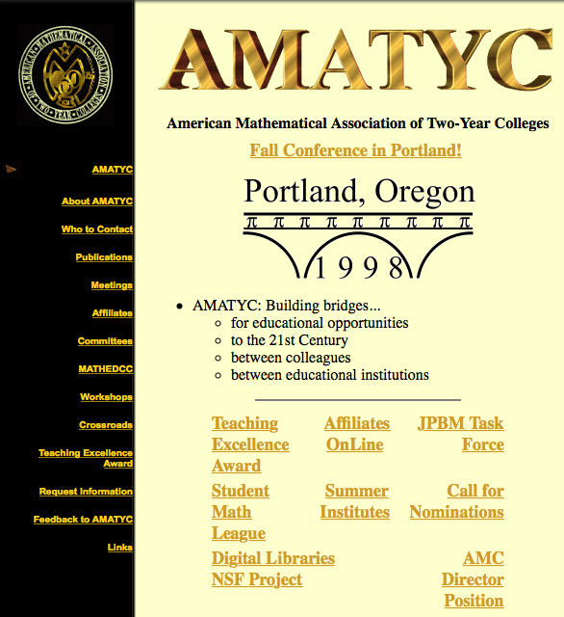
https://web.archive.org/web/19980506050624/http://www.amatyc.org/

Slide 27
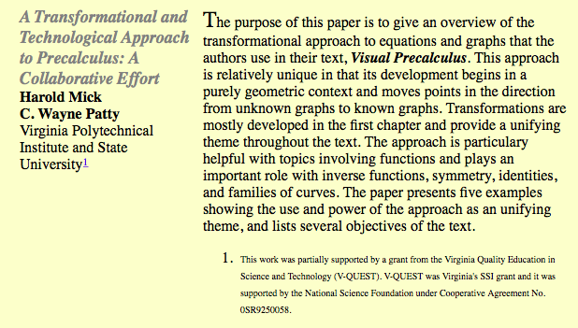

Slide 28
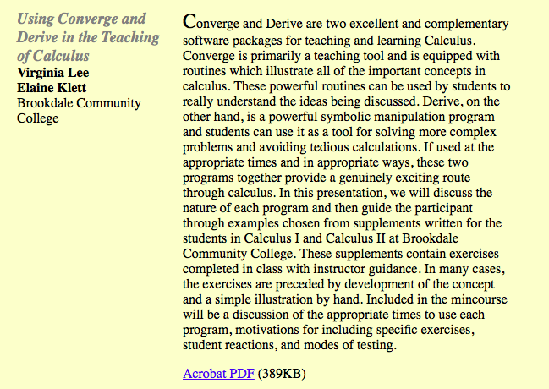
“....which illustrate all of the important concepts in calculus.”

Slide 29
Art of Mathematics from the 90’s

Slide 30
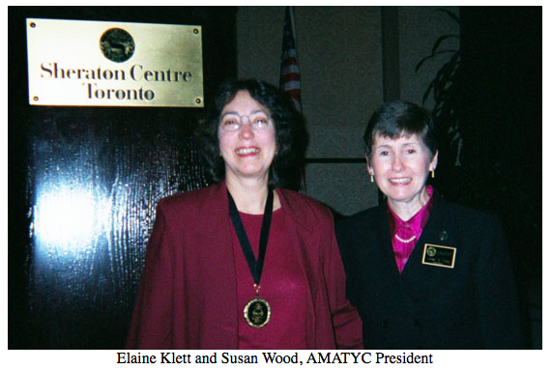

Slide 31
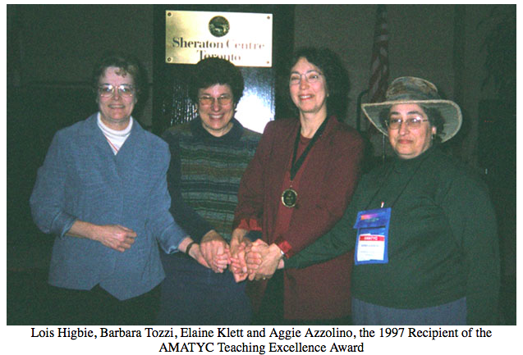

Slide 32
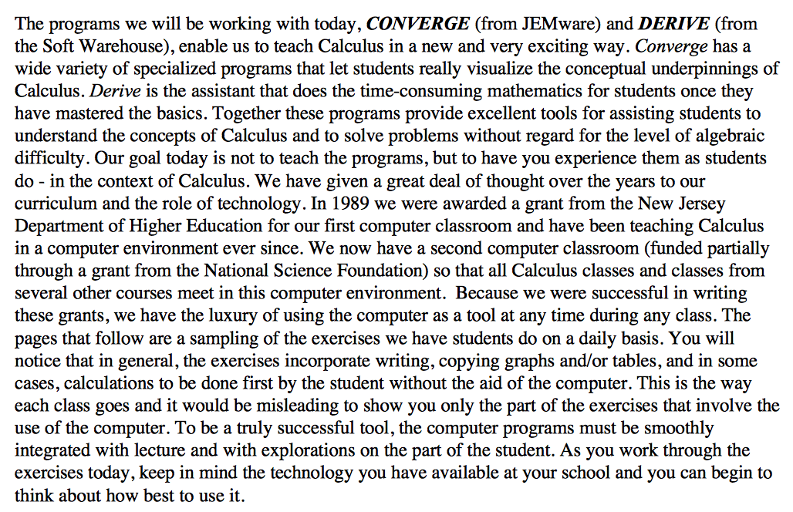
“In 1989 we were awarded a grant from the New Jersey Department of Higher Education for our first computer classroom and have been teaching Calculus in a computer environment ever since.”
https://web.archive.org/web/20050312032331/http://www.amatyc.org/Proceedings/LongBeach22/Lee.pdf

Slide 33
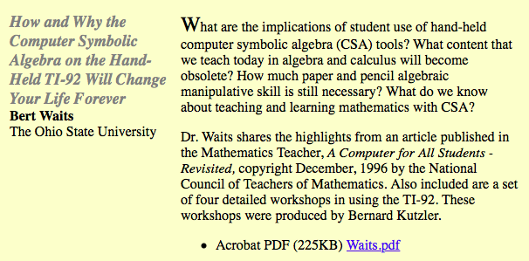

Slide 34
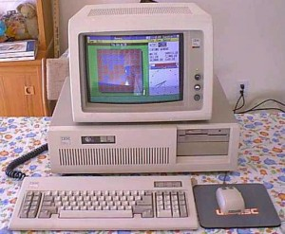
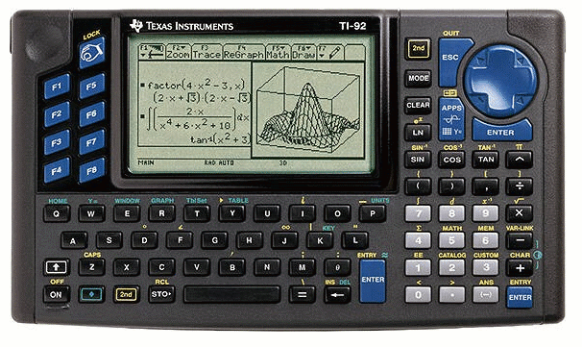
http://www.rentcafe.com/blog/apartmentliving/dorm-life-has-changed-since-1992/

Slide 35
20 years later - those student’s children are waiting for us?

Slide 36
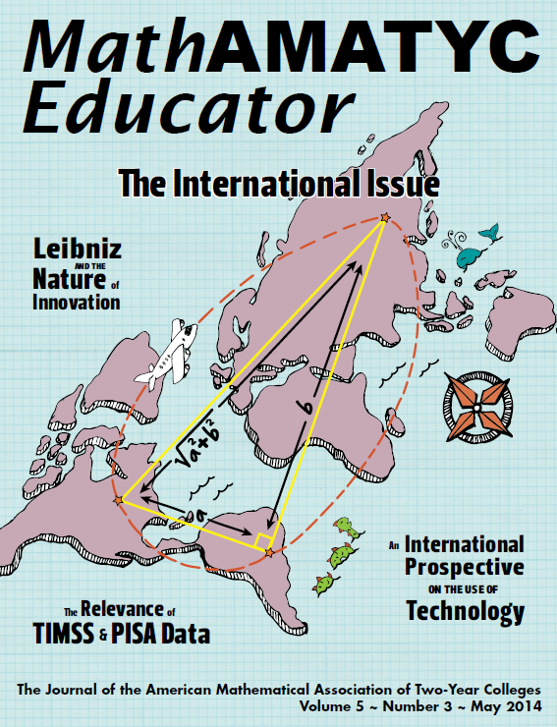

Slide 38
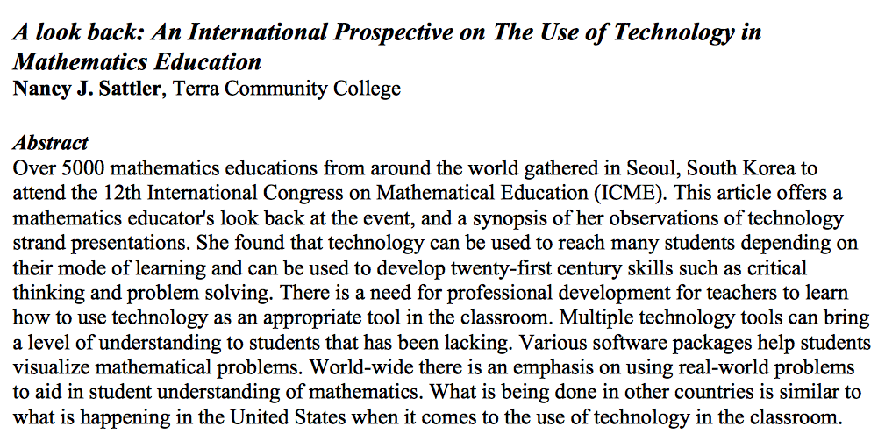
“Multiple technology tools can bring a level of understanding to students that has been lacking. Various software packages help students visualize mathematical problems.”

Slide 41
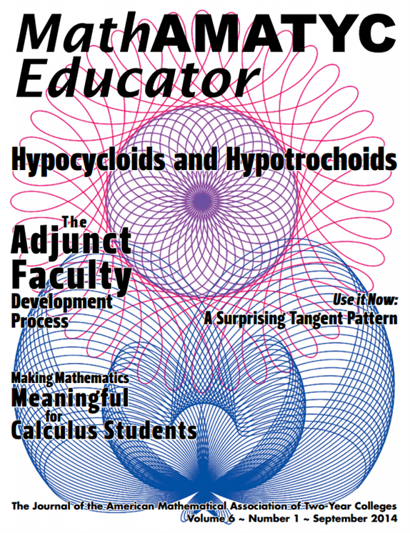
Art of Mathematics?
Mathematical Art?

Slide 42
http://nathanfriend.com/inspirograph/

Slide 43
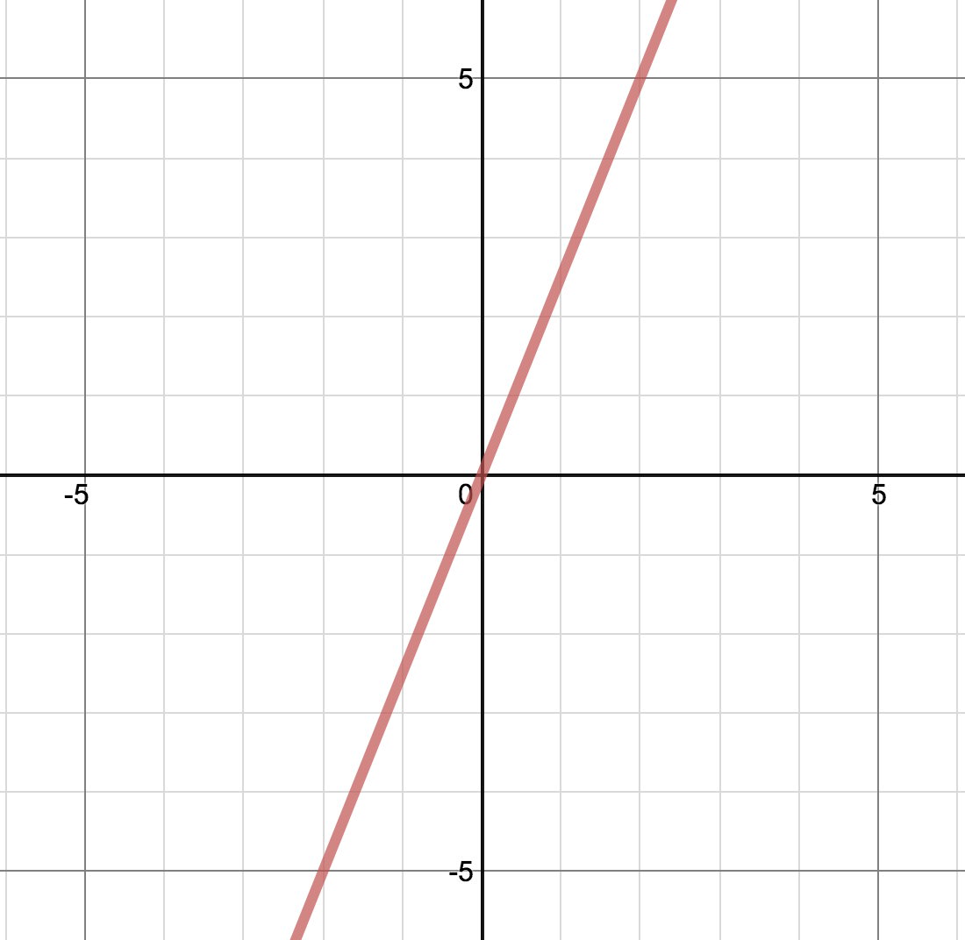
Art of linear equations?

Slide 44
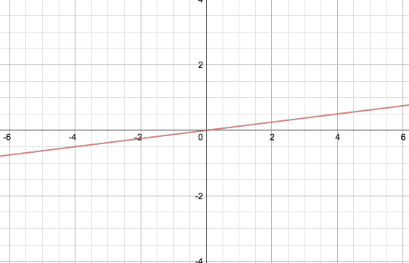
More visual?
Art of mathematics?

Slide 45
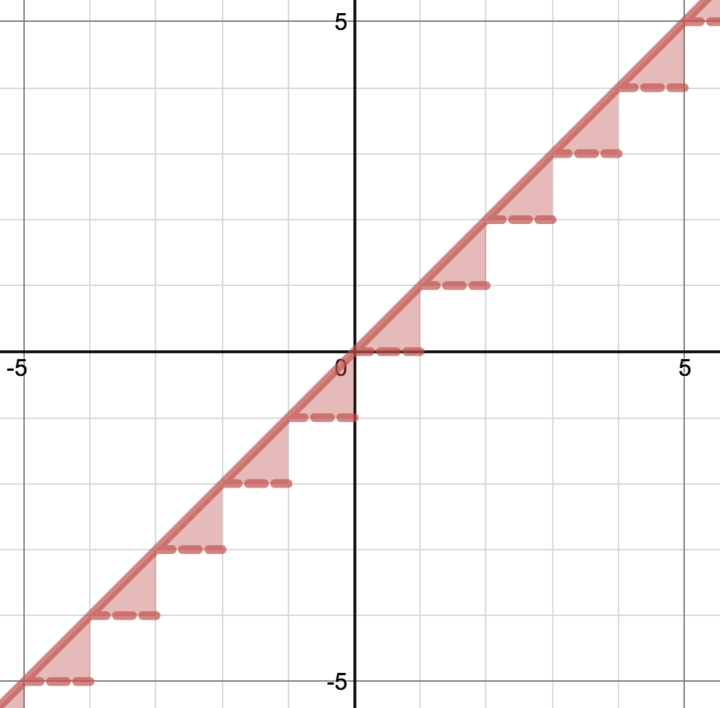
More visual?
But why?

Slide 46
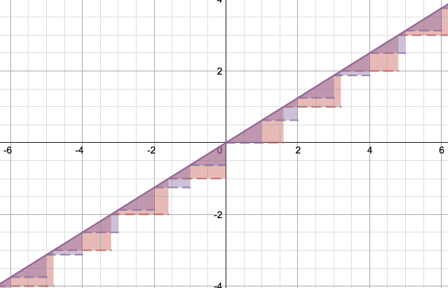
Just a fancy show of a linear equation?
A visual to help students learn?
https://www.desmos.com/calculator/msp7rqw0xk

Slide 47
WOW!
Ooooo!
Ahhhh!
Cool!
What will students learn from this art?
Art of Mathematics

Slide 48
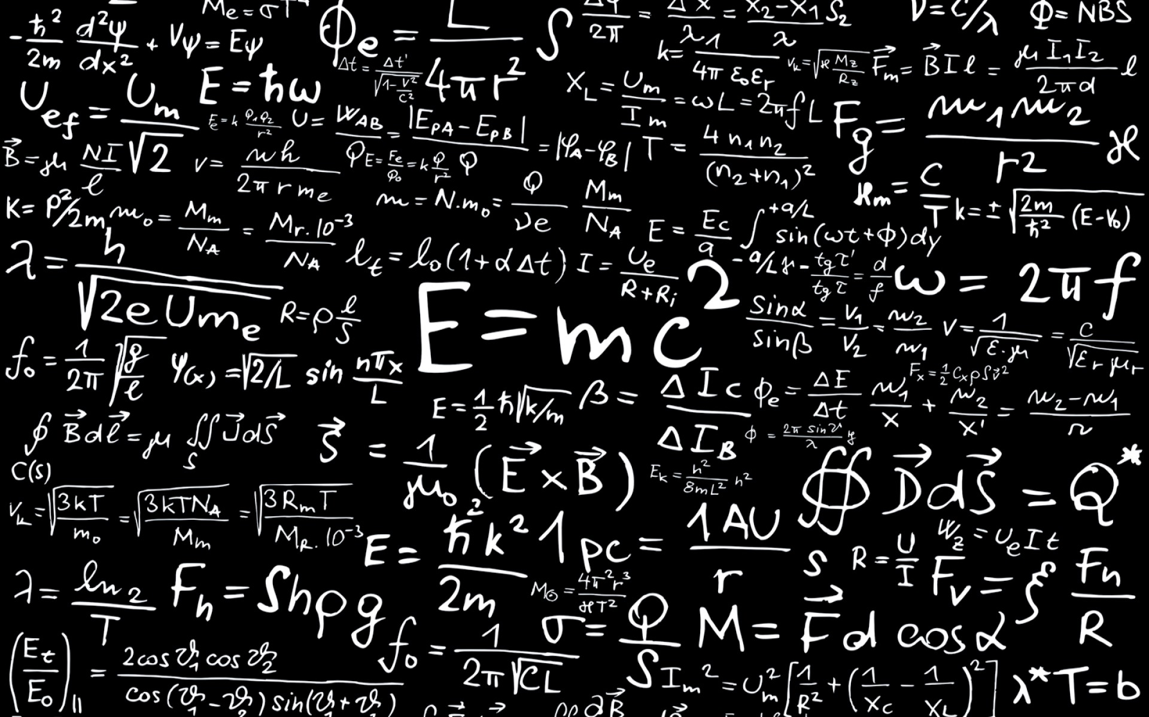
The writing is not on the wall...

Slide 49
The art of math is on the wall.
What will you visualise on the wall?

Slide 50
Back to the Future:
How the Math of the Past Looked Better Than Today
Luke Walsh - Catawba Valley CC - North Carolina
lwalsh@cvcc.edu | @lukeselfwalker
http://shethinksifactorsexy.wordpress.com

