Slide 1
Intro to Statistics –
An Active Learning Redesign
Stephanie Beck
Mathematics Faculty
Front Range Community College – Boulder County Campus

Slide 2
“At the beginning level, statistics should not be presented as a branch of mathematics. Good statistics is not equated with mathematical purity or rigor, but is more closely associated with careful thinking.”
Robert V. Hogg (1991) Statistical Education: Improvements are Badly Needed, The American Statistician, 45:4, 342-343, DOI: 10.1080/00031305.1991.10475832

Slide 3
GAISE College Report 2016
Full Report Available at https://www.amstat.org/asa/files/pdfs/GAISE/GaiseCollege_Full.pdf

Slide 4
Guidelines for Assessment and Instruction in Statistics Education (GAISE) College Report
Published in 2016
Rationale
  More students are studying statistics.
  Many students are exposed to statistical thinking in grades 6 – 12.
  The rapid increase in available data has made the field of statistics more salient.
  More and better technology options for education have become widely available.
  Alternative learning environments have become more popular.
  Innovative ways to teach the logic of statistical inference have received increasing attention.

Slide 5
Gaise Recommendations
1. Teach statistical thinking.
    Teach statistics as an investigative process of problem-solving and decision-making.
    Give students experience with multivariable thinking.
  2. Focus on conceptual understanding.
  3. Integrate real data with a context and purpose.
  4. Foster active learning.
  5. Use technology to explore concepts and analyze data.
  6. Use assessments to improve and evaluate student learning.

Slide 6
Active Learning Institute

Slide 7
FRCC’s
Active Learning Institute offers faculty and instructors a chance to work hard with a cohort of like-minded colleagues—in order to redesign their classes around evidence-based instructional strategies.
Participants in the institute meet for nine two-hour sessions over the course of one semester.
All nine sessions are learner-centered and intentionally modeled around active learning strategies—giving participants the chance to experience active learning as students in the institute.
Teachers learn to:
  Prioritize learning outcomes for their students;
  Make the course content relevant to students; and
  Provide students with sufficient, guided practice for the desired outcomes.
Hosted by Kerri Mitchell and Eric Salahub (both Rhetoric, Languages and Philosophy Faculty at FRCC’s Larimer Campus)
https://blog.frontrange.edu/2019/05/08/what-is-active-learning/

Slide 8
Prioritize learning outcomes for students
Transition from “knowledge transmission” paradigm to “active learning” paradigm
Content vs. Outcomes
Merge personal outcomes with CCCNS course level outcomes

Slide 9
Make the course content relevant to students
Inter-disciplinary approach
Conscious selection of data sets
Focus on statistical thinking rather than algebraic manipulation
Emphasize use of technology (Excel primarily)
Use of discussion boards to allow students to engage each other using the language of statistics

Slide 10
Relevance
Met with faculty in other disciplines: psychology, religious studies, and geography
How do they currently use stats in their courses and/or disciplines?
What would it be helpful for students to be able to transfer outside of MAT135?
What support can mathematics faculty provide to faculty in other departments?

Slide 11
Provide students with sufficient, guided practice for the desired outcomes
Plan summative assessments (which are aligned with outcomes) in the beginning of course design
In-class activities and homework provide opportunity to practice skills and thinking necessary to do well on assessments
Institute designed to expose teachers to active learning strategies and assessment techniques
  Prior knowledge surveys, write to learn activities Frayer models, student-led lecture, etc.

Slide 12
Deliverables
Course Level Outcomes
Summative Assessments
Active Learning Lessons
Previous Syllabus and revised Active Learning Syllabus
Narrative Reflection

Slide 13
Active Learning Lessons Template
Day | Pre-work (the “homework”) ** This is work that students must complete outside of class in order to be prepared for the active learning that will then happen in class. | In-Class work (the course architecture) ** This is work that students do while in the classroom. The instructor will facilitate and guide this work, providing structured tasks that are linked to specific outcomes. | Formative Assessment (the teaching) ** Use this column to indicate where you will take a look at student learning to determine if students are meeting your identified outcomes. Indicate here how you will check in, and where you will provide guidance and just-in-time teaching if they need it.
Day #1 | Pre-work Outcomes: What objectives or outcomes will the pre-work address? What content knowledge will it allow students to build and what skills or abilities will it encourage students to practice? Pre-work: What will students do before coming to the next class to prepare for class? | Lesson Outcomes: What specific outcomes will students have the opportunity to meet during this class? What broader, overall course outcomes does this lesson support? Content Connections: What content connections will students need to build during this class in order to promote their understanding and application of the material at hand? How will they make these content connections during class? Practice: What practice will students have the opportunity to engage in during this class period so that they can obtain the content knowledge and skills needed to meet the lesson and course outcomes? | Formative Assessment: What sorts of formative assessment will you do here, and why? Formative Feedback: What sorts of formative feedback will you offer during class and outside of class, and why?

Slide 14
AMATYC Recap

Slide 15





Slide 16
Equity and Statistics Focus
Keynote Francis Su “Mathematics for Human Flourishing”
Featured speaker John Urschel “The Equity Equation: Closing the Gap in Today’s Math Classroom”
Themed Session: Engaging Introductory Statistics Students with Real Data
18 talks specific to statistics with many more highlighting tech tools

Slide 17
Ask Good Questions Blog
Talk titled, “Teaching Introductory Statistics : Ask Good Questions” by Allan Rossman from Cal Poly- San Luis Obispo
30 years of introductory statistics teaching experience
Weekly blog posts including detailed activities, questioning strategies, and test questions
https://askgoodquestions.blog

Slide 18
New York Times
“What’s Going on in this graph?
NYT bi-weekly posts challenge students to answer three questions:
What do you notice? If you make a claim, tell us what you noticed that supports your claim.
What do you wonder? What are you curious about that comes from what you notice in the graph?
What’s going on in this graph? Write a catchy headline that captures the graph’s main idea.
Talk titled “Data Moves” by Robert Gould
“Data cleaning is statistical thinking.”

Slide 19
Statprep little apps
StatPREP Little Apps are designed to let students explore specific statistical techniques in the context of data.
http://statprep.org/little-apps/
https://dtkaplan.shinyapps.io/LA_linear_regression/

Slide 20

Codap
Common online data analysis platform
Talk titled “Analyzing and Redesigning Tasks to Promote Statistical Inference,” by Asli Mutlu from Wake Tech
CODAP is (and always will be) free and open source.
CODAP is data science software built for education by experienced learning scientists and open source software developers, and funded by grants from the National Science Foundation.
https://tinyurl.com/AMATYC-2019-Stat-Session
https://codap.concord.org/

Slide 21
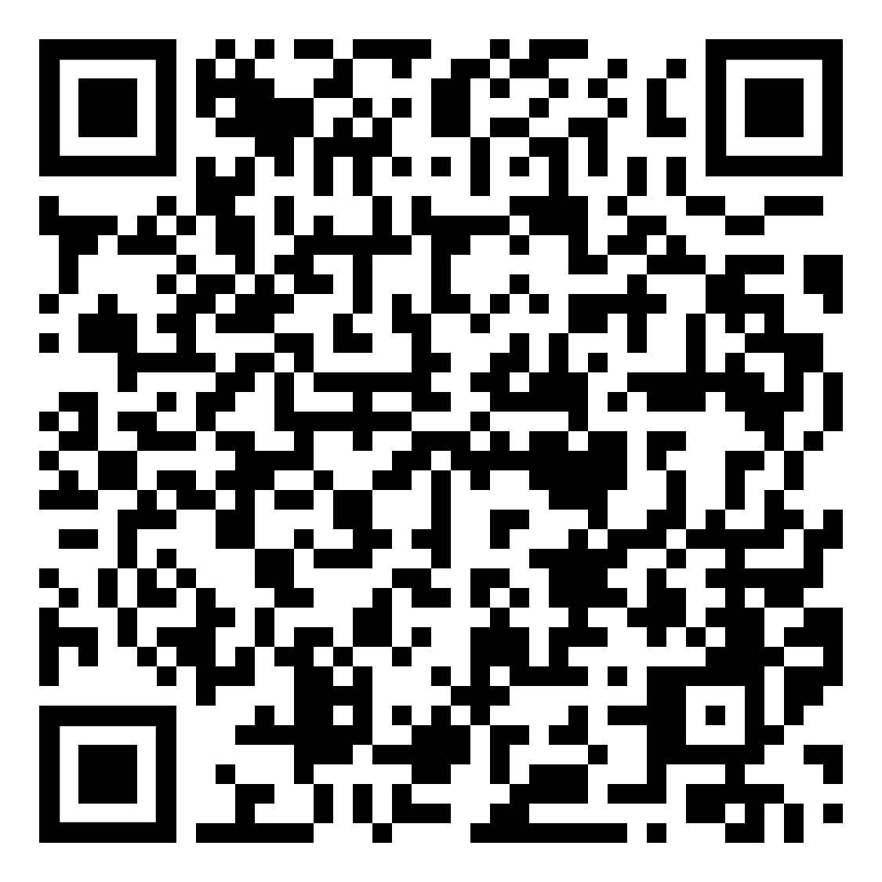
Real-life data collection
Mentioned in a number of talks
Increase buy-in for students by using data they can relate to because they collected themselves
  Conduct probability experiments
  First Day Survey
Use technology to gather in real-time
  GoogleSheets or GoogleDocs
  https://docs.google.com/spreadsheets/d/1XfJu58bbmxKlz3hRwvduxkxGzK6HSslf_3gX4ALW3bA/edit?usp=sharing

Slide 22
Great Apps for your Tech Toolbox
Remind App
Quizziz
Socrative
Plickers
Kahoot!
The Answer Pad
Symbolab
Genius Scan
Live Binders

Slide 23
Implementation

Slide 24
Revised Syllabus
In “The New Science of Learning: How to Learn in Harmony With Your Brain,” Terry Doyle and Todd Zakrajsek describe what it means to learn:
“Neuroscience researchers have made it clear that learning is an active process and learning takes work. The more work you do with something that you are learning, and the more ways you engage with it- such as listening, talking, reading, writing, reviewing, or thinking about it- the stronger the connections in your brain become and the more likely the new learning will become a more permanent memory.”
Communicate with students the intent of switching to an active learning model.
Revise grade breakdown to incentivize active participation
Clearly describe expectations, in particular related to class preparation

Slide 25
Personal Course Outcomes:
Communicate using the language of statistics with confidence and appropriate terminology.
Analyze and create numerical summaries and graphical displays of sample data with and without technology.
Analyze bivariate data by applying the concepts of correlation and regression.
Apply the basic rules of probability.
Utilize the appropriate probability distribution.
Utilize technology to further statistical understanding and reasoning and to create/communicate inferences about data sets.
Demonstrate problem-solving and analytical skills to apply appropriate tools/processes/formulas given a particular data set/situation.
Gain curiosity and awareness about data.
Develop statistical literacy.

Slide 26
Elements of Course
Class Preparation
      Assignments with videos on MyMathLabs+
In-Class Activities
      Variety of formats, inquiry-based
      Submitted after each class for feedback
Bi-weekly Discussions
      Using discussion boards on D2L
      Use discussion rubric for scoring
Projects (four throughout semester)
      Open-ended, student guided
Tests (four throughout the semester, all cumulative)

Slide 27
No Lecture?
A student-centered instructional approach places less emphasis on transmitting factual information from the instructor, and is consistent with the shift in models of learning from information acquisition (mid-1900s) to knowledge construction (late 1900s). This approach includes
  more time spent engaging students in active learning during class;
  frequent formative assessment to provide feedback to students and the instructor on students’ levels of conceptual understanding; and
  in some cases, attention to students’ metacognitive strategies as they strive to master the course material.
— Discipline-Based Education Research: Understanding and Improving Learning in Undergraduate Science and Engineering, S. R. Singer, N. R. Nielsen, and H. A. Schweingruber (eds.), National Research Council, The National Academies Press, 2012

Slide 28
Stats in the world Discussions
Discussion Topics:
#1: Perception vs. Reality
#2: What’s going on in this graph? NYT
#3: Misleading Graphs
#4: How likely is “likely”? Chance of Rain.
#5: Newspaper/Magazine Article Critique
#6: Community Event Use of Statistics.
#7: Spurious Correlations

Slide 29
Open-Ended Student projects
Global Issue Project
  Use visualization of real data to create a picture of a global issue
Campus Issue Project
  Design a sample and use real data with descriptive statistics to answer a question about students’ peer population
Discipline Specific Project (broken into two parts)
  Inferential statistics in the context of discipline of each student

Slide 30
Takeaways

Slide 31
If students Take ownership, they will surprise us!
Student participation in Discussions has been astonishing!
First two student-led projects have been fantastic!
The quality of questions and evidence of curiosity about data has also been really promising!

Slide 32
OER
Increase accessibility and minimize cost barrier
Long-term access for use in future courses
Any recommendations?

Slide 33
Switching to Remote?
Plan to increase use of applets for student investigation
Video conferencing (Zoom with GoogleDocs?)
Requiring video check-in as part of remaining projects
Other ideas?

