Slide 1
Community College of Denver
Teresa adams| Mathematics department

Slide 2
Emerging insights about Dev Ed reforms at CCD

Slide 3
Internal and external motivations drove adoption of new Dev Ed instructional model

Slide 4
CCD exists in an ecosystem generally supportive of Dev Ed reforms, with some factors partially offsetting

Slide 5
Dev Ed reforms at CCD reflect significant compression while moving to pathways

Slide 6
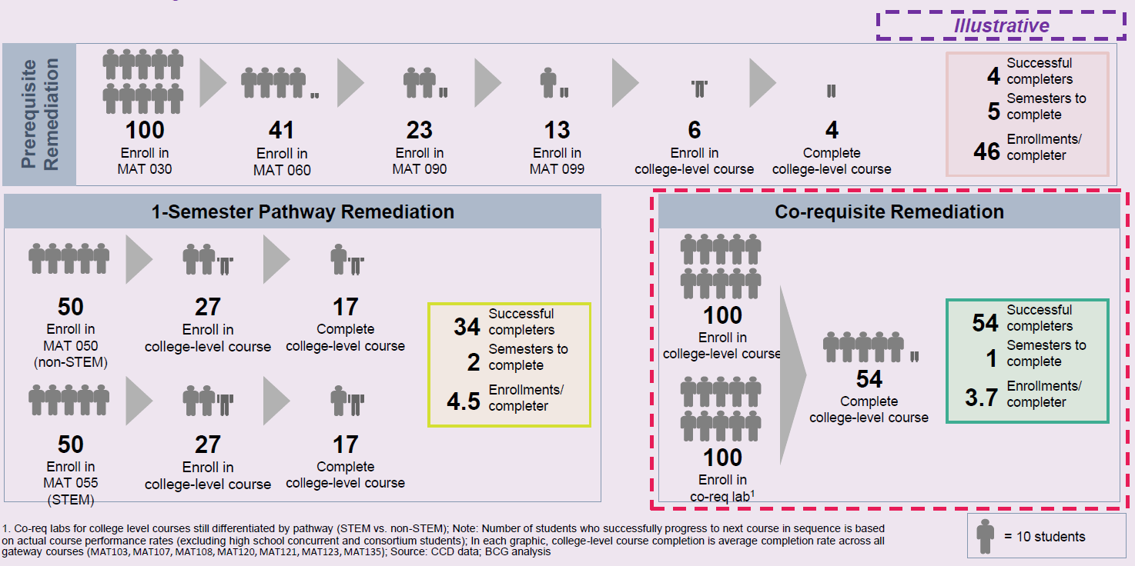
Co-req remediation increases completion and increases efficiency of remediation for students and institutions

Slide 7
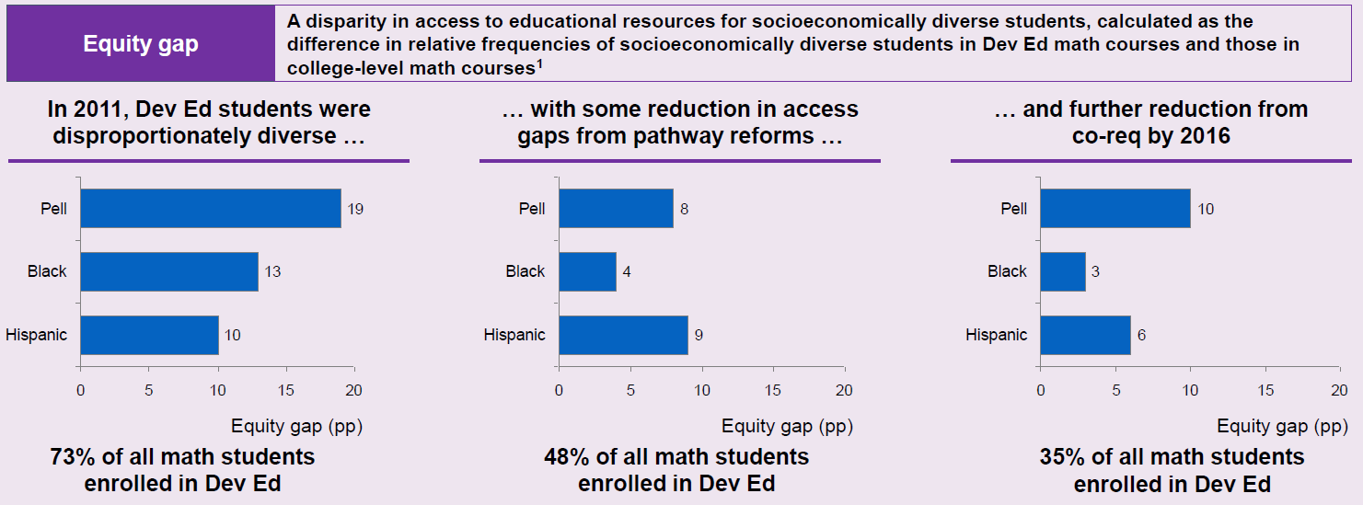
CCD Dev Math reforms have reduced equity gaps across demographic groups since 2011
1. For example, in 2011 Pell students made up 79% of Dev Math students but only 60% of college-level math students, resulting in an equity gap of 19pp; an equity gap close to 0 means that the demographics of Dev Ed courses mirror those of college-level courses and therefore there is no inequitable access to education; Source: CCD data; BCG analysis

Slide 8
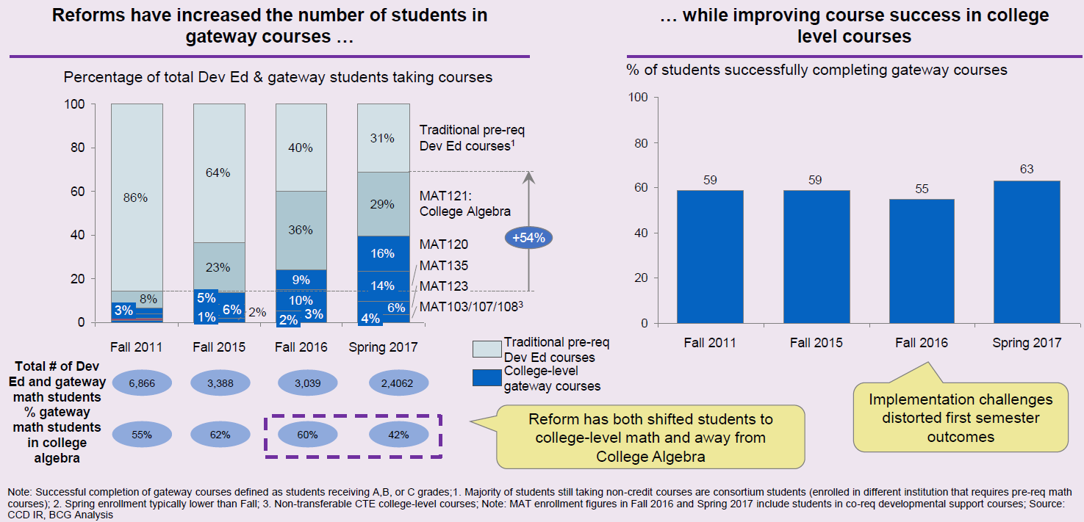
Reforms have successfully shifted enrollment mix and accelerated credit accumulation for students

Slide 9
Reforms enabled Dev Ed students to accelerate time to degree with substantial cost savings implications

Slide 10
Initial Co-req design
CCD started offering co-req courses in Fall 2015 for College Algebra only. Students had to place into the course or the student received a “C” in a pre-req Dev Ed math course.
Fall of 2016 CCD went to scale on co-reqs for all college gateway math courses. CDD stopped requiring students to take placement exams.
MAT 025 Model – our Pre-Algebra co-req course
Meet after MAT class
Linked classes
Study hall
Work on homework
May be taught by the same instructor
Students graded on 50% attendance, 50% some sort of graded assignment – wasn’t specified

Slide 11
Co-req design Spring 2017 and moving forward for college gateway math courses
Moved to focus on Pre-Algebra (MAT050/055) skills
Online Integrated review from the publisher
Approximately 50% of the students in the college level course enroll
Linked classes
Meets BEFORE MAT course
Typically taught by same instructor
Reteach most difficult Pre-Algebra skills
Just in Time Remediation through activates, Mini lectures and Supplemental Review of Developmental Math Topics
Vocabulary is emphasized
Students graded on 25% attendance, 25% online integrated review, 50% worksheets/handouts
When reforms were first announced, “faculty told me, 'I don't want to do co-req remediation, but I'll try it out of respect for you.' Now faculty are saying, 'Those lab students are the leaders in my lectures; instead of keeping us behind they are leading us forward.'" – Math Department Chair
"As long as we focus on students, we can get faculty buy-in" – Math Department Chair

Slide 12
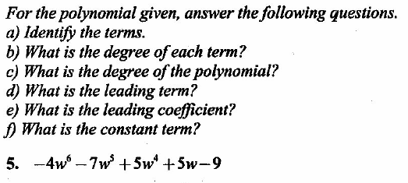
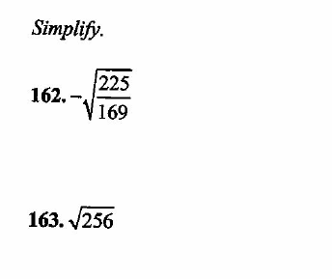
Students work on online intergraded review:

Slide 13
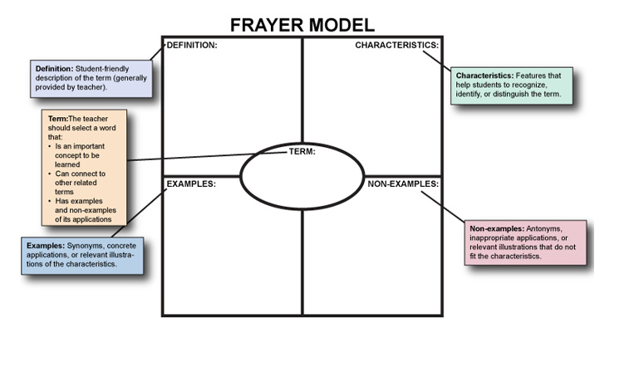
Students work on vocabulary:

Slide 14
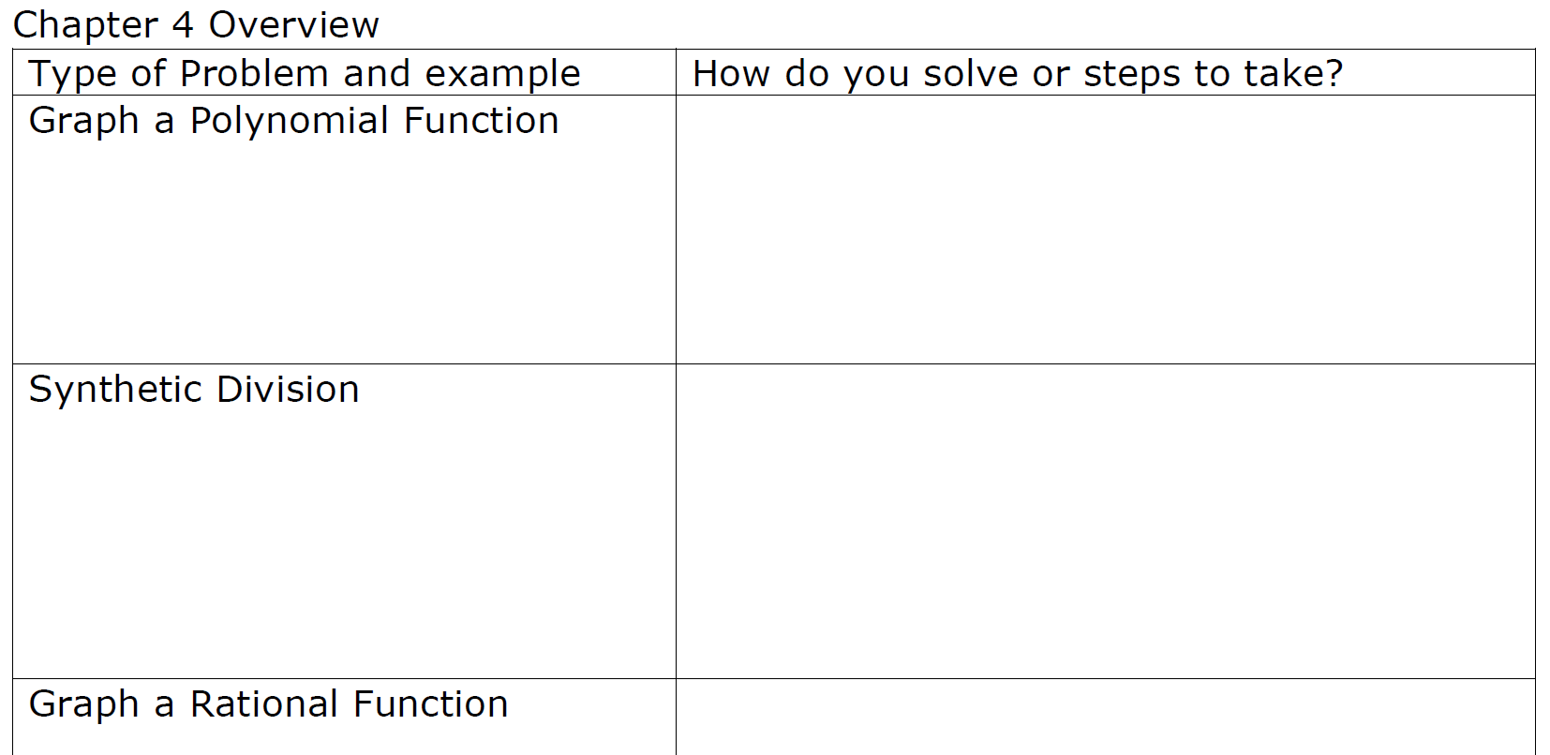
Students work on review guides

Slide 15
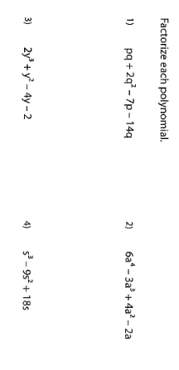
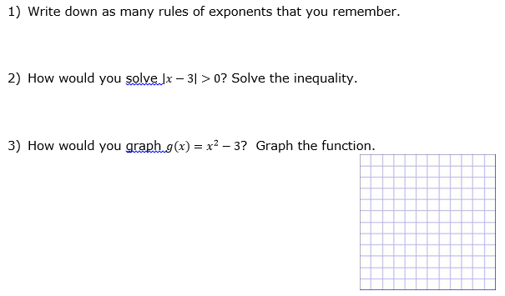
Students work on Just in Time Remediation worksheets

Slide 16
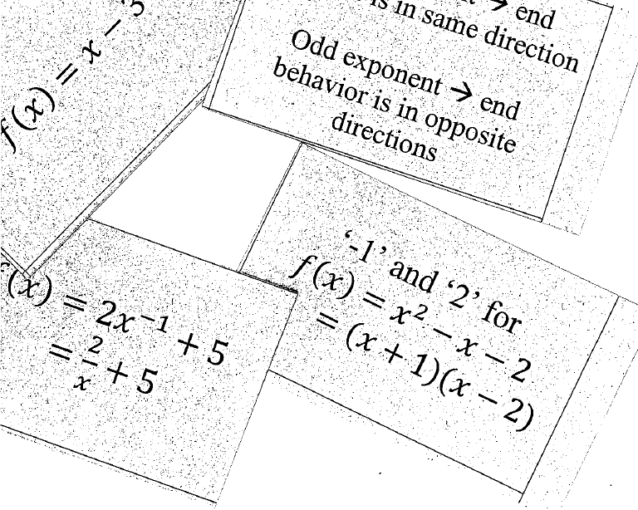
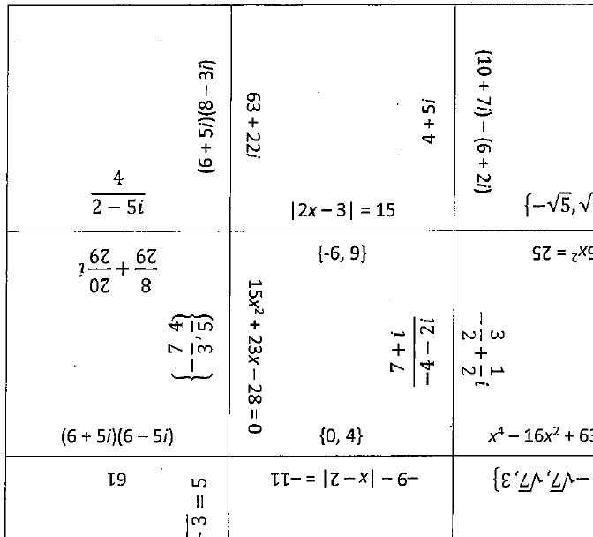
Students work on Tactivites

