Slide 1

lumen learning mission:
Enable Unprecedented Learning for
All Students
Howard HS of Technology by US Department of Education
CC BY 2.0 / color overlay on original

Slide 2

Why do we exist?
What specifically do we do?
How can we work together?
Photo by AbsolutVision on Unsplash

Slide 3

Empowering faculty and students
to be highly successful
10% less state funding for higher education
67% of students go without a textbook
48% take fewer courses due to textbook cost
50% of faculty say it’s too hard to find OER
76% of faculty members are contingent labor
Photo by James Sutton on Unsplash

Slide 4


Founded in 2012, growing out of Gates Foundation-funded grant projects
Digital courseware used by 2,000 faculty at 350+ institutions
260,000 students saved more than $30 million in 2019
Content accessed by 75 million independent learners in 2019
Photo by Mark Autumns on Unsplash

Slide 5

What Lumen Does
What’s different about Lumen?
Evidence-based learning design
Built for accessibility
Seamlessly embedded in LMS
Continuously improving OER content
Outstanding faculty support
Simple to Adopt Digital Courseware
50+ high-enrollment courses
$25/student/course
Photo by Monica Melton on Unsplash

Slide 6
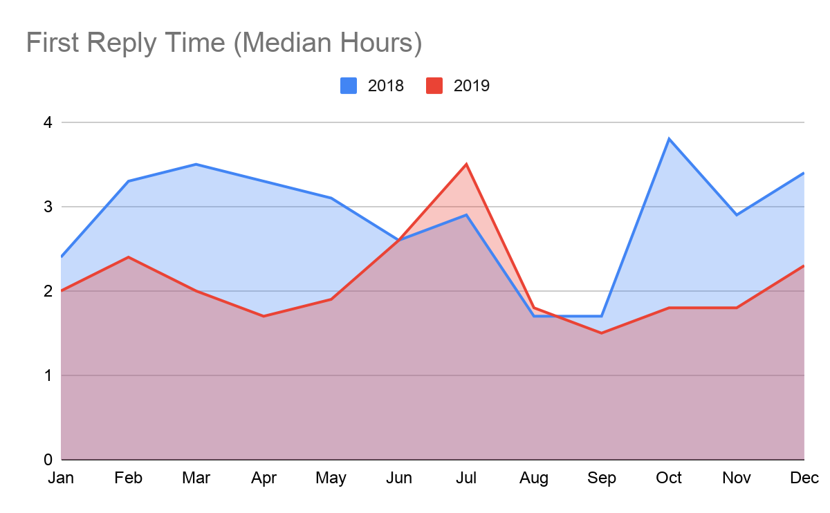
Outstanding Customer Support
2019 customer support satisfaction rating
97%
2019 Uptime
Waymaker
99.9%
2019 Uptime
OHM
99.9%
First Response Time 2019 Median
2.1 hours

Slide 7
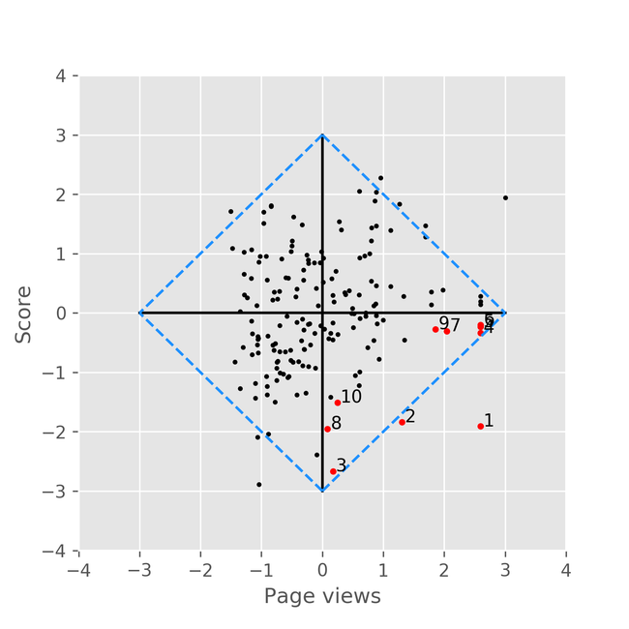
Continuous Improvement
Using Learning Outcome Analysis with OER
Identify poor-performing outcomes
Evaluate content and assessments aligned with these outcomes
Improve OER content
Measure effectiveness
Strong Learning +
Low Content Usage
Strong Learning +
High Content Usage
Weak Learning +
Low Content Usage
Weak Learning +
High Content Usage

Slide 8
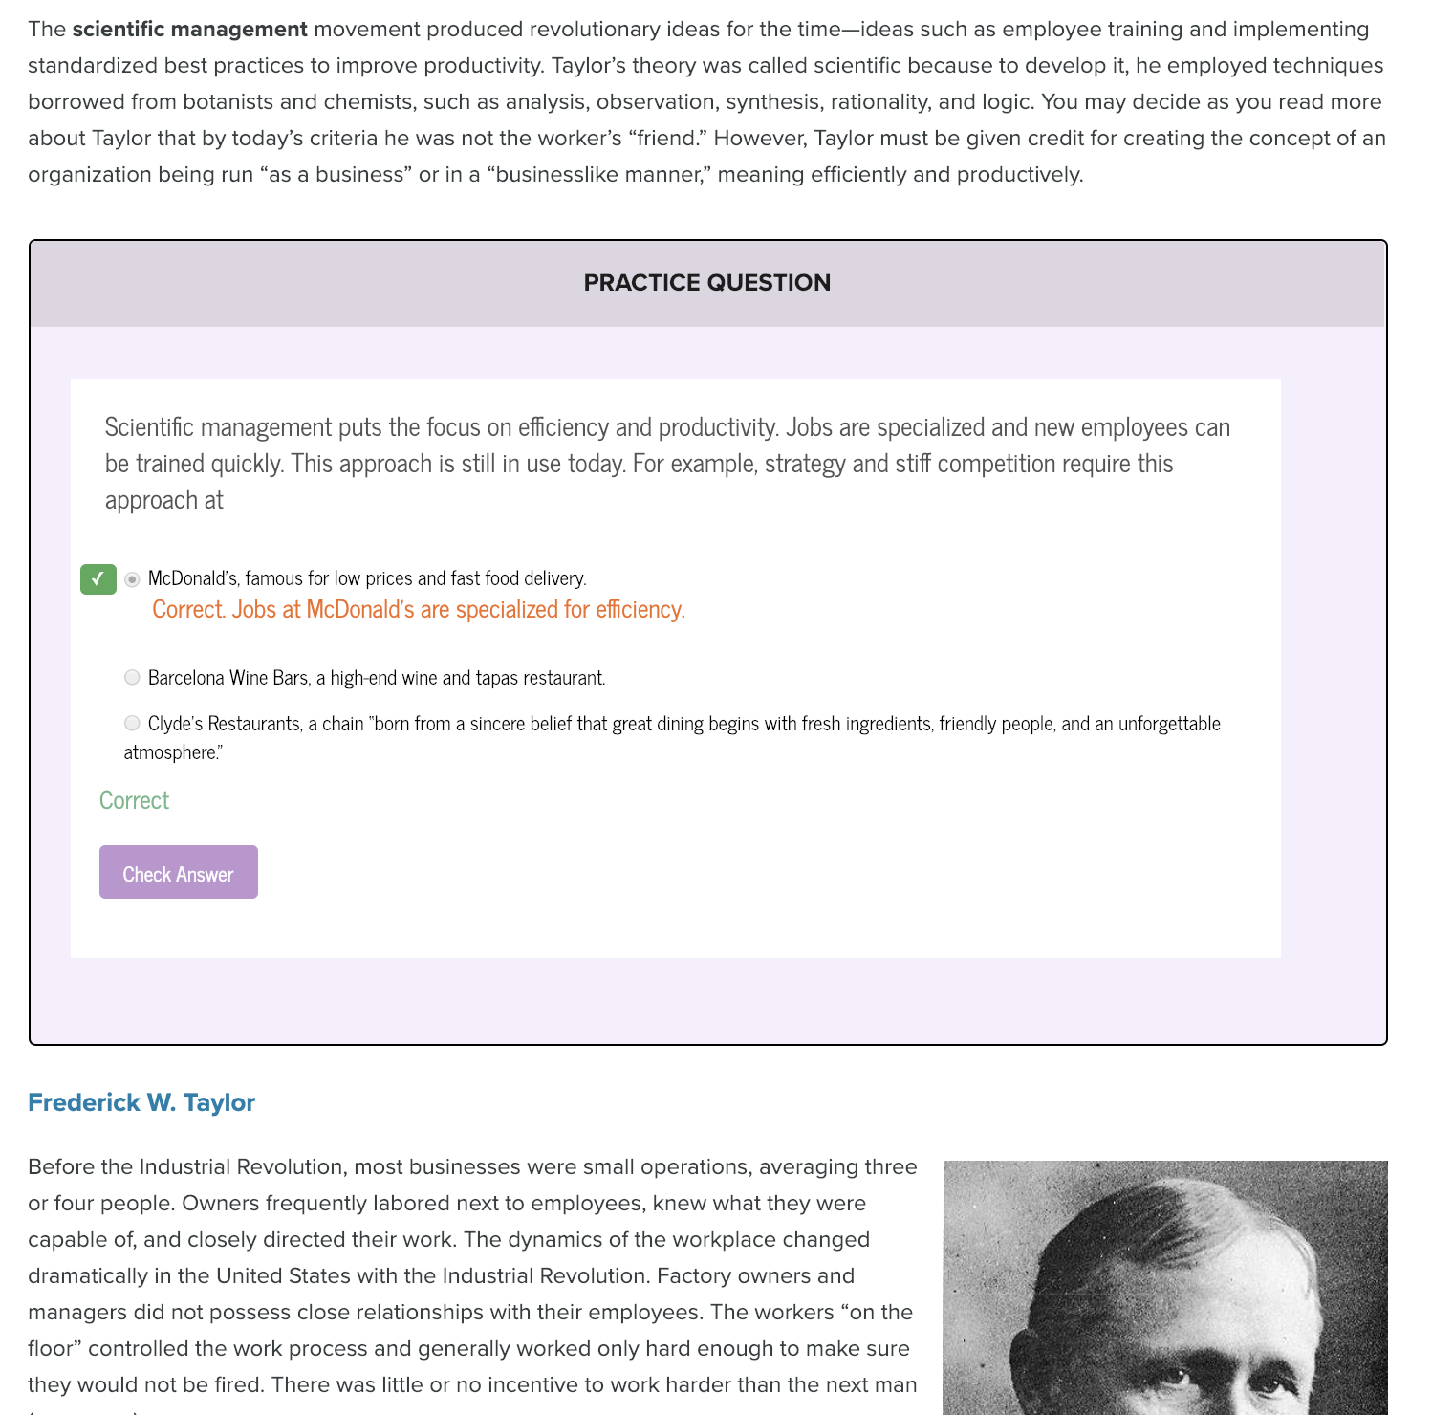
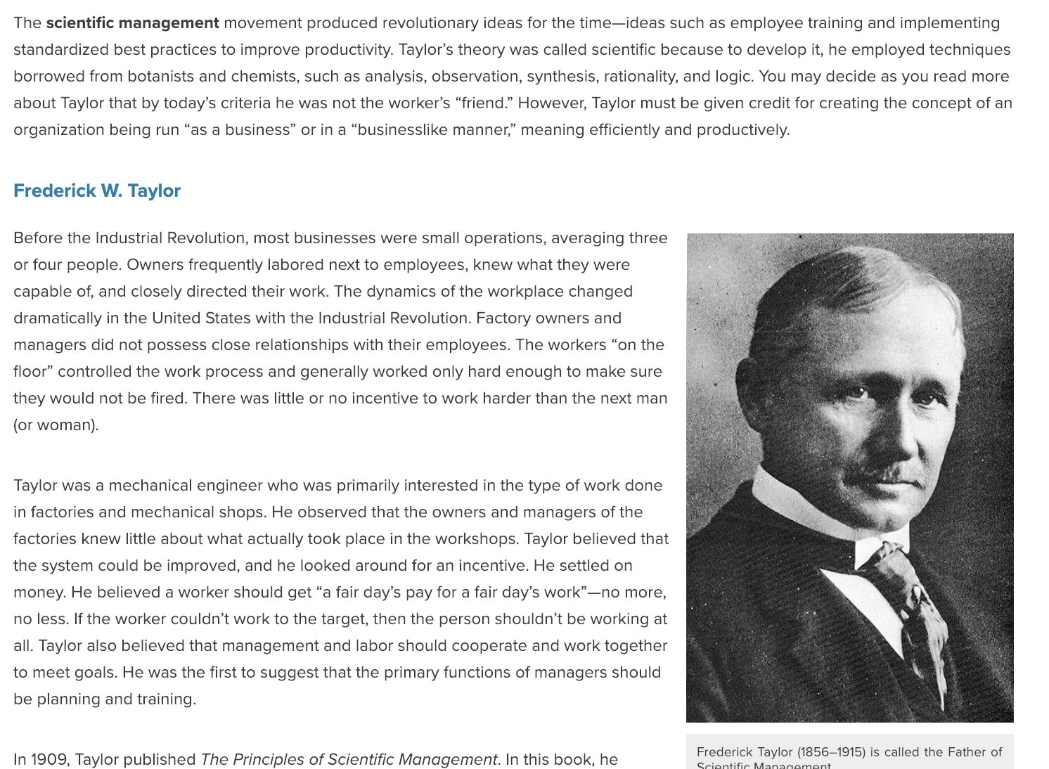
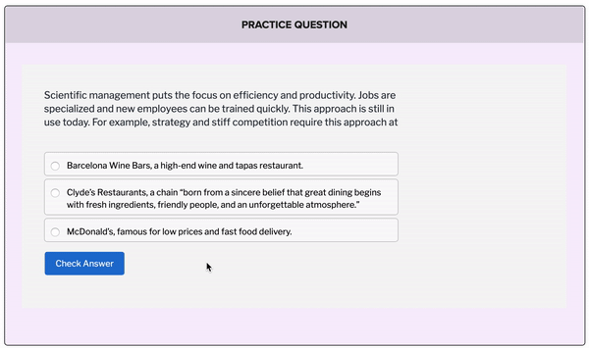
BEFORE
Static Text
AFTER
Text with Practice Opportunity

Slide 9
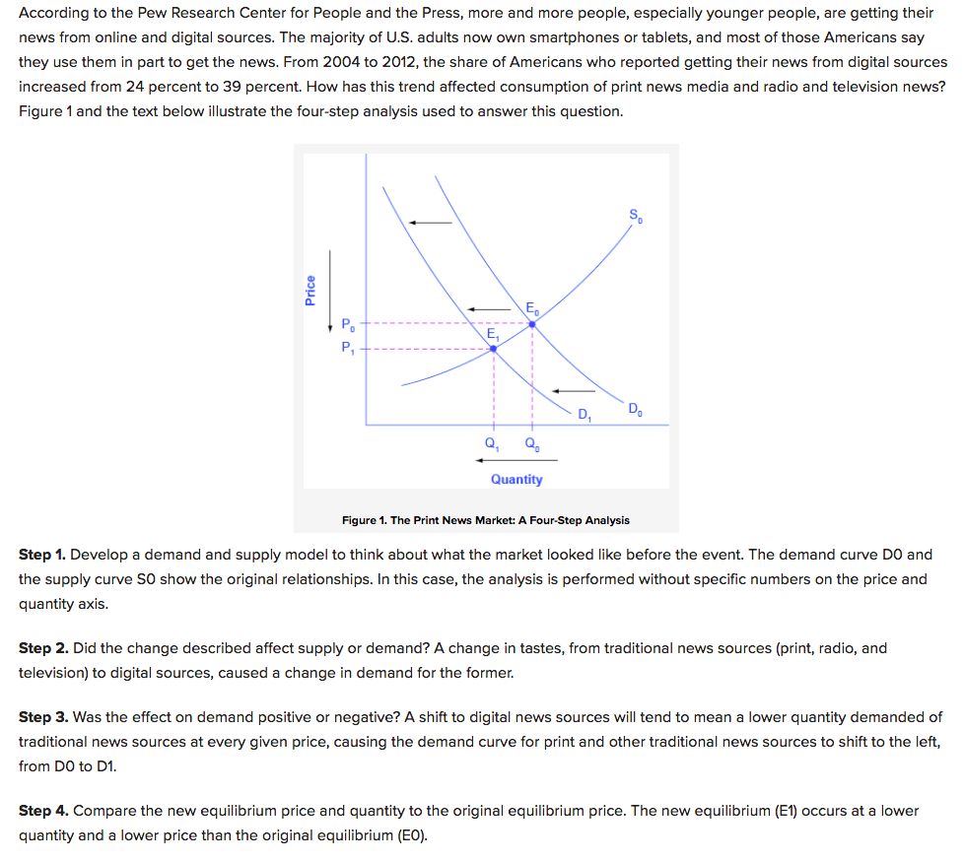
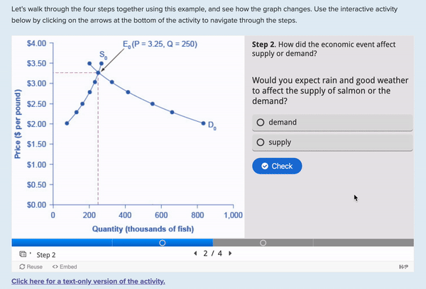
BEFORE
Static Text
AFTER
Interactive Case Study
Add: screenshot of econ course BEFORE targeted improvements
Add: screenshot of econ course AFTER targeted improvements

Slide 10
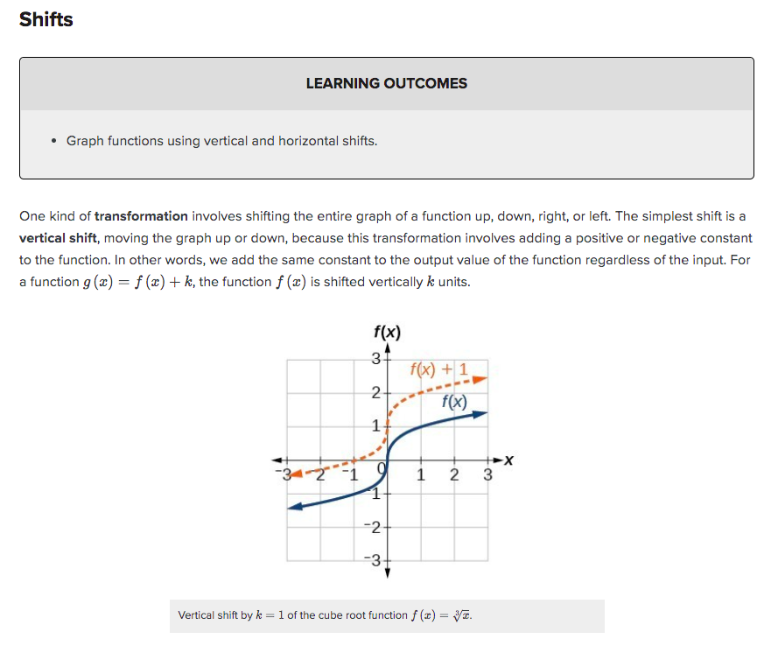
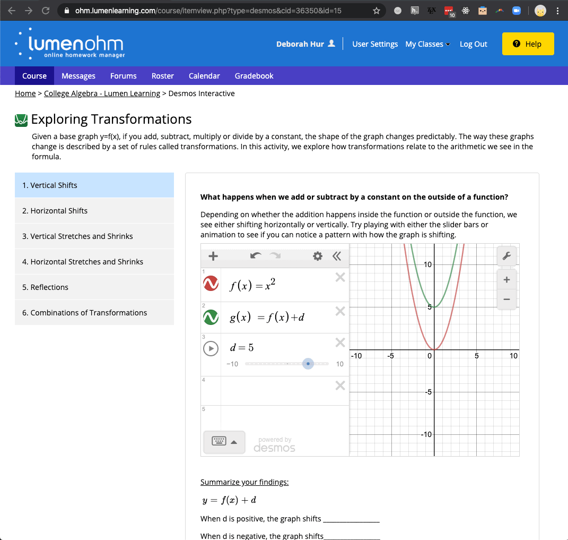
BEFORE
Static Graph
AFTER
Interactive Graphing Simulation

Slide 11
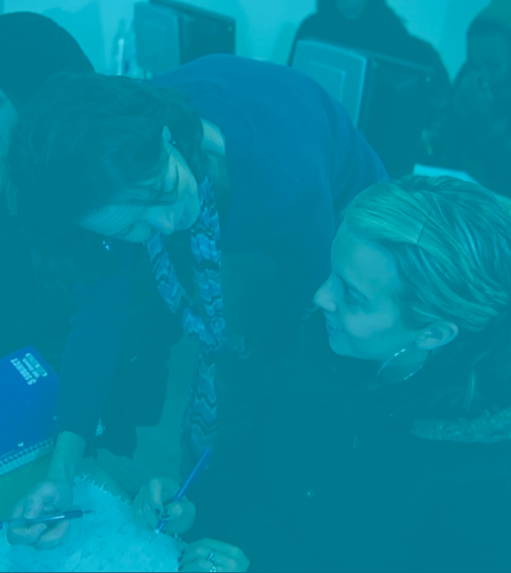
What’s possible with Lumen?
Face-to-face workshops
Virtual hackathons
Analyze your student data
Compare vs. national data
Collaborate with your faculty
Improvements to strengthen learning for your students
Professional recognition for scholarly contributions
More: lumenlearning.com/improvinglearning
Continuous Improvement
at Scale

Slide 12

Affordable.
Accessible.
Easy to Use.
Seamless in your LMS.
Well-supported.
Course materials
you can rely on
Photo by NESA by Makers on Unsplash

Slide 13
Ready-to-Teach Courseware
Interactive textbook, assessments, supplemental materials
Plus:
Digital tools to strengthen learning
Personalized Learning Courseware
Online Homework System
✓OER
✓Outcome alignment
✓Frequent practice & feedback
✓Personalization
✓Faculty-student connection
✓Data-driven improvements
✓OER
✓Outcome alignment
✓Frequent practice & feedback
$25
per student/term
standard pricing
any course
Waymaker
OHM

Slide 14
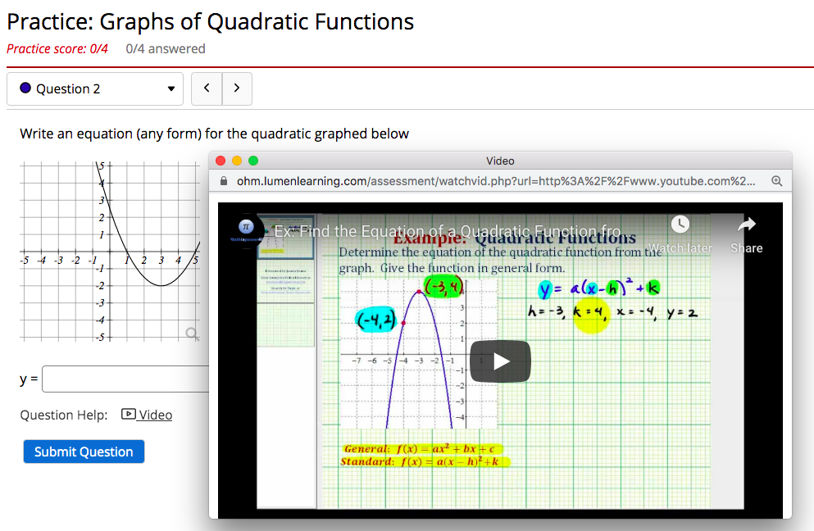
Lumen OHM
Online Homework for Quantitative Courses
Robust algorithmic assessments
Large question libraries
Customizable template courses
Simple, quick course set-up
Desmos interactive graphing
$25/student/term
Self-Guided Demo

Slide 15


