Slide 1
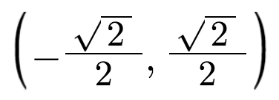
Nix the
Trig Tricks
Luke Walsh
Catawba Valley CC
lwalsh@cvcc.edu

Slide 2
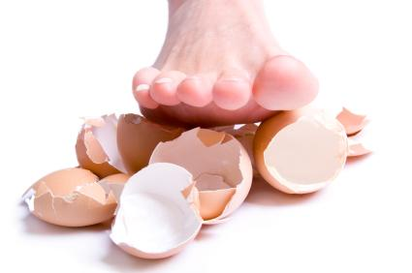
Warning: Tricks can be touchy.
http://investingcaffeine.com/tag/walk-on-egg-shells/
Notes:
Teachers rarely like to be told be teach. So, someone saying, “Hey, you teach tricks. Stop it.” can be a touchy subject. So, the goal today is question and explore the different methods of trig that are being taught.

Slide 3

You will not tell me how to teach!
http://thoughtcatalog.com/charlie-shaw/2013/09/31-students-on-their-worst-teacher-horror-stories/
Notes:
Teacher can be unwilling to change. “My way has worked and it will continue to work.”

Slide 4

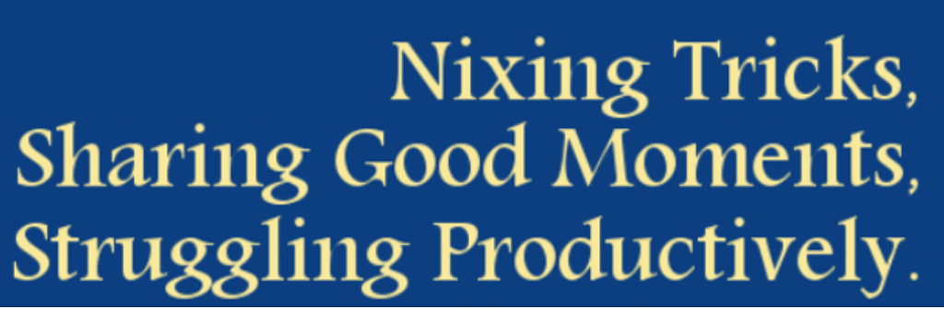
Tina Cardone
@crstn85
http://www.drawingonmath.blogspot.com
Notes:
Tina had the courage to say, “Hey don’t do this.” The idea of nixing tricks was first introduced to me be Tina Cardone. This quote is taken from her Twitter page and it really resonates with my type of philosophy in teaching Mathematics.

Slide 5
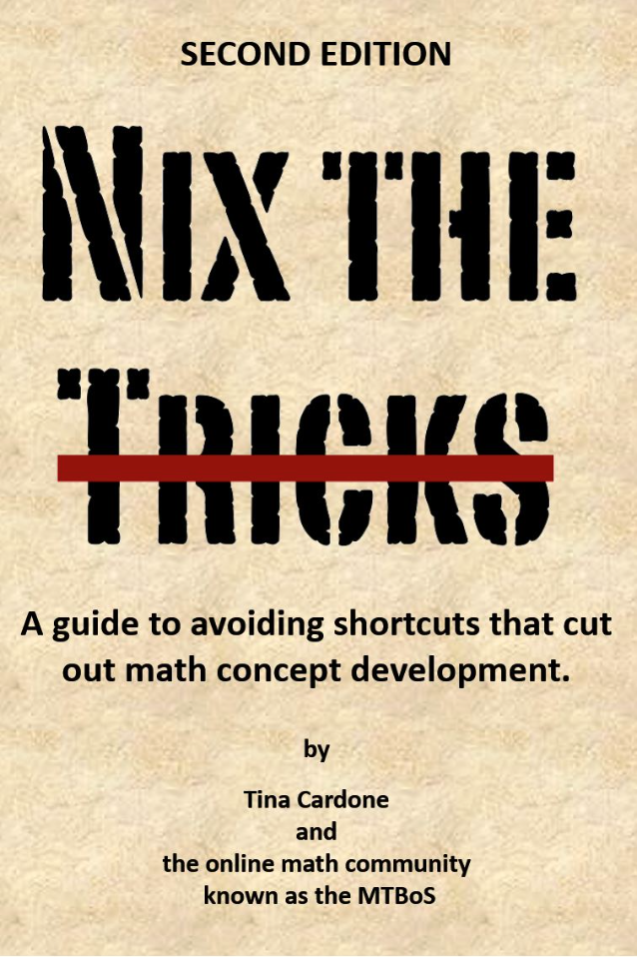
A guide to avoiding shortcuts that cut out math concept development.
Notes:
Math tricks at the community college? What are they? DEV, STEM, NON STEM? How many has a student already seen? How many are reinforced?

Slide 6
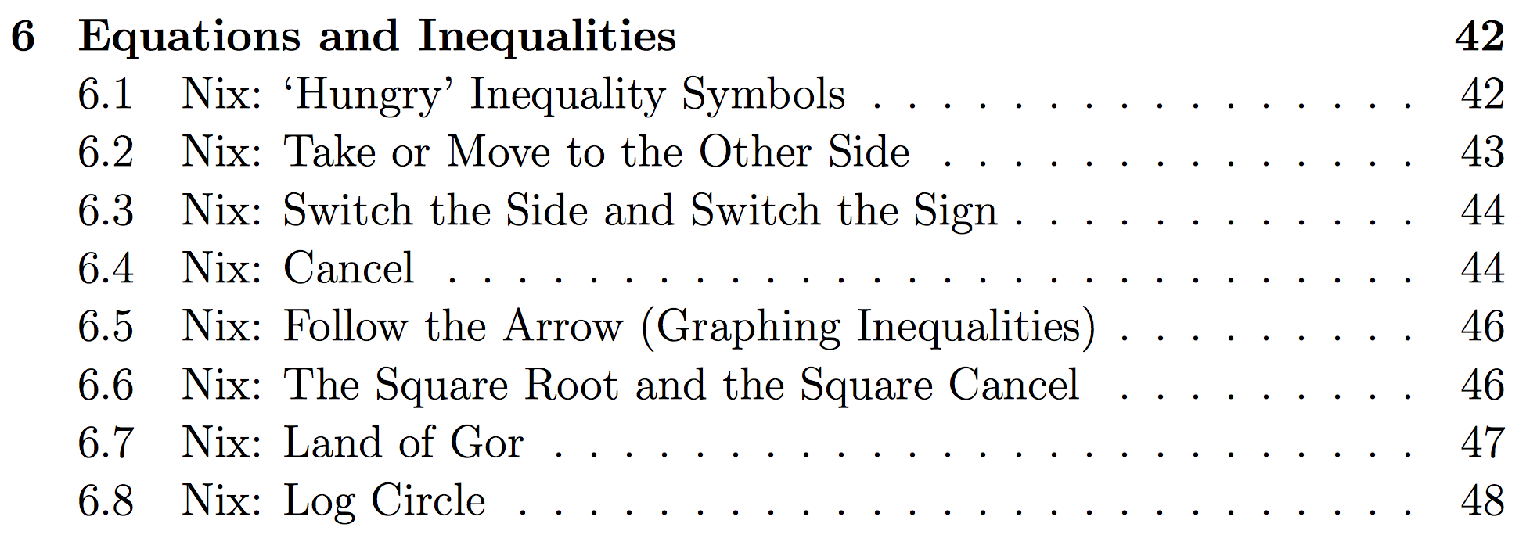
Excerpt from the Table of Contents
What makes a trick nix worthy?
Notes:
How many of these have you heard of? Is the trick the only way some students can get it? If so what are they getting? A technique to do a problem? A technique of understanding the process.

Slide 7
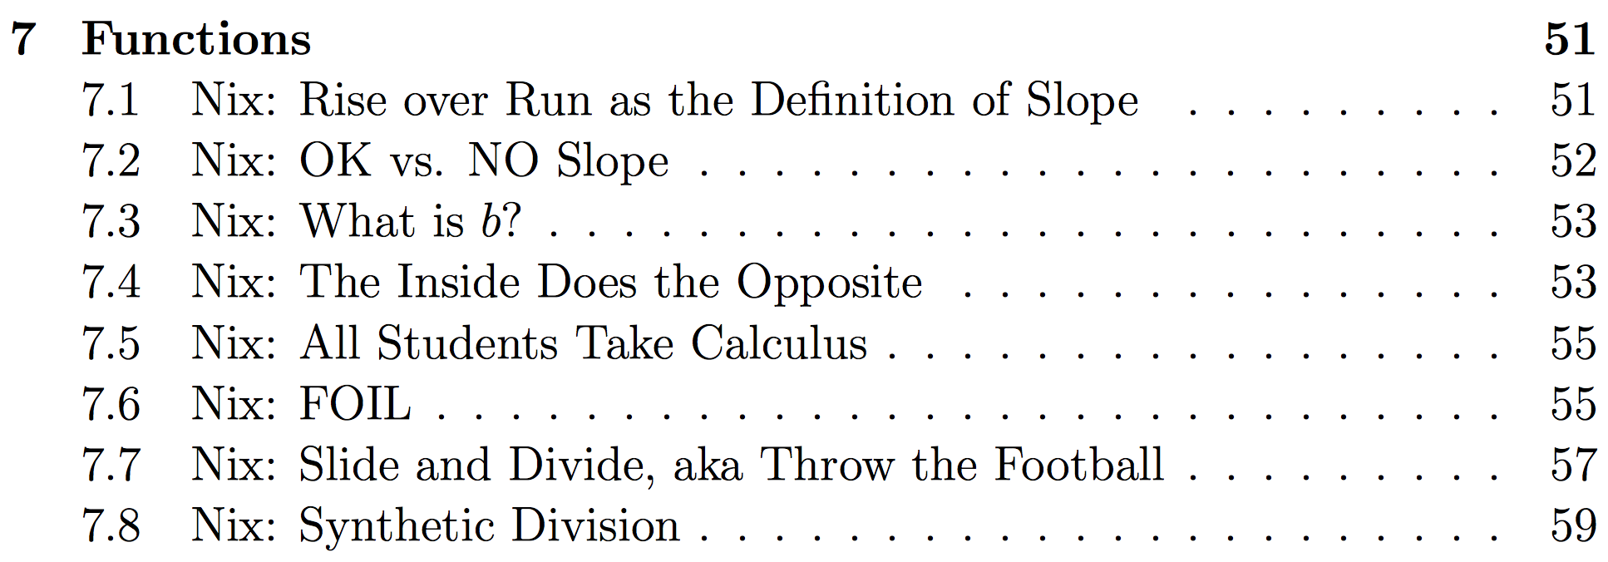
EXAMPLE
Notes:
An example of a Trig Trick

Slide 8
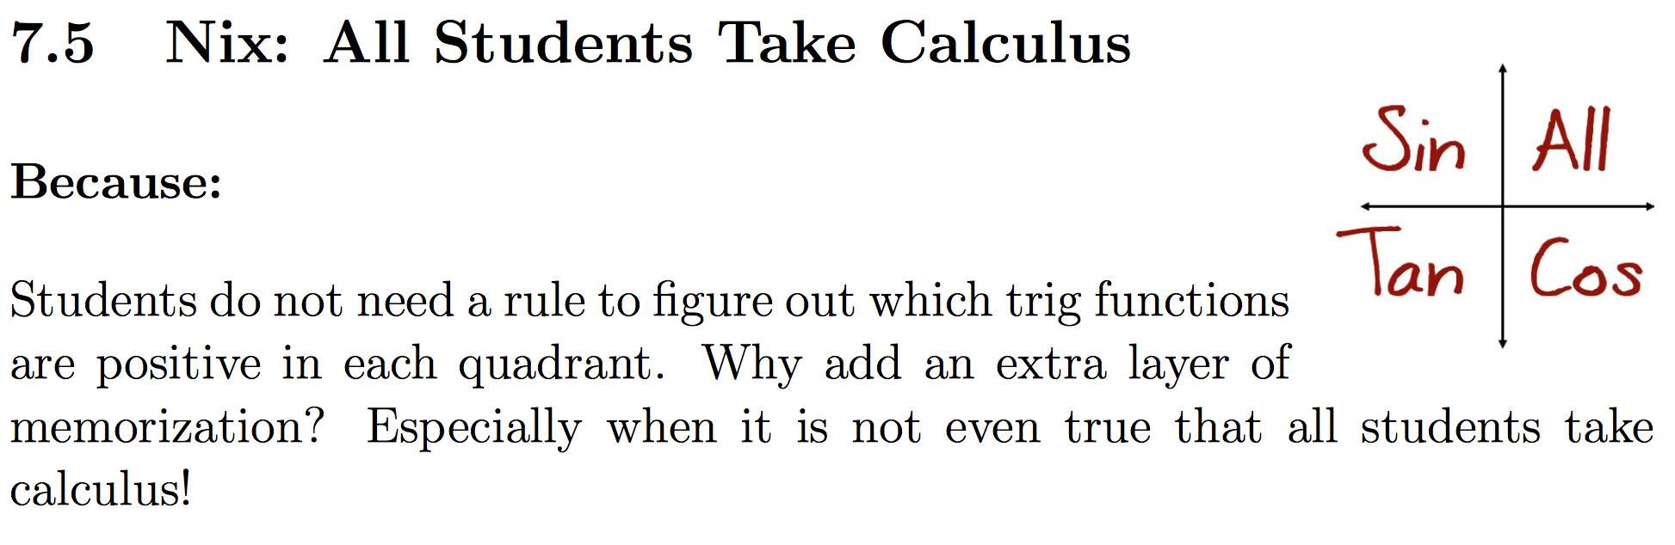
WHAT
WHY?
pg 55, Nix The Tricks
Notes:
The what and why format of the Nix The Tricks.

Slide 9
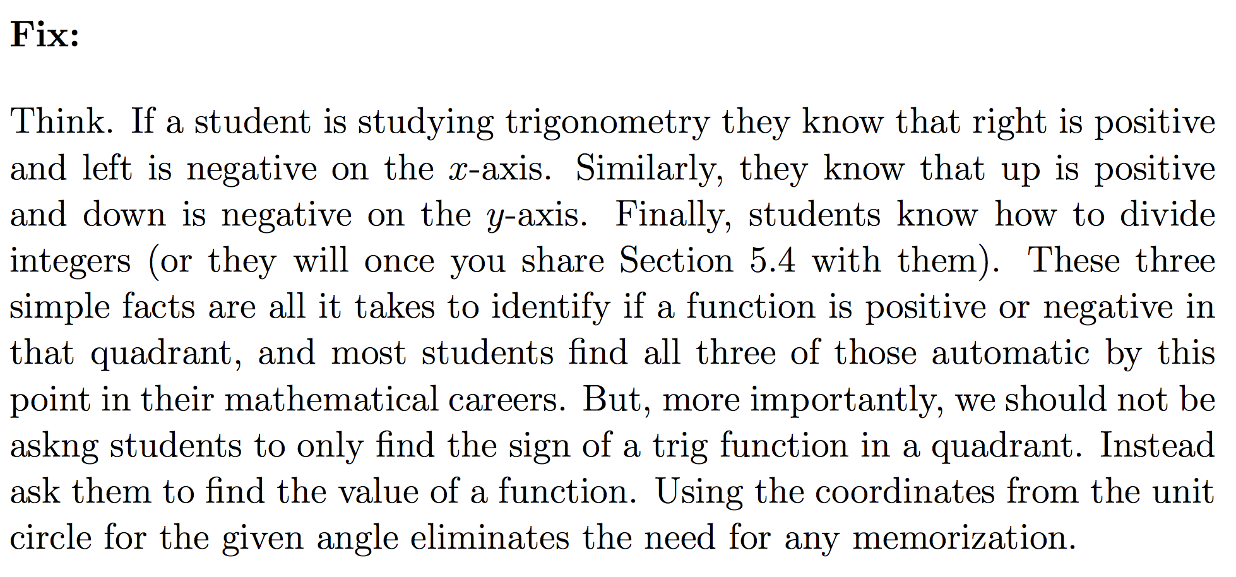
Discussion
Notes:
Each trick has a fix, an alternative to replace the trick. Good discussion points to have with a department to figure out the material will be taught.

Slide 10
Fade These Tricks Out
What should fade in?

Slide 11

TRIG
Notes:
Building a new chapter

Slide 12
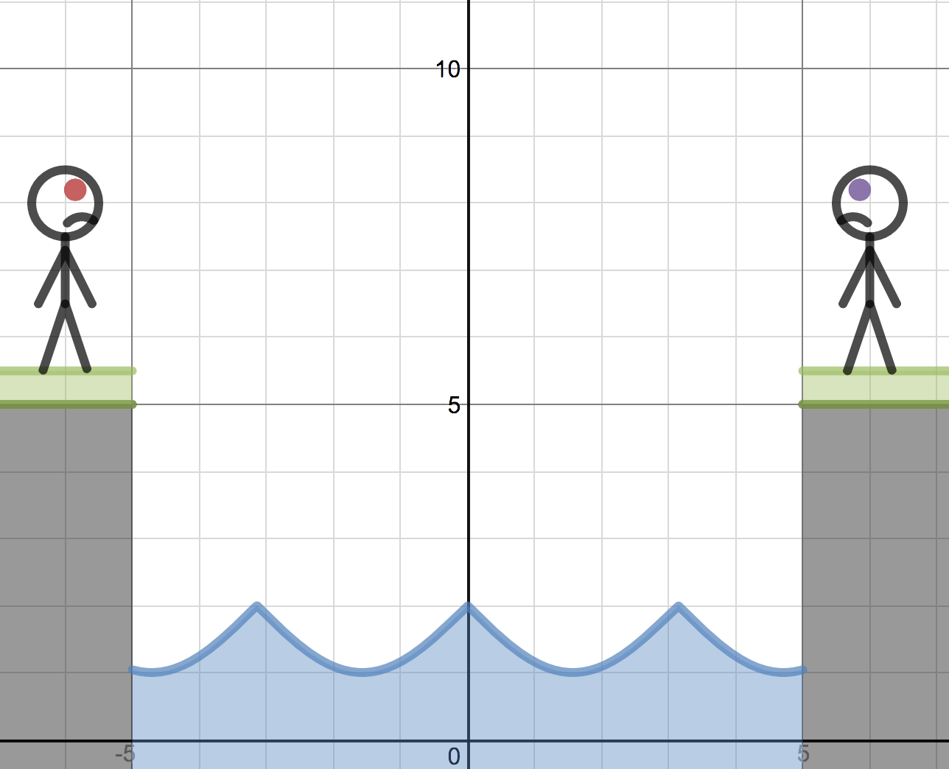
Algebra
Trig
What is the bridge between these courses?
https://www.desmos.com/calculator/4nb4qfbdxk
Notes:
What is the bridge between pre-calc algebra and pre-calc trig? Do

Slide 13
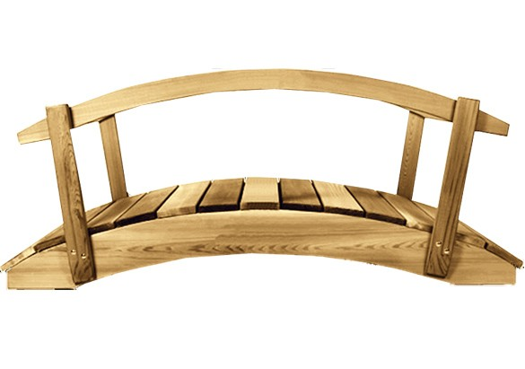
Algebra
Trig
Why cross? Will I return?
https://www.desmos.com/calculator/4nb4qfbdxk
Notes:
Is there really a necessity to learn more math? What struggles have students experienced that made them realized that they have to learn trig.

Slide 14
Linear
Quadratics
Deja vu?
https://www.desmos.com/calculator/4nb4qfbdxk
Notes:
Do students experience this type of struggle when going from linear to quadratics. Do students see that the bridge is not one way?

Slide 15
Before we cross the bridge from Algebra to trig....
let’s do trig, Algebra style!
Notes:
Reinforce Algebra, bring a need for the trig. Path of no tricks, “sharing good moments and struggling productively

Slide 16
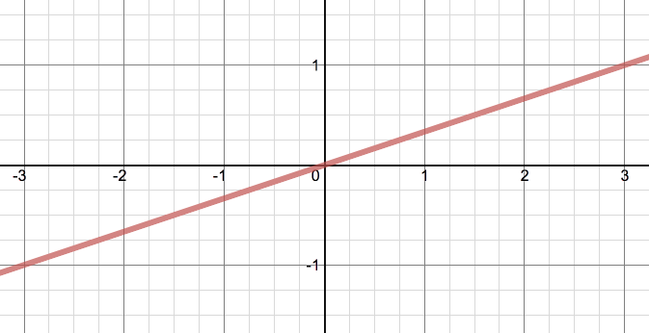
What is the equation of the red graph?
What would be a coordinate not seen?
Notes:
What is the equation of the red graph? What would be a coordinate point not seen in this graph?

Slide 17
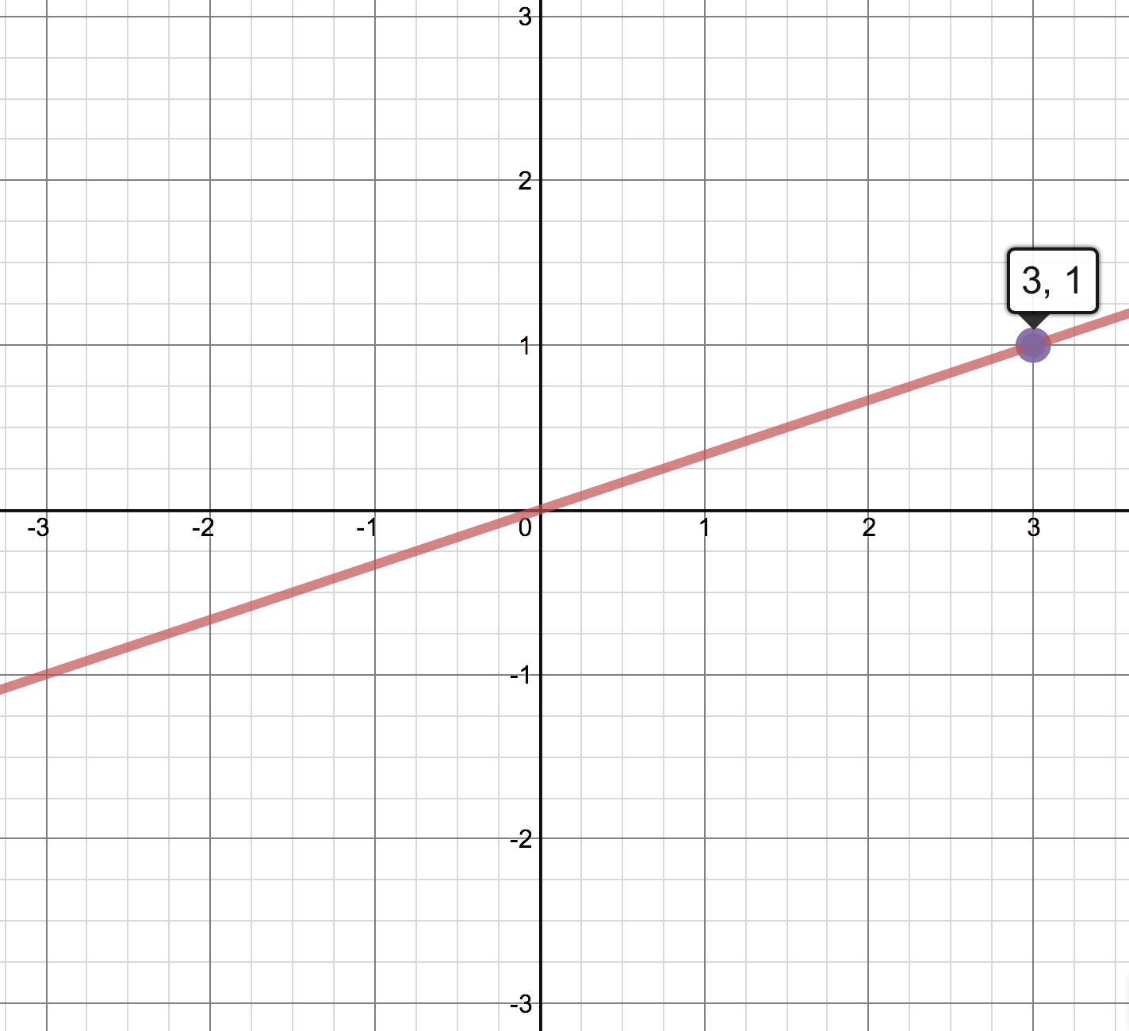
Find four coordinates that have the same distance to the origin
Notes:
Do you need to know the distance formula? Reflection properties? Is this an odd function?

Slide 18
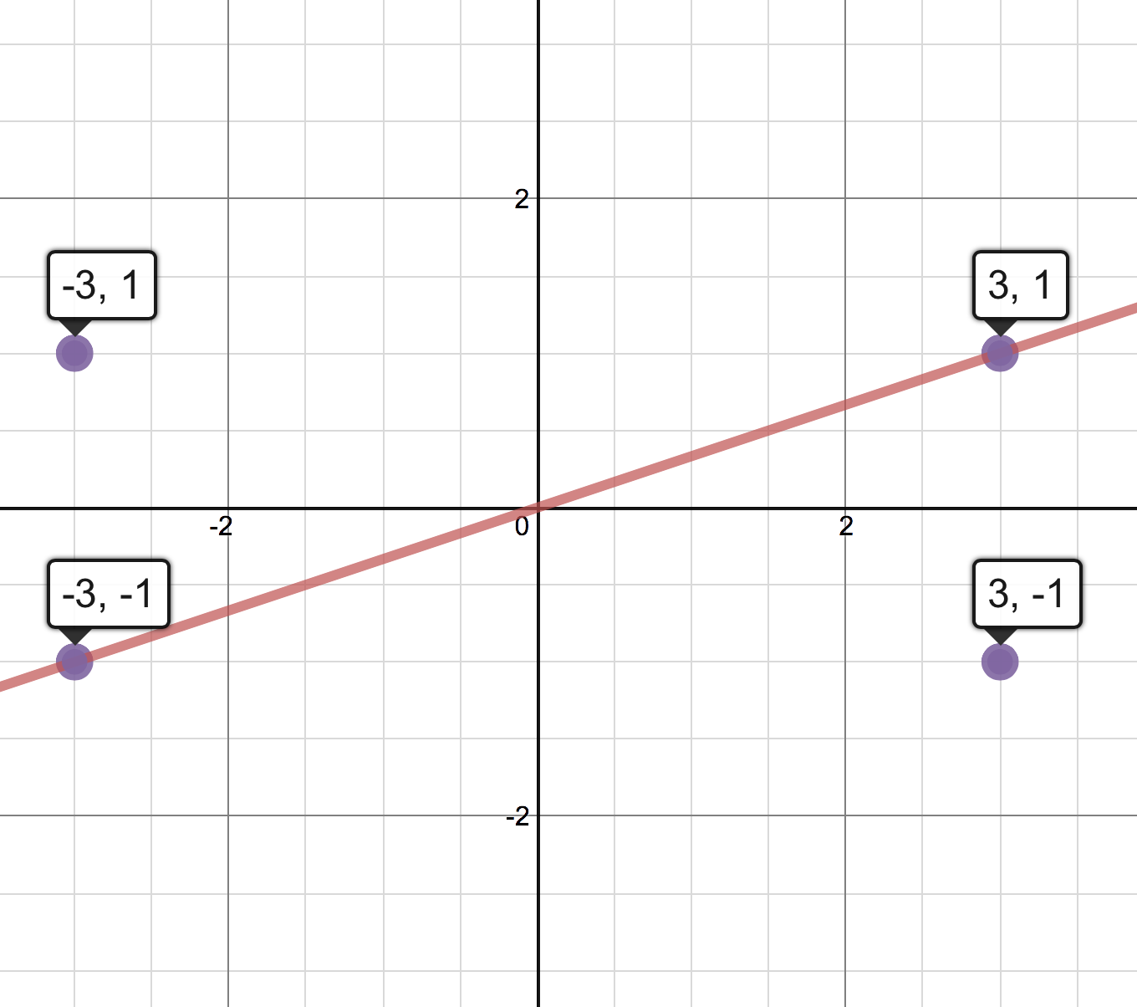
Why is the three negative?
Why is the one negative?
Notes:
Common answer from students. Building the foundation for what is positive and negative, given a quadrant. How could you convince someone that these have the same distance. (Have the same horizontal and vertical distance) No need for ASTC.

Slide 19
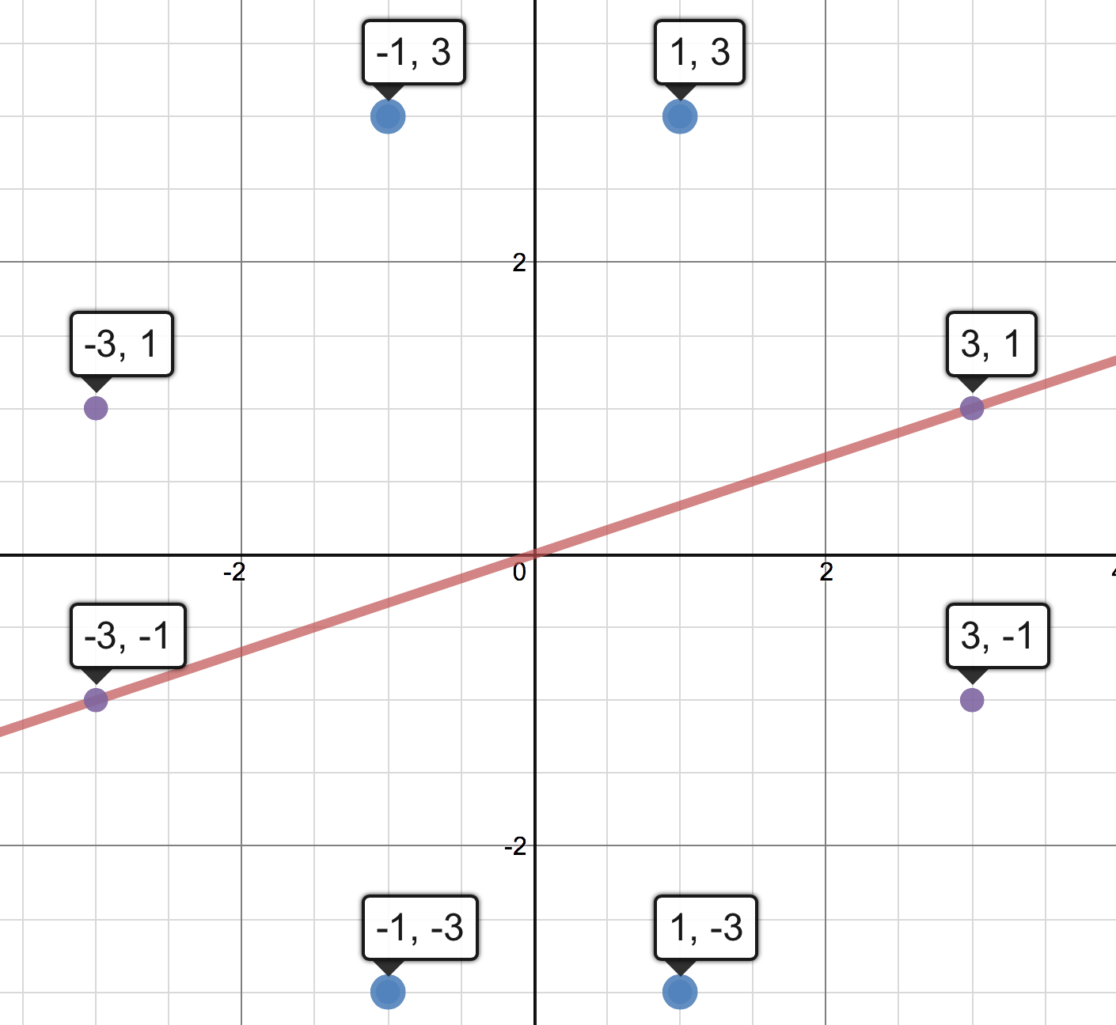
Why do all of these points have the same distance to (0,0)?
Notes:
Why does switching the x and y give another coordinate with the same distance? Building the relationship for (½, sqrt(3)/2) and (sqrt(3)/2, ½)

Slide 20
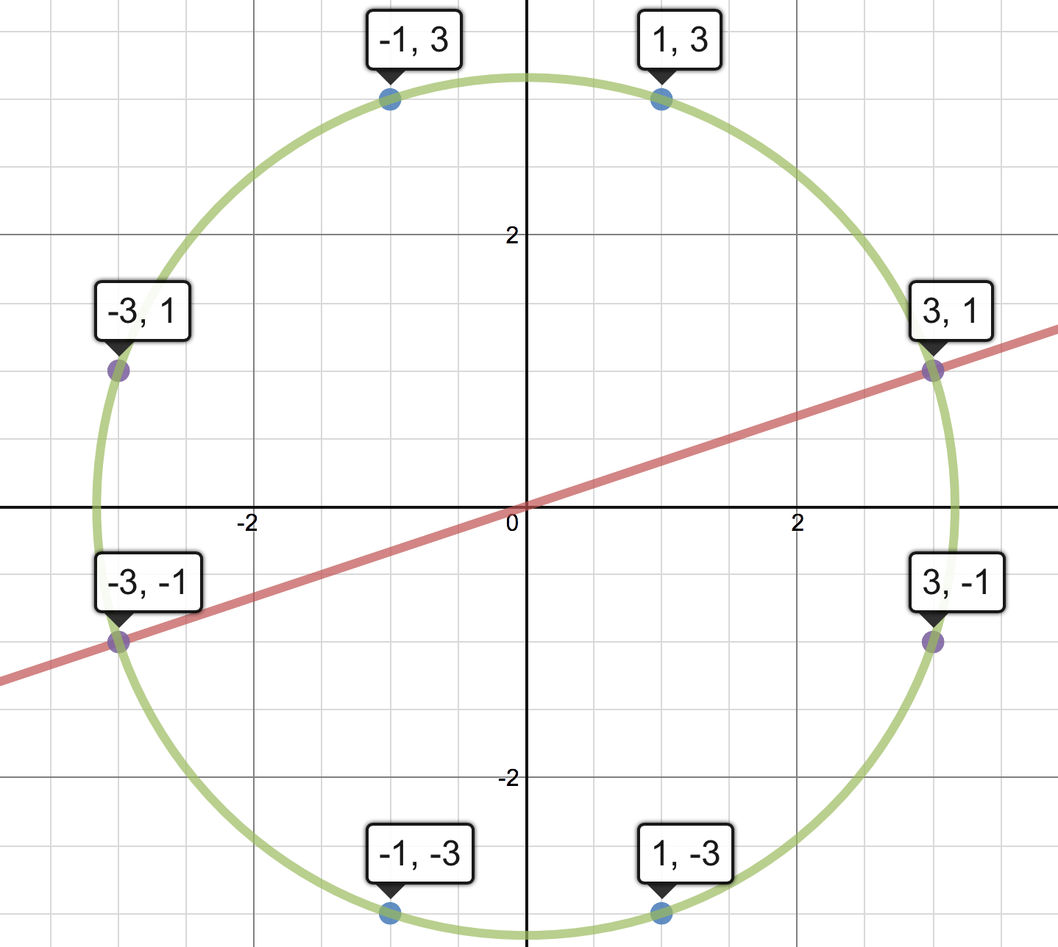
Do students know the equation of a circle?
Notes:
Discover the idea that the circle represents the collection of points that are the same distance from a center point. Are there any other integer coordinate points?

Slide 21
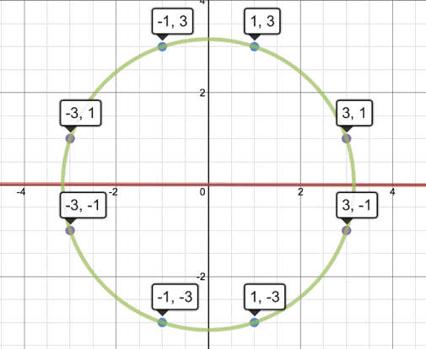
Can you find the intersection point?
Notes:
What if the slope of the red line can change? Can we now find the intersection point?

Slide 22
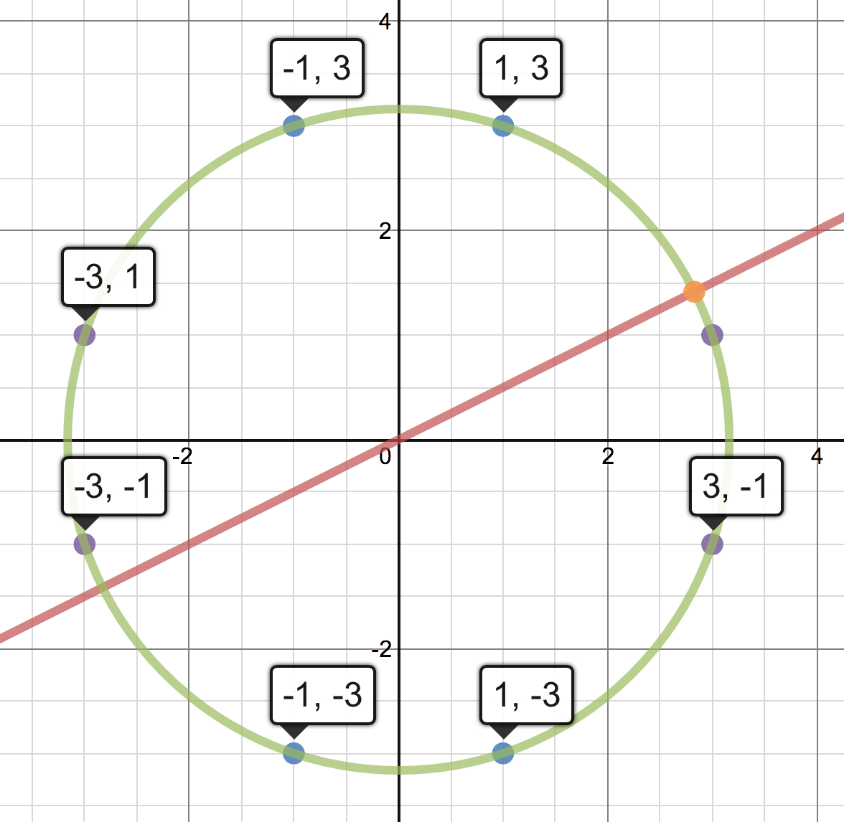
(?, ?)
y = ½ x
Notes:
If the slope is 0.5 what is the coordinate of the orange circle?

Slide 23
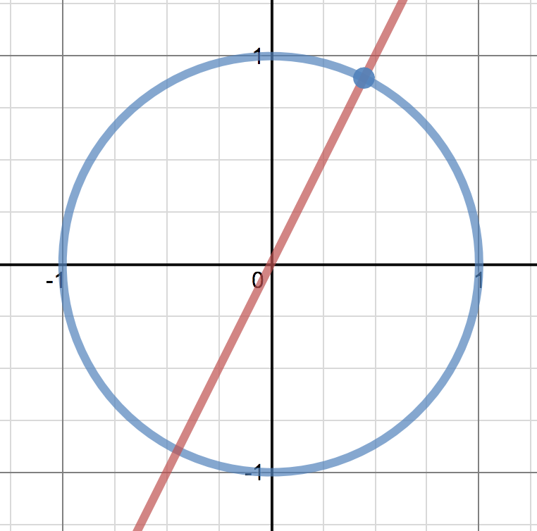
System of Equations: Unit Circle & y=mx
Notes:
Given a slope of m what is coordinate of the intersection point?

Slide 24
Can we find all of the intersections?
Notes:
So why trig? Can you find all intersection points?

Slide 25
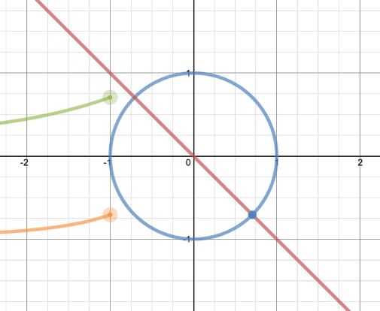
What is the green graph? Orange?
Notes:
Graphing the position of the x-coord and y-coord as the slope changes.

Slide 26
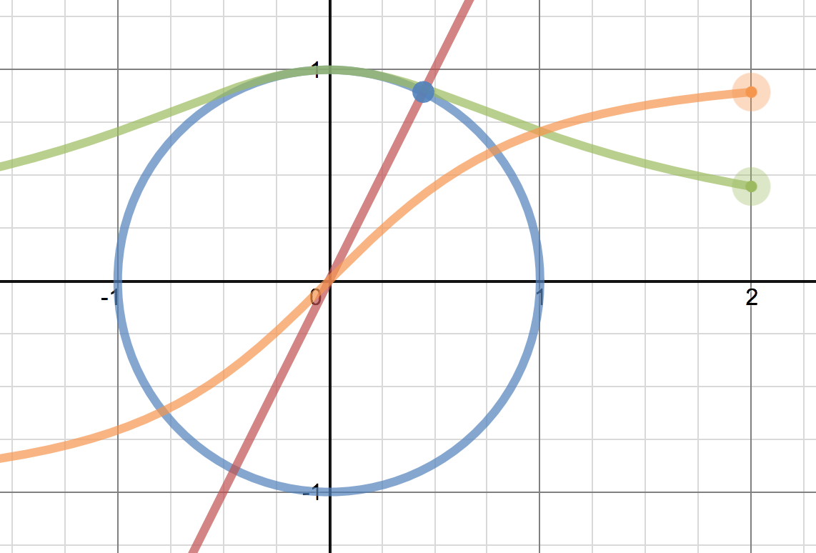
Vertical and Horizontal Position
Notes:
We have only been using pre-calc algebra. Notice that we have not created any new functions. We are using the the foundations of algebra to explore.

Slide 27
Graph Orange & Green Simultaneously
Notes:
(green, orange) Graph at the same time. Introduction into parametrics.

Slide 28
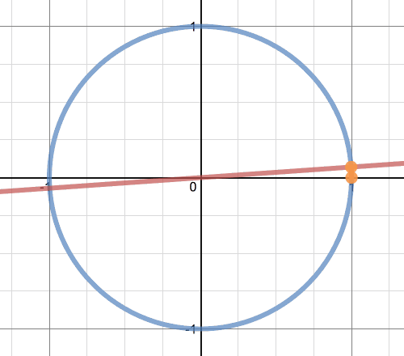
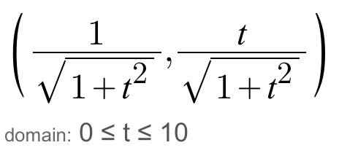
Setting the seed for (cos(θ), sin(θ))
Notes:
Combine the orange and green, look at both at the same time, aka parametric equation

Slide 29
What are problems with using slope?
Which quadrant for a given m?
What to do when m is undefined?
Need large m values as you get closer to the top of the circle.
Notes:
The algebra can only take us so far. Using the slope presents some problems.

Slide 30
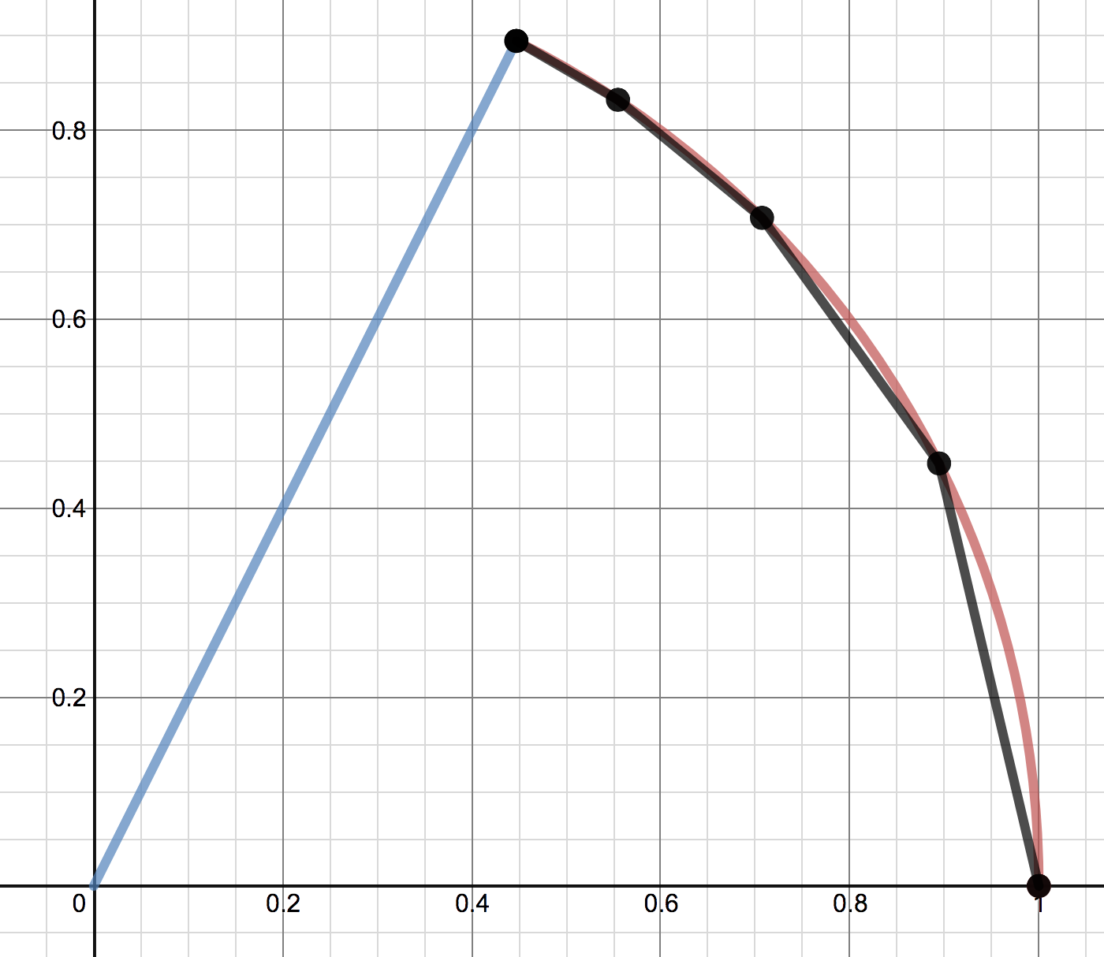
What are problems with using slope?
https://www.desmos.com/calculator/nl8olo2hw1
m=2
m=1.5
m=1
m=0.5
How do you find arc length?
m=0
Notes:
Builds the idea of taking a limit. Student calculate intersection points for m=2, m=1.5, m=1, m=½. Helps appreciate how easy the arc length can be found by using an angle measurement.

Slide 31

Trigonometry to the rescue!
The unit circle will help us float, even in the largest of amplitude sinusoidal waves.
#SlideWithaBadMathPun
Notes:
Trig to the rescue. We need a better way to find the intersection point on a circle.

Slide 32
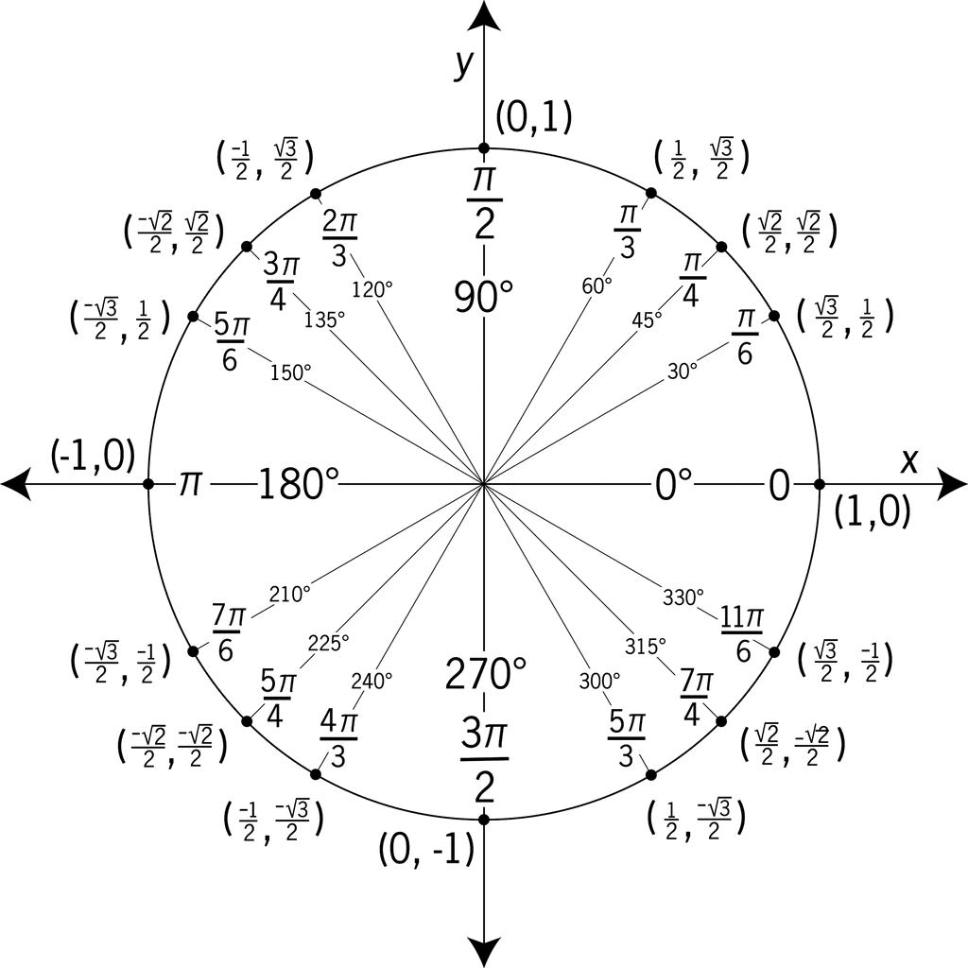
No trick of “Poof! Here is a circle. Here are angles. Here are points on the unit circle.”

Slide 33
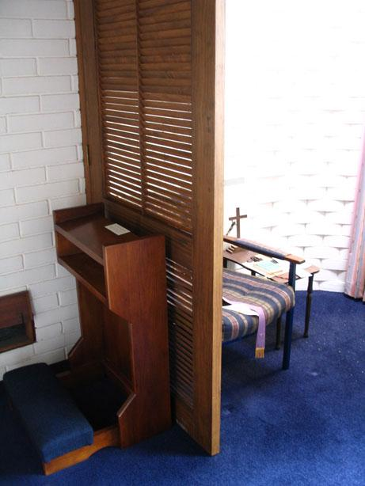
I have a confession to make.
Revolve around the unit circle six times and think about what you could do differently.
Forgive me Math, for I have taught a math trig trick to my students today.
Notes:
I have taught math tricks and I still teach math tricks. I am not perfect. Always trying to learn different ways of teaching the material so I don’t have to depend on a trick.

Slide 34
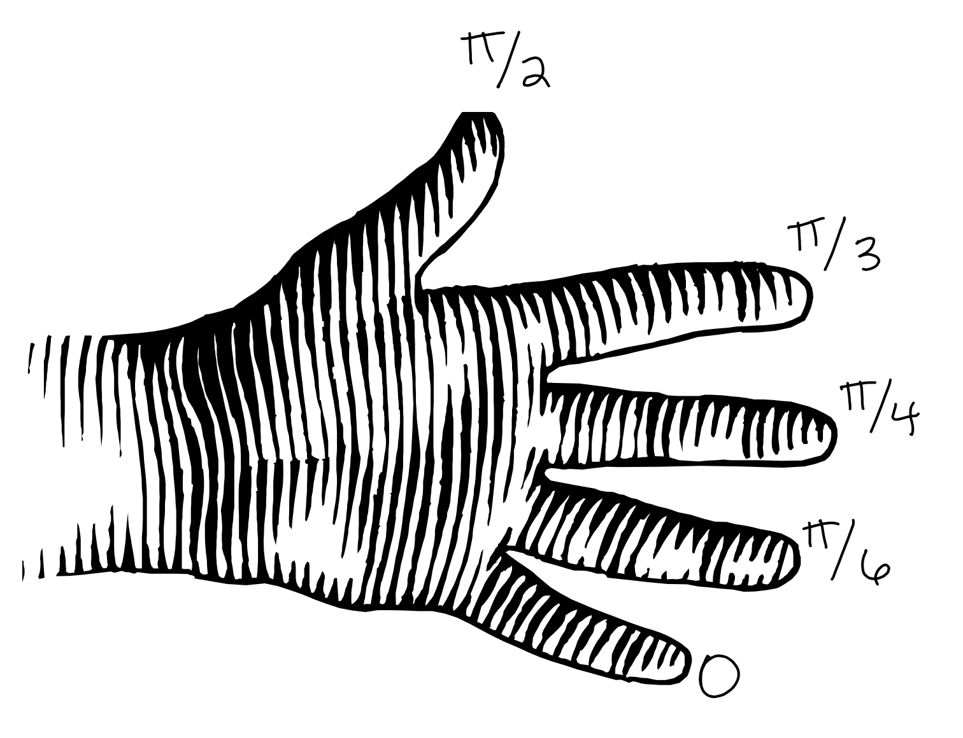
http://www.foresthills.edu/userfiles/161/Classes/5071/The%20Finger%20Trick%20for%20Trig.pdf
Notes:
This is a trick I used to have students do. Now, I don’t focus on this trick any more.

Slide 35
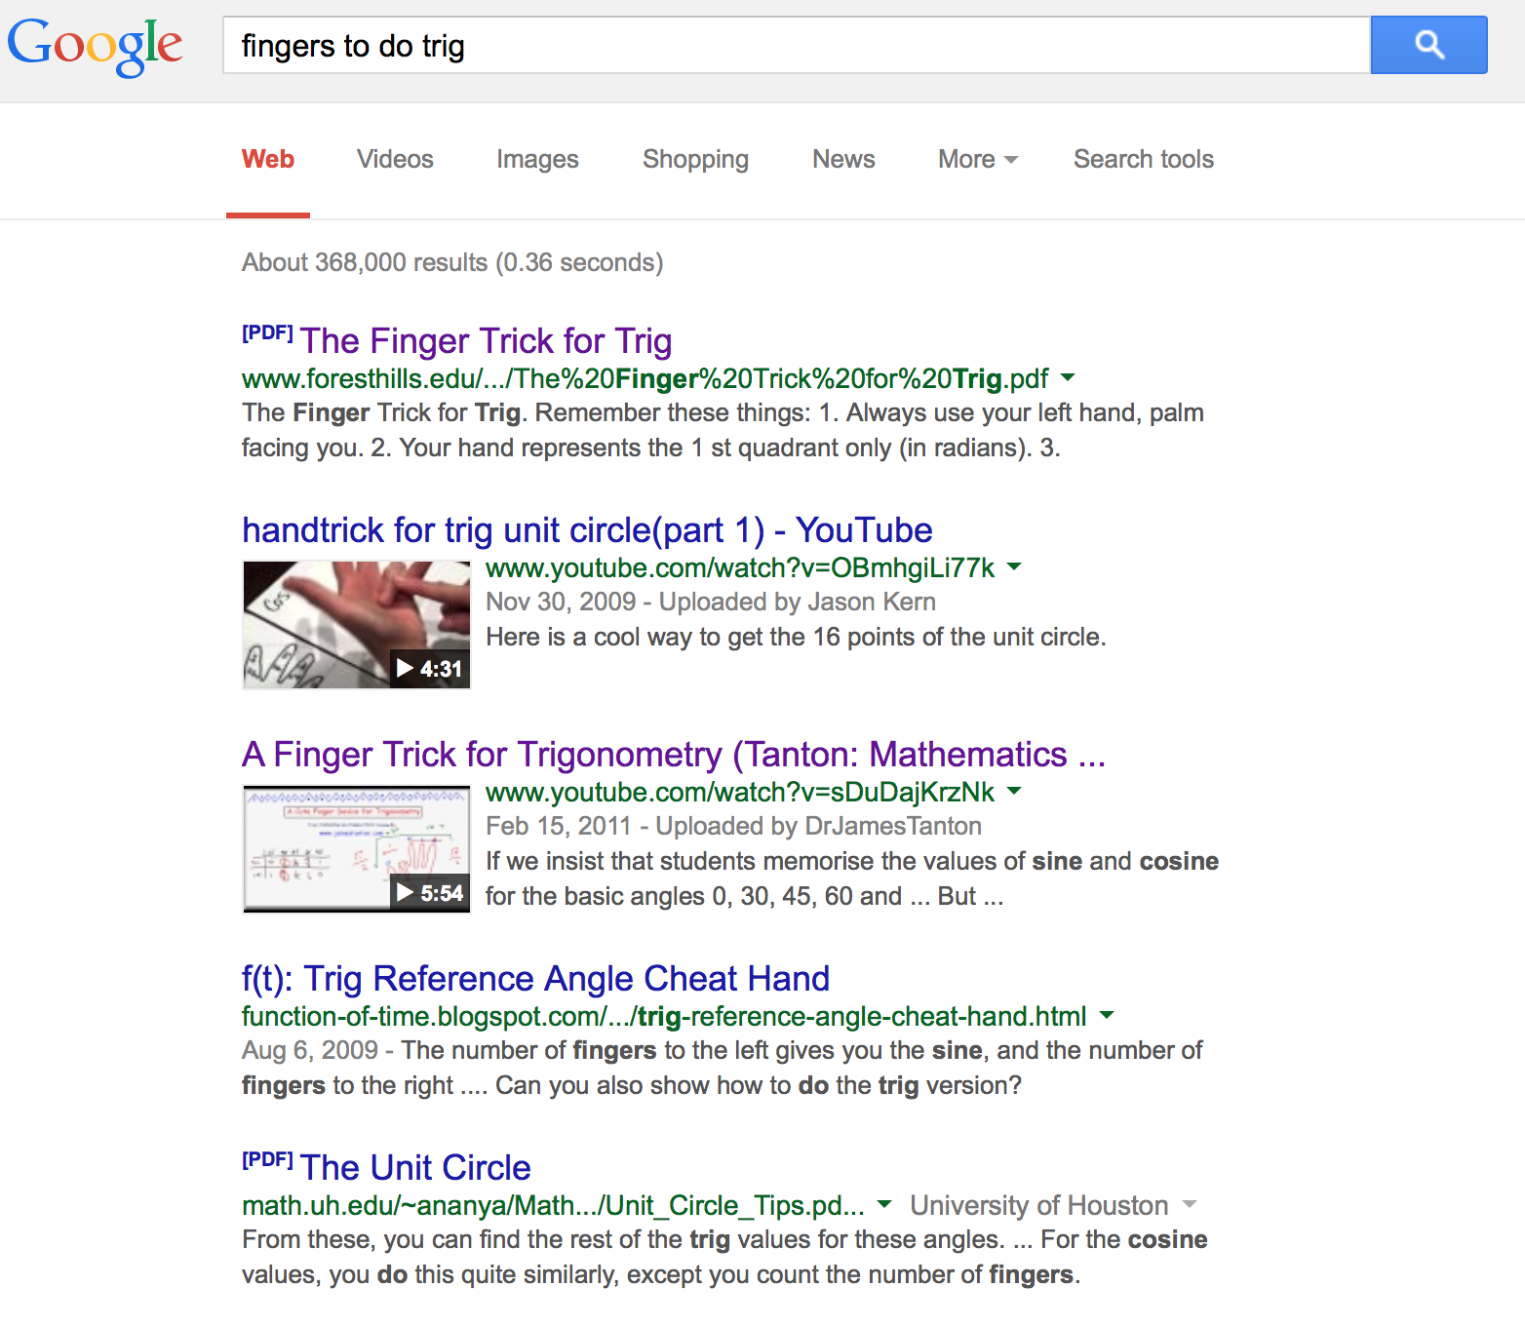
Notes:
This “trick” is every where, from high school to colleges.

Slide 36
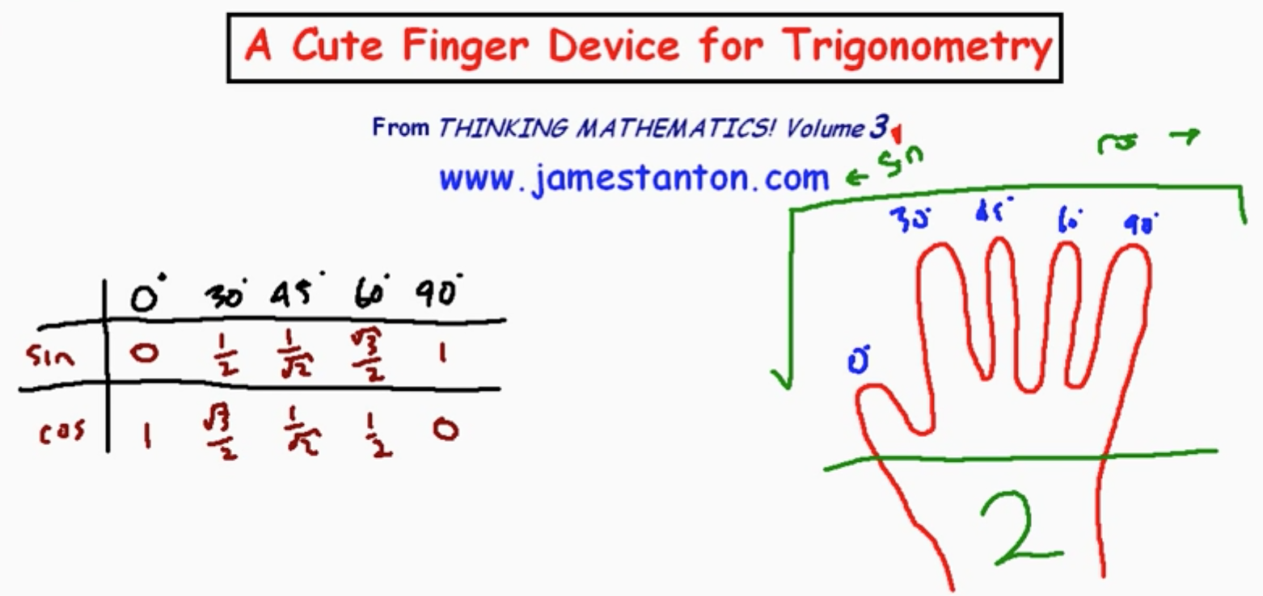
http://youtu.be/sDuDajKrzNk
“If we insist that students memorise the values of sine and cosine for the basic angles 0, 30, 45, 60 and 90 degrees, then here's a cute little trick for doing so using the fingers on your hand. (Notice: This all goes against my principles of as a mathematician - memorisation is joyless! But I do admit this finger trick is cute!)”
Notes:
Even the great James Stanton has done a video about this. He gives a warning, but how many teachers would listen to this warning? I didn’t at first.

Slide 37
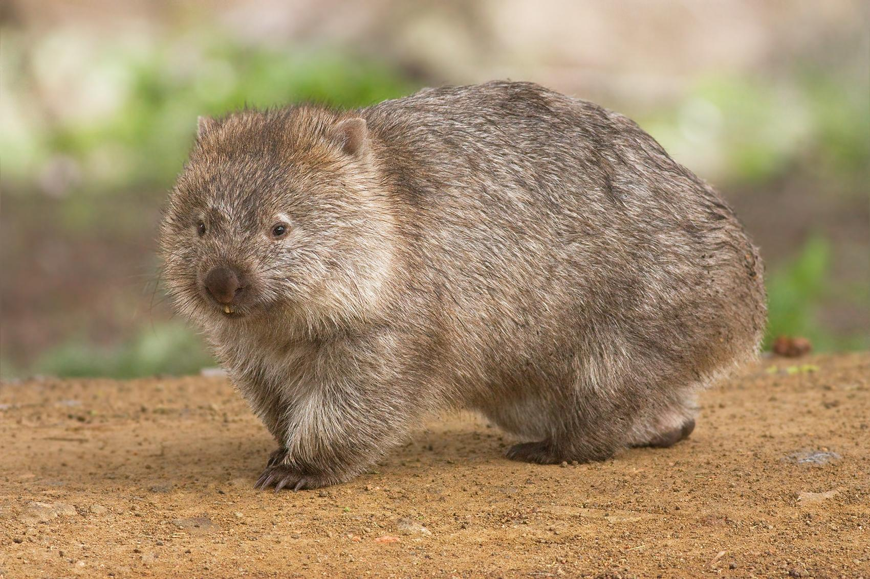
FEAR THE CUTE MATH TRICK
Notes:
Aw, look at that. What is it? Who cares, it is a cute math trick, just waiting for your students.

Slide 38
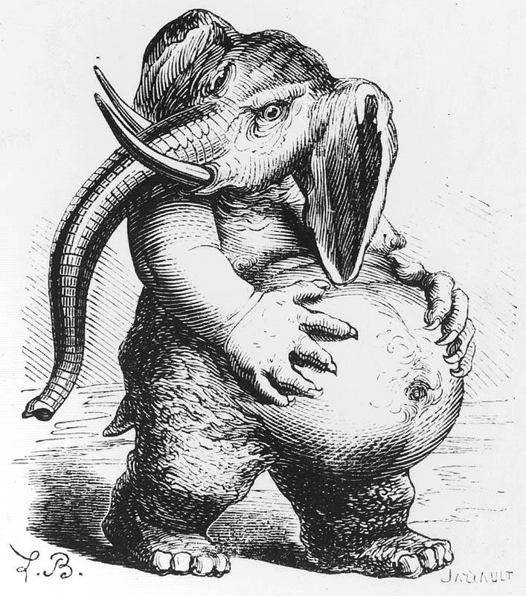
A student after years of only learning math through tricks.
http://fantastic.library.cornell.edu/imagerecord.php?record=48
Notes:
What student’s perception of math is, the mark of the beast. What role does learning by tricks have on this?

Slide 39
Ideas to Explore

Slide 40
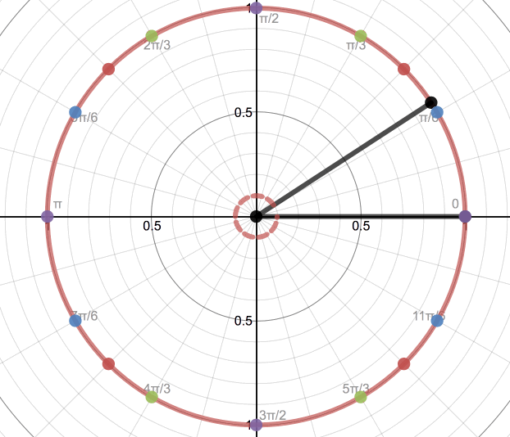
https://www.desmos.com/calculator/dwngnu1cte
Notes:
Goes back to where we started. One point can be reflected into the other quadrants. Focus on sqrt(3)/2 > ½. Then we can ask, is the horizontal or vertical position greater? The idea of a reference angle refers back to the point in the first quadrant.

Slide 41
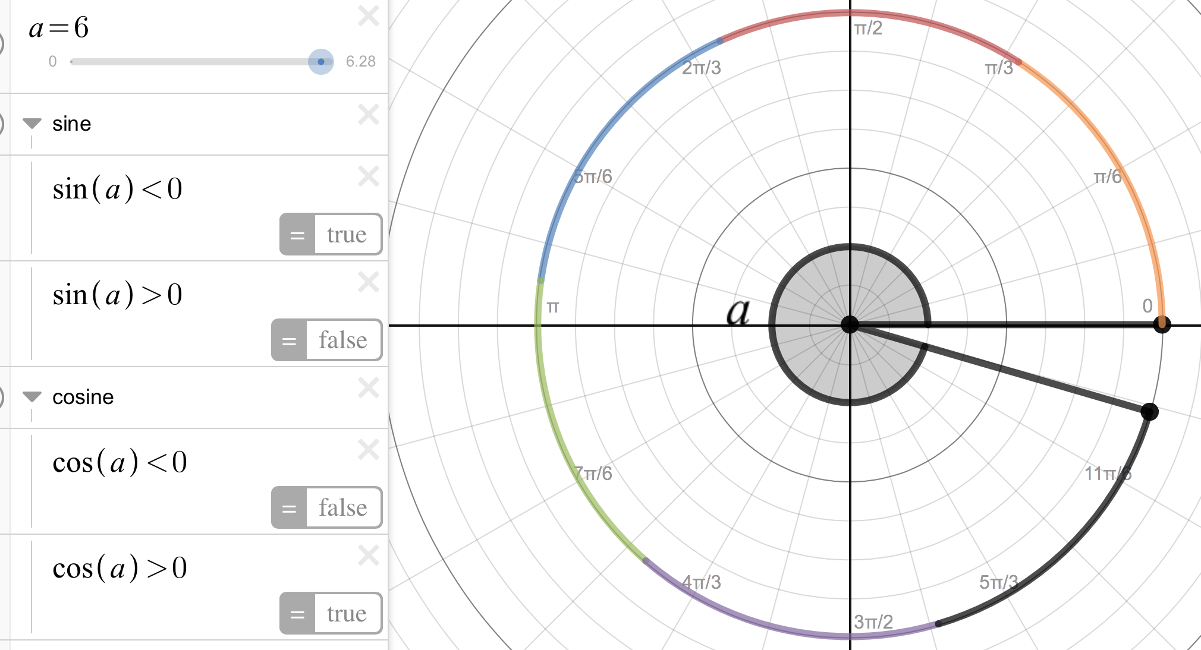
https://www.desmos.com/calculator/dektibxchm
Notes:
Now we can build on the idea of how radian is based on the the radius, cos(a) will be the x position and sin(a) will the y position of the coordinate (x, y)

Slide 42
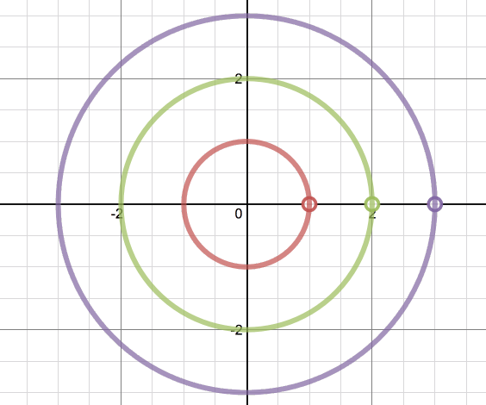
Who is going the fastest?
https://www.desmos.com/calculator/mw1e7mwwfe

Slide 43
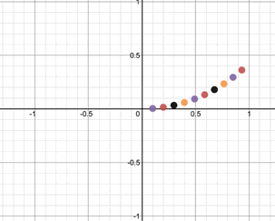
Explore (rcos(B*θ), rsin(B*θ))
https://www.desmos.com/calculator/kalzgi3yv2

Slide 44
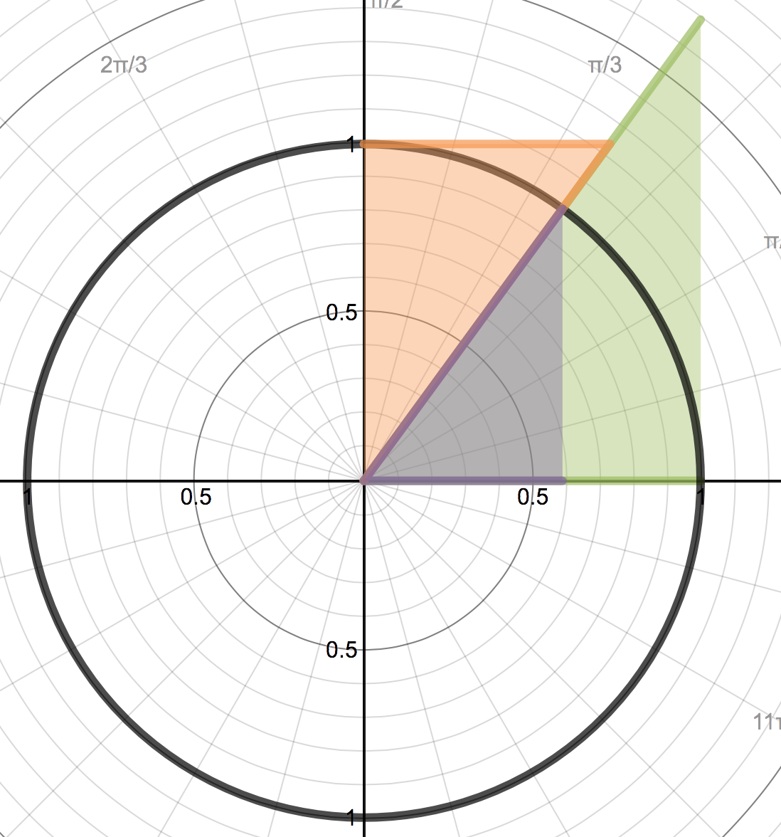
https://www.desmos.com/calculator/ilvre1znm4
sec(a)
tan(a)
a
1
tan²(a)+1=sec²(a)
Notes:
Relate the three basic trig identities back to the unit circle. EX: 1+tan^2(a)=sec^2(a) Use triangles build the idea of right triangle trig instead of unit circle trig.

Slide 45
hypotenuse
opposite
sin(a)
=
opposite
1
hypotenuse
sin(a)
1
a
No SOHCAHtrickTOA!
Notes:
Use triangles build the idea of right triangle trig instead of unit circle trig.

Slide 46
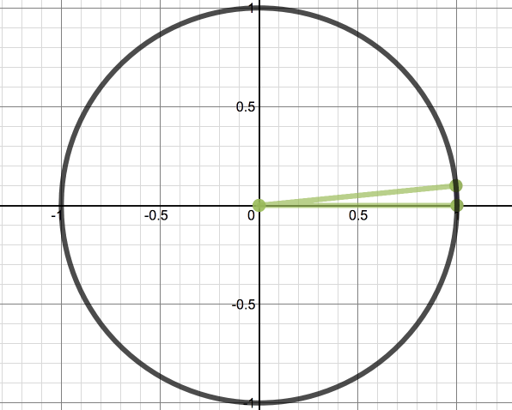
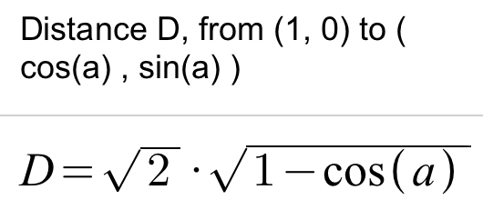
What is the length of the purple?
https://www.desmos.com/calculator/bx8recciq1
Notes:
Introduction into of Law of Sines. The length of the purple is a good use of a trig identity and algebra skills.

Slide 47
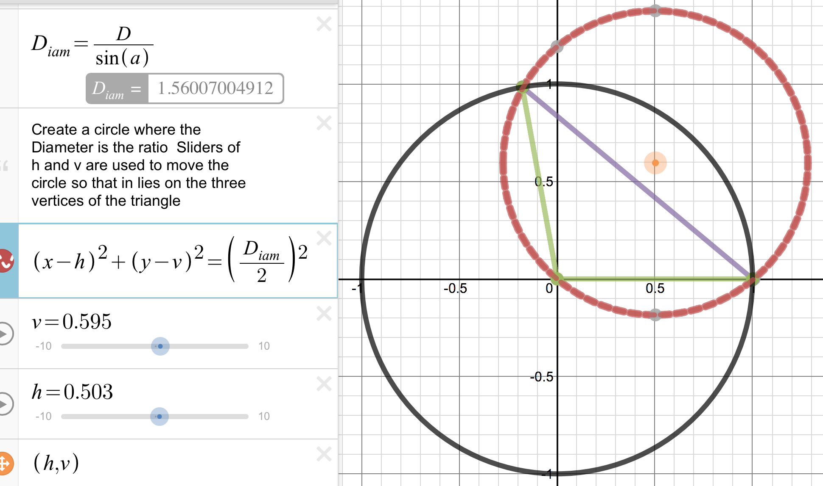
This is Law of Sines on the Unit Circle
How could this lead into triangle trig?
Notes:
First show how the ratio a/sin(a) is the diameter of the circumscribed circle.

Slide 48
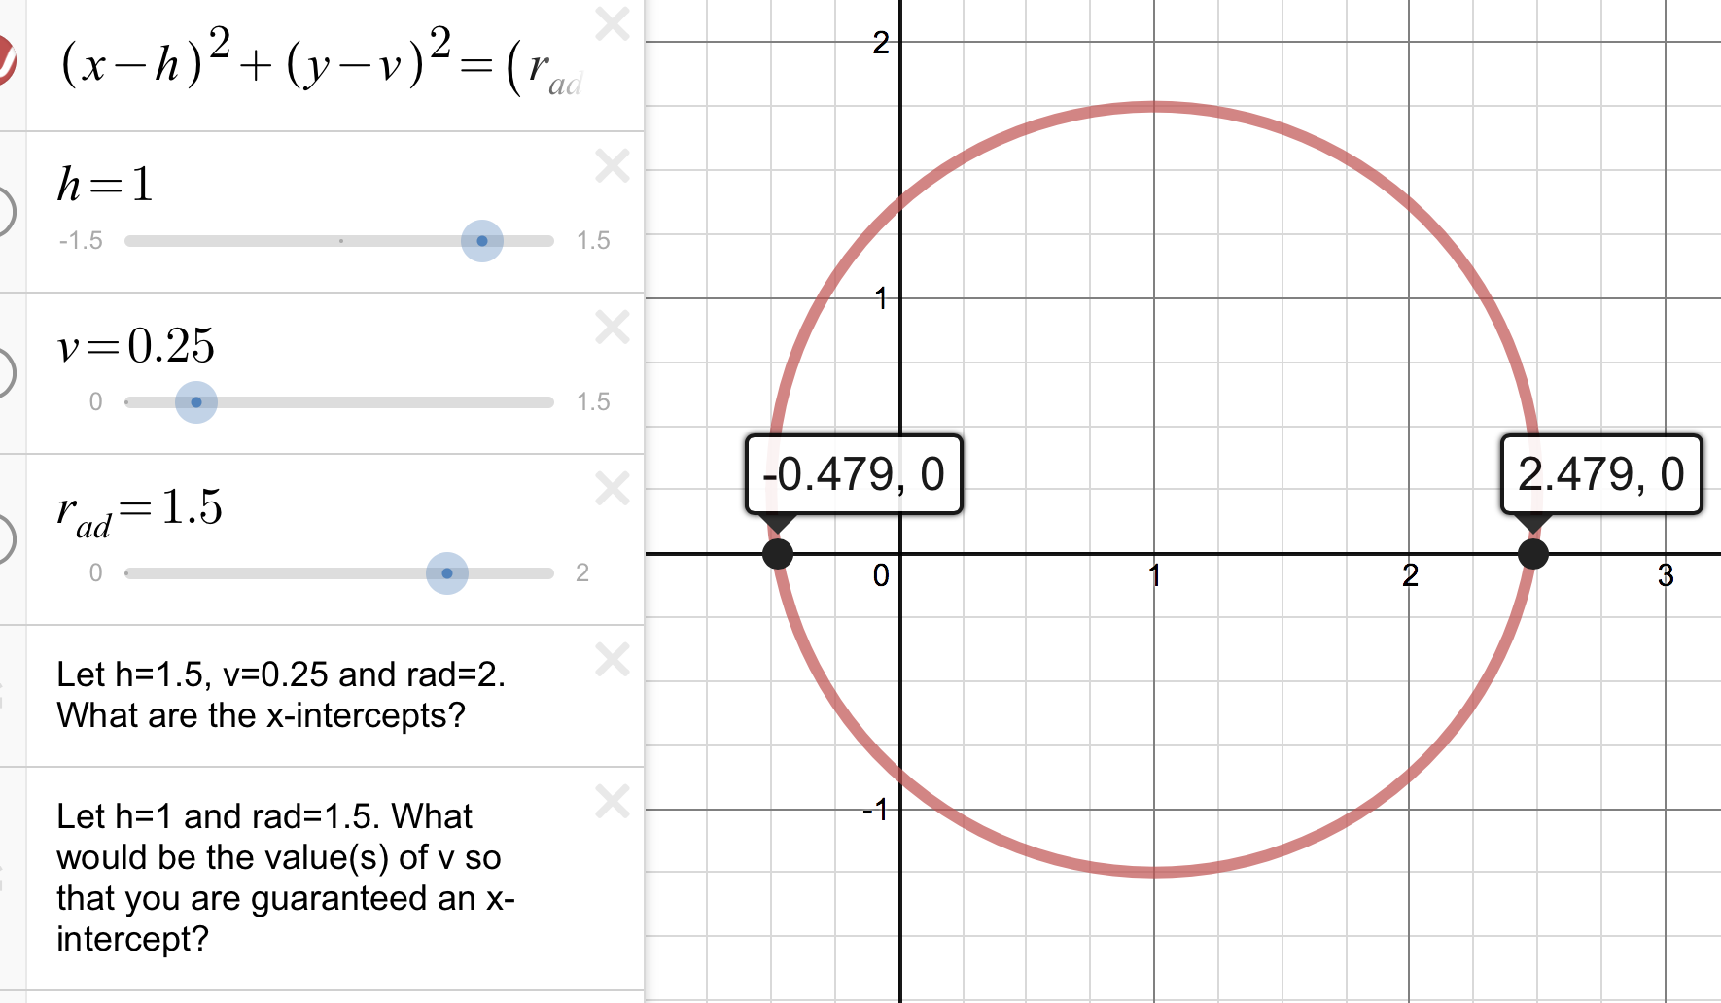
What are the x-intercepts of a circle?
https://www.desmos.com/calculator/r2lfslqf6c
AKA: ambiguous case of SSA.
Notes:
Transformations of a circle. When will there be two x-intercepts? one x-intercept? zero x-intercepts. Setting up the idea that v has less than r.

Slide 49
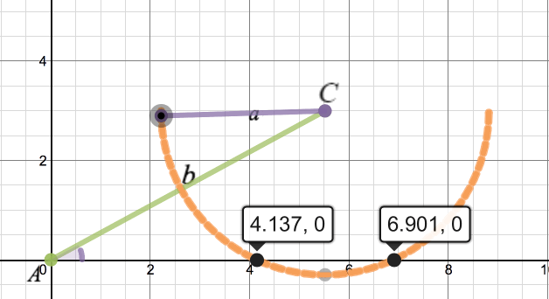
The x-intercepts are the side lengths.
https://www.desmos.com/calculator/fmgymmxhis
SSA - Use Law of Cosines
Notes:
Side Side Angle. Notice that circle has two x-intercepts. Use these as the side lengths.

Slide 50
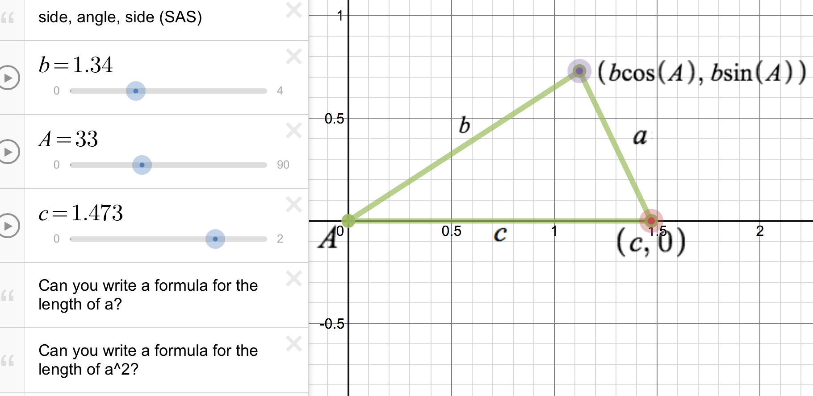
Discover the Law Cosines
https://www.desmos.com/calculator/hfrly3j9fg
The 3 different forms - SSA, SAS, SSS
Notes:
Finding the length of a is a process that has already been covered. This time it develops the Law of Cosines.

Slide 51
Thank you for...
Be on the lookout and
Notes:
Sum it all up here.

Slide 52
TRIG
Notes:
nix those tricks and those trig tricks

Slide 53
Nix the
Trig Tricks
Luke Walsh
Catawba Valley CC
lwalsh@cvcc.edu
Notes:
Final Slide

