Slide 1
Innovation in the Classroom with OER and WEBWorK Problems
Creating and improving problems with WeBWorK
Brittni Lorton
Community College of Denver
ColoMATYC Spring 2019

Slide 2
OER and WeBWorK overview
Open Educational Resources (OER) are not only an excellent way to remove barriers for our students but they also provide an opportunity for faculty to bring their innovation and creativity to the curriculum.
WeBWorK is an open-source online homework platform for math and science curriculum.
Currently, RRCC, CCD and CCCOnline are using WeBWorK in some of their courses.

Slide 3
OER and WeBWorK overview
Some benefits of using WeBWorK
Free to students!
Can choose from thousands of available problems.
Can create your own custom content.
Installation allows for automatic account creation and single sign on within D2L.
Can connect with D2L gradebook for seamless homework grading.

Slide 4
WeBWorK at CCD
At CCD, we have been using WeBWorK in many of our math classes over the last couple years. We are currently using WeBWorK in MAT 121, MAT 122, and 201.
MAT 166 and MAT 202 and others to come soon.
In the past, CCD and RRCC worked together to create shared curriculum in WeBWorK for MAT 121 under an Innovation Grant. Faculty members from both colleges worked together to create homework problems for 121 using the OpenStax textbook problems.

Slide 5
WeBWorK at CCD
During summer 2018, 5 faculty members from CCD created WeBWork problems to use in MAT 201 under our STEM Sirviendo Grant.
We used problems from the OpenStax textbook to create the homework sets.
Now that we have used our problems in MAT 201 during the fall 2018 semester, we are now working on improving the problems and homework sets.
We are currently working on finalizing the same MAT 202 project and will have that completed by the end of this semester.

Slide 6
Benefits of Authoring Problems in WeBWorK
Learn to code
Catered to your course
Think 'outside the box' problems
Customized homework sets
  Increased difficulty
  Decreased hints/solutions
  Specifically designed to match your lectures and classwork

Slide 7
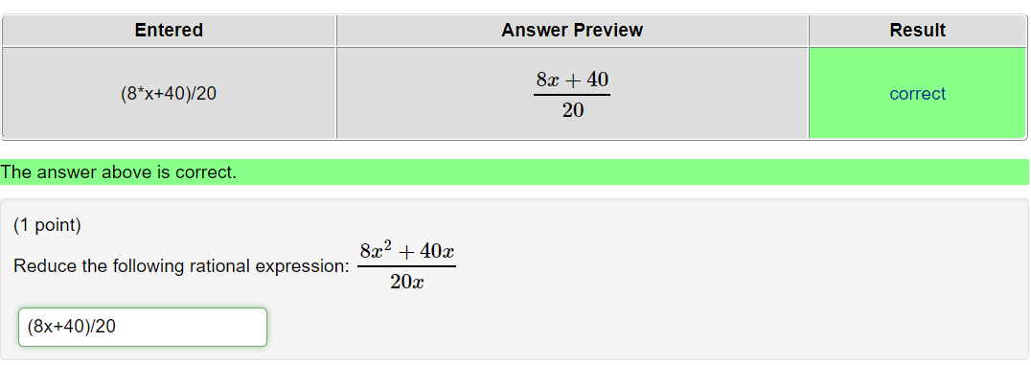
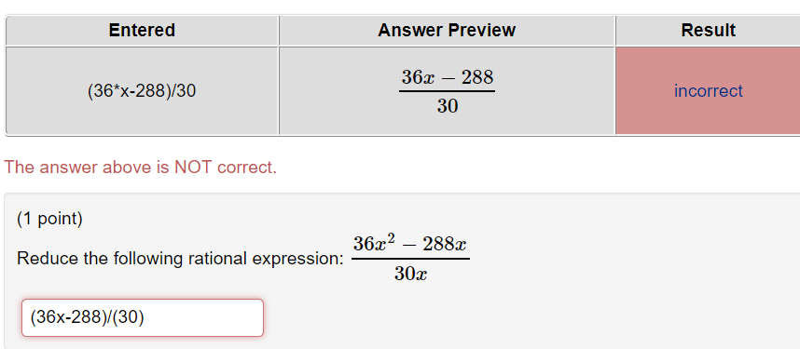
Example 1 – misleading student messages....

Slide 8
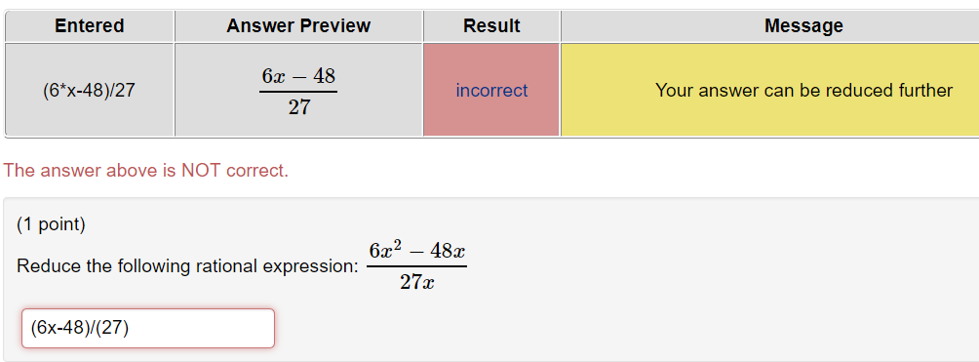
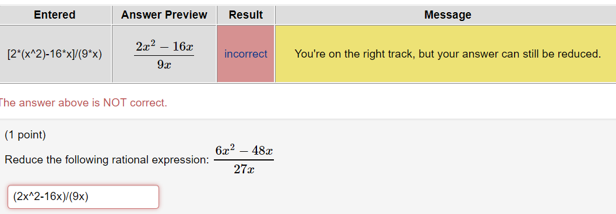
Example 1 – misleading student messages...turned into productive messages.

Slide 9
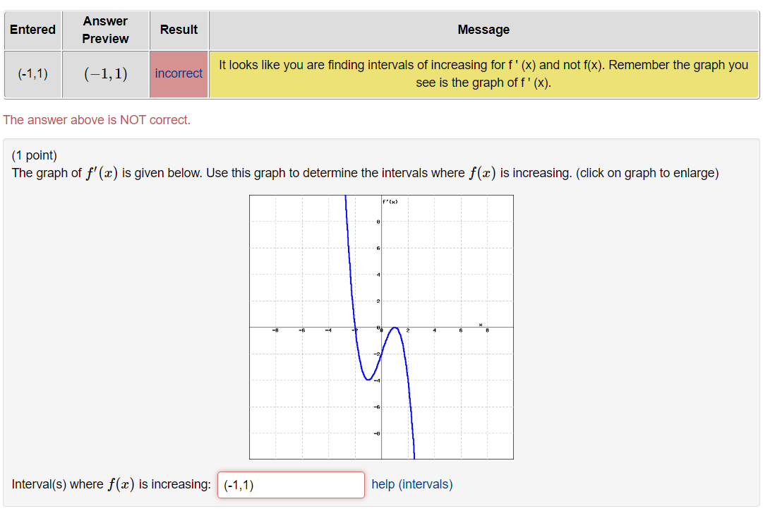
Example 2 – customized messages for common student errors

Slide 10
Example 3 – acquisition, meaning making, and transfer
Acquisition-->A classic algebra problem--> "Graph the line ax+by=c"
Meaning Making--> "Find the equation of a given line"
Transfer--> "Create a new line, then find the equation of that line, and then do at least 4 times"

Slide 11
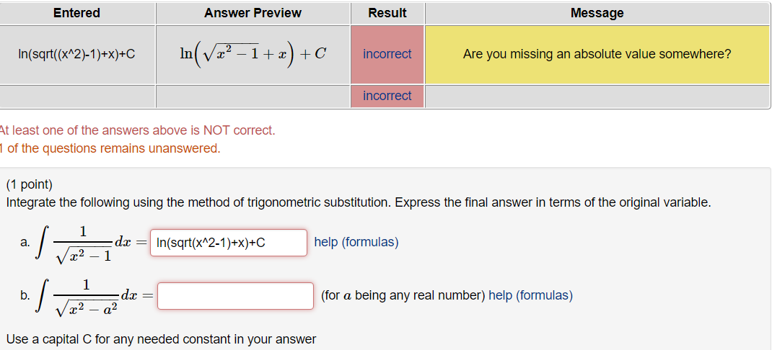
Example 4 – Customized message if student is missing just an absolute value

Slide 12
Example 6 – Customized homework sets
Create customized hints within homework sets.
Increaase difficulty of problems while decreasing hints
  Detailed hint for the first problem or two, containing an example worked out
  Next few problems have just a hint of an appropriate formula only, no example worked out
  Last few problems have no hints at all

Slide 13
WeBWorK at CCCS
We have access to WeBWork through CCCS servers
We will update to the latest WeBWorK version in May 2019.
If you or anyone on your campus is interested in using WeBWorK in your courses let us know.
Currently, CCD and RRCC have a full suite of problems for College Algebra, Trigonometry, and Calculus One (soon to be Calc Two and others) associated with the OpenStax textbooks. We are happy to share with anyone who wants!
(If you are interested, Brenda.Forland@rrcc.edu is working with our system office IT department to get access to all the colleges who wish to use WeBWorK)

Slide 14
Resources
www.webwork.maa.org
www.webwork.maa.org/wiki
www.webwork.maa.arg/wiki/authors
If you want to see the code or have access to these problems in your own WeBWorK courses please let me know. Brittni.Lorton@ccd.edu

Slide 15
Q&A
Brittni.Lorton@ccd.edu

